Slide 1
Securely run and grow your business with
Microsoft 365 Business
Name / Title / Date
Notes:
In designing Microsoft 365 Business, we wanted to address the day to day challenges SMBs are facing. We wanted to enable SMBs to get more done by allowing them to utilize AI and cloud components that are fully integrated into the Office apps. We wanted to make collaboration fast, simple and secure to strengthen teamwork and increase productivity. Finally, we wanted to bring these best-in-class productivity tools together with leading edge security capabilities that safeguard your business, so that your employees can be empowered to be productive from anywhere, on any device.
Ultimately, we designed Microsoft 365 Business to provide easy to use advanced technology solutions, at affordable costs, to help SMBs grow. If you’re in a competitive market and running a small business, you don’t benefit by waiting to see what your competitors do and then playing catch-up. But you also don’t benefit from making major infrastructure investments in new technologies and systems.

Slide 2
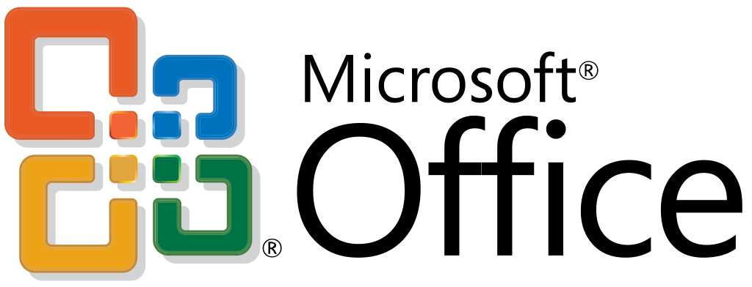
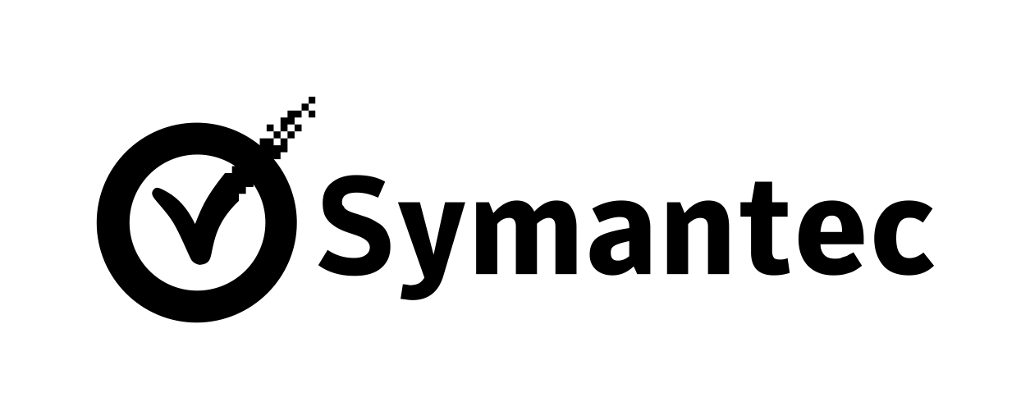
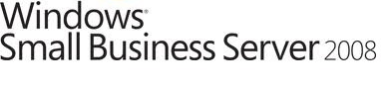
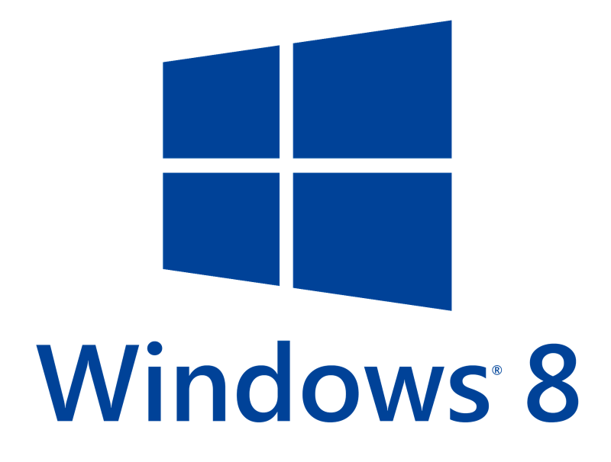
What does today look like for SMB’s?
Employees using personal mobile devices
PCs refreshed when dead
IT purchasing decisions made “on the spot”
No technology strategy
New PCs bought adhoc
“Good enough” platforms
Legacy back office
Fragmented
end-point solutions
Local Logins /MSA
Notes:
This is how things look for a lot of small businesses today.
Customers’ IT infrastructure is becoming increasingly fragmented as they attempt to improve workforce productivity and try to work within budget constraints. The irony is that this fragmentation means the customer is spending more money, but you aren’t necessarily making more profit.
When customers add new services and solutions to fill the real and perceived gaps in their IT, they are holding onto legacy systems that are ‘good enough.’ These legacy systems take more time to manage, which also impacts your profit margins.
Meanwhile, your customers are using many different devices, and whether they know it or not, have a mobile workforce that needs additional security and protection. Studies show 60% of small companies go out of business within six months after a cyber-attack!* It is cumbersome for you to sell and implement a compelling security and business continuity offering because you need to source different best-of-breed solutions outside the Microsoft stack.
*[footnote]
Source: Small Business Trends, CYBER SECURITY STATISTICS – Numbers Small Businesses Need to Know, Jan. 3, 2017

Slide 3
Fragmentation leads to real business risk
50%
43%
50% more time in collaborative activities¹
37% of the global
workforce is mobile²
43% of cyber-attacks target small business³
¹ Harvard Business Review, January-February Issue 2016, ‘Collaborative Overload’
² Strategic Analytics, Global Mobile Workforce Forecast, 2015-2020, November 2015
³ Small Business Trends, CYBER SECURITY STATISTICS – Numbers Small Businesses Need to Know, Jan. 3, 2017
Notes:
Let me paint a picture for you of challenges that I’ve heard from many customers and through published research.
Employees are spending much more time together working together in formal and informal meetings, phone calls and ad hoc interactions than they have in the past 20 years.
Many of those same folks are also mobile. They may be traveling for work, working from home or working from another locations but they need to access to company networks and the information they contain.
…And while unfortunate, bad actors know that small businesses are likely to have less-defended IT infrastructures that make them a target for cyber attacks be it ransomware, viruses, or straightforward hacks into network. 43 percent of cyber attacks target small businesses of less than 100 users.
Only a portion of those small businesses (14%) rate their ability to mitigate cyber risks, vulnerabilities, and attacks as highly effective and the chances of an SMB surviving a cyberattack are dim.
So SMBs are facing a dynamic workplace in which they need to ensure their employees have the tools to streamline collaboration, support employees remotely and protect their business from internal and external threats. Sounds like an expensive proposition but it doesn’t have to be.
[Alternative data points. Use these as substitutions if they are more relevant for your customer.]
And we know, on average, SMB owners spend 33 hours a month doing administrative tasks—that’s almost a full work week on admin stuff!
Techaisle, Global Small Business Study , April 2016
Like many of our customers, they are inundated with different solutions, different apps (14+ on average according to an Osterman Research survey*), and they don’t always work together. “There’s always an app for that” and it’s difficult to determine what’s best for you, what actually works, and how to manage it all.
*Osterman Research, 2014 “The Benefits of Vendor Consolidation and Centralized IT Management”
We understand that you have limited resources; your employees are wearing many hats and are always on the go. You need to be able to run and grow your business from anywhere without interruption, without security concerns.
We want to help you and your team work better together, be more productive with mobile solutions, and in a secure environment so that you can focus your time on the things that matter and not IT complexity.
* Harvard Business Review, January-February Issue 2016, ‘Collaborative Overload’
** Techaisle, 2015 SMB ‘Mobility Adoption Trends Study’
***Strategic Analytics, Global Mobile Workforce Forecast, 2015-2020, November 2015
† Small Business Trends, CYBER SECURITY STATISTICS – Numbers Small Businesses Need to Know, Jan. 3, 2017

Slide 4
What is Microsoft 365 Business
Office 365
Advanced Security
Device management
Office Applications Word, Excel, PowerPoint, Outlook, and more
Online Services Exchange, OneDrive (1TB), Teams, and more
Advanced Services Exchange Online Archiving
External Threat Protection Office 365 Advanced Threat Protection Multi-Factor Authentication Enforce Windows Defender to be on Enforce Bitlocker to be turned on
Internal data leak prevention Data Loss Prevention Azure Information Protection
Device management Microsoft Intune Windows 10 Credential guard SSO > 10 apps
Deployment assistance Windows AutoPilot Auto-installation of Office apps AAD Auto-enroll
+
+
Additional Benefits
Consistent security configuration across Windows 10, macOS, Android, and iOS devices |  | Upgrade from Windows 7 Pro or Windows 8.1 Pro to Windows 10 Pro ad no additional cost |  | 99.9% financially-backed uptime guarantee; 24x7 online and phone support
Notes:
Microsoft 365 Business will help you to compete more efficiently, sell more services and retain customers because it brings all of the technology that small business need at a single per-user/per-month price point.
Microsoft 365 Business brings together the security and innovation of Windows 10 with the power and familiarity of Office 365 and streamlined management and maintenance capabilities built specifically for small and mid-sized businesses. Microsoft 365 Business is designed to help keep company data secure while ensuring employees are their most productive, in the office or on the go.
With productivity apps such as Word and Excel, cloud storage, email and calendaring, and an exceptional chat-based workspace to bring teams together, your customers will be able to achieve more as they create and collaborate with people inside and outside their company in ways that they never dreamed possible.
Microsoft 365 Business standardizes your customer’s devices on Windows 10, the most secure Windows ever. Building upon this strong foundation, Microsoft 365 Business adds cloud-based management and servicing which helps ensure that customer devices are properly configured to take advantage of the security innovations in Windows 10 and significantly reduces the businesses risk profile.
Microsoft 365 Business also includes mobile application data and device management, even on personal devices. With this functionality, when an employee leaves the organization, or loses their device, for example, you are going to be able to protect your customers’ company data, while reassuring the employee that her pictures and text messages remain private on her personal device.
Since Microsoft 365 Business is cloud-delivered and enabled, you can count on automatic updates to keep your customers’ apps and devices current with the latest and greatest security protection and features from Microsoft. Your customers will get to host their data on the same cloud that hosts data from over 85% of Fortune 500 companies.
This is all made more efficient for you through the Admin Console. The admin console not only simplifies things on your end, but gives you self-service tools that can create lower delivery costs and increased consulting and managed services margins. This frees up time on your end to invest in new capabilities that expand your business into new market areas.

Slide 5
Microsoft 365 Business | Simplifying SMB technology investment
Archiving
~$6.50
Office 365 Business Premium
Device Management
~$6.50
Windows 10 Business
Cloud identity managment
~$3
Intune
Chat-based teamwork
$8
Office 365 Advanced Threat Protection
Microsoft 365 Business
A single, integrated solution with support for hybrid identity
Email Filtering
$30
Azure Information Protection P1
Device Anti Virus
~$12.50
Data Loss Prevention
Online Meetings
~$29
File Storage
Exchange Online Archiving
~$12.50
Productivity Software
AAD Features
$10
3rd party solutions
>$100
Microsoft Offerings
$20
Notes:
Recently, we have made some drastic changes to Microsoft 365 Business to help you on this journey of making the shift
We worked closely with 30 partners from private preview, to public preview, thru launch to define what our SMB customers needed to help them on their journey
As a result, we added significant value to the product, with no change to the price
Items to highlight are ATP, AIP P1, Intune and DLP
These together combine to $34.50 when purchased separately, equating to a 42% discount when purchased in M365 Business
On top of this, we have extended support for deployment in hybrid identity environments
We are also committed to enabling a more seamless and inexpensive experience for upgrading SMB’s using Windows Home devices to Microsoft 365 Business

Slide 6
INTRODUCING
Microsoft 365 Business
Get more
done
Work better together
Build your business
Safeguard your data
Simplified for you
Notes:
What is Microsoft 365 Business?
Microsoft 365 Business is a complete integrated solution powered by Office 365 and windows 10 designed to help you securely run and grow your business.
It brings together the best-in-class productivity capabilities of Office 365 that enable you and your employees to create, connect and co-author from anywhere, on any device while also providing you peace of mind through sophisticated security features to safeguard your business information from threats.
Microsoft 365 Business also helps you build your business through specific tools that help you interact with and find new customers
With Microsoft 365 Business you have one subscription that enables collaboration, has tools that help you grow your business while providing you peace of mind by safe guarding your business information.

Slide 7
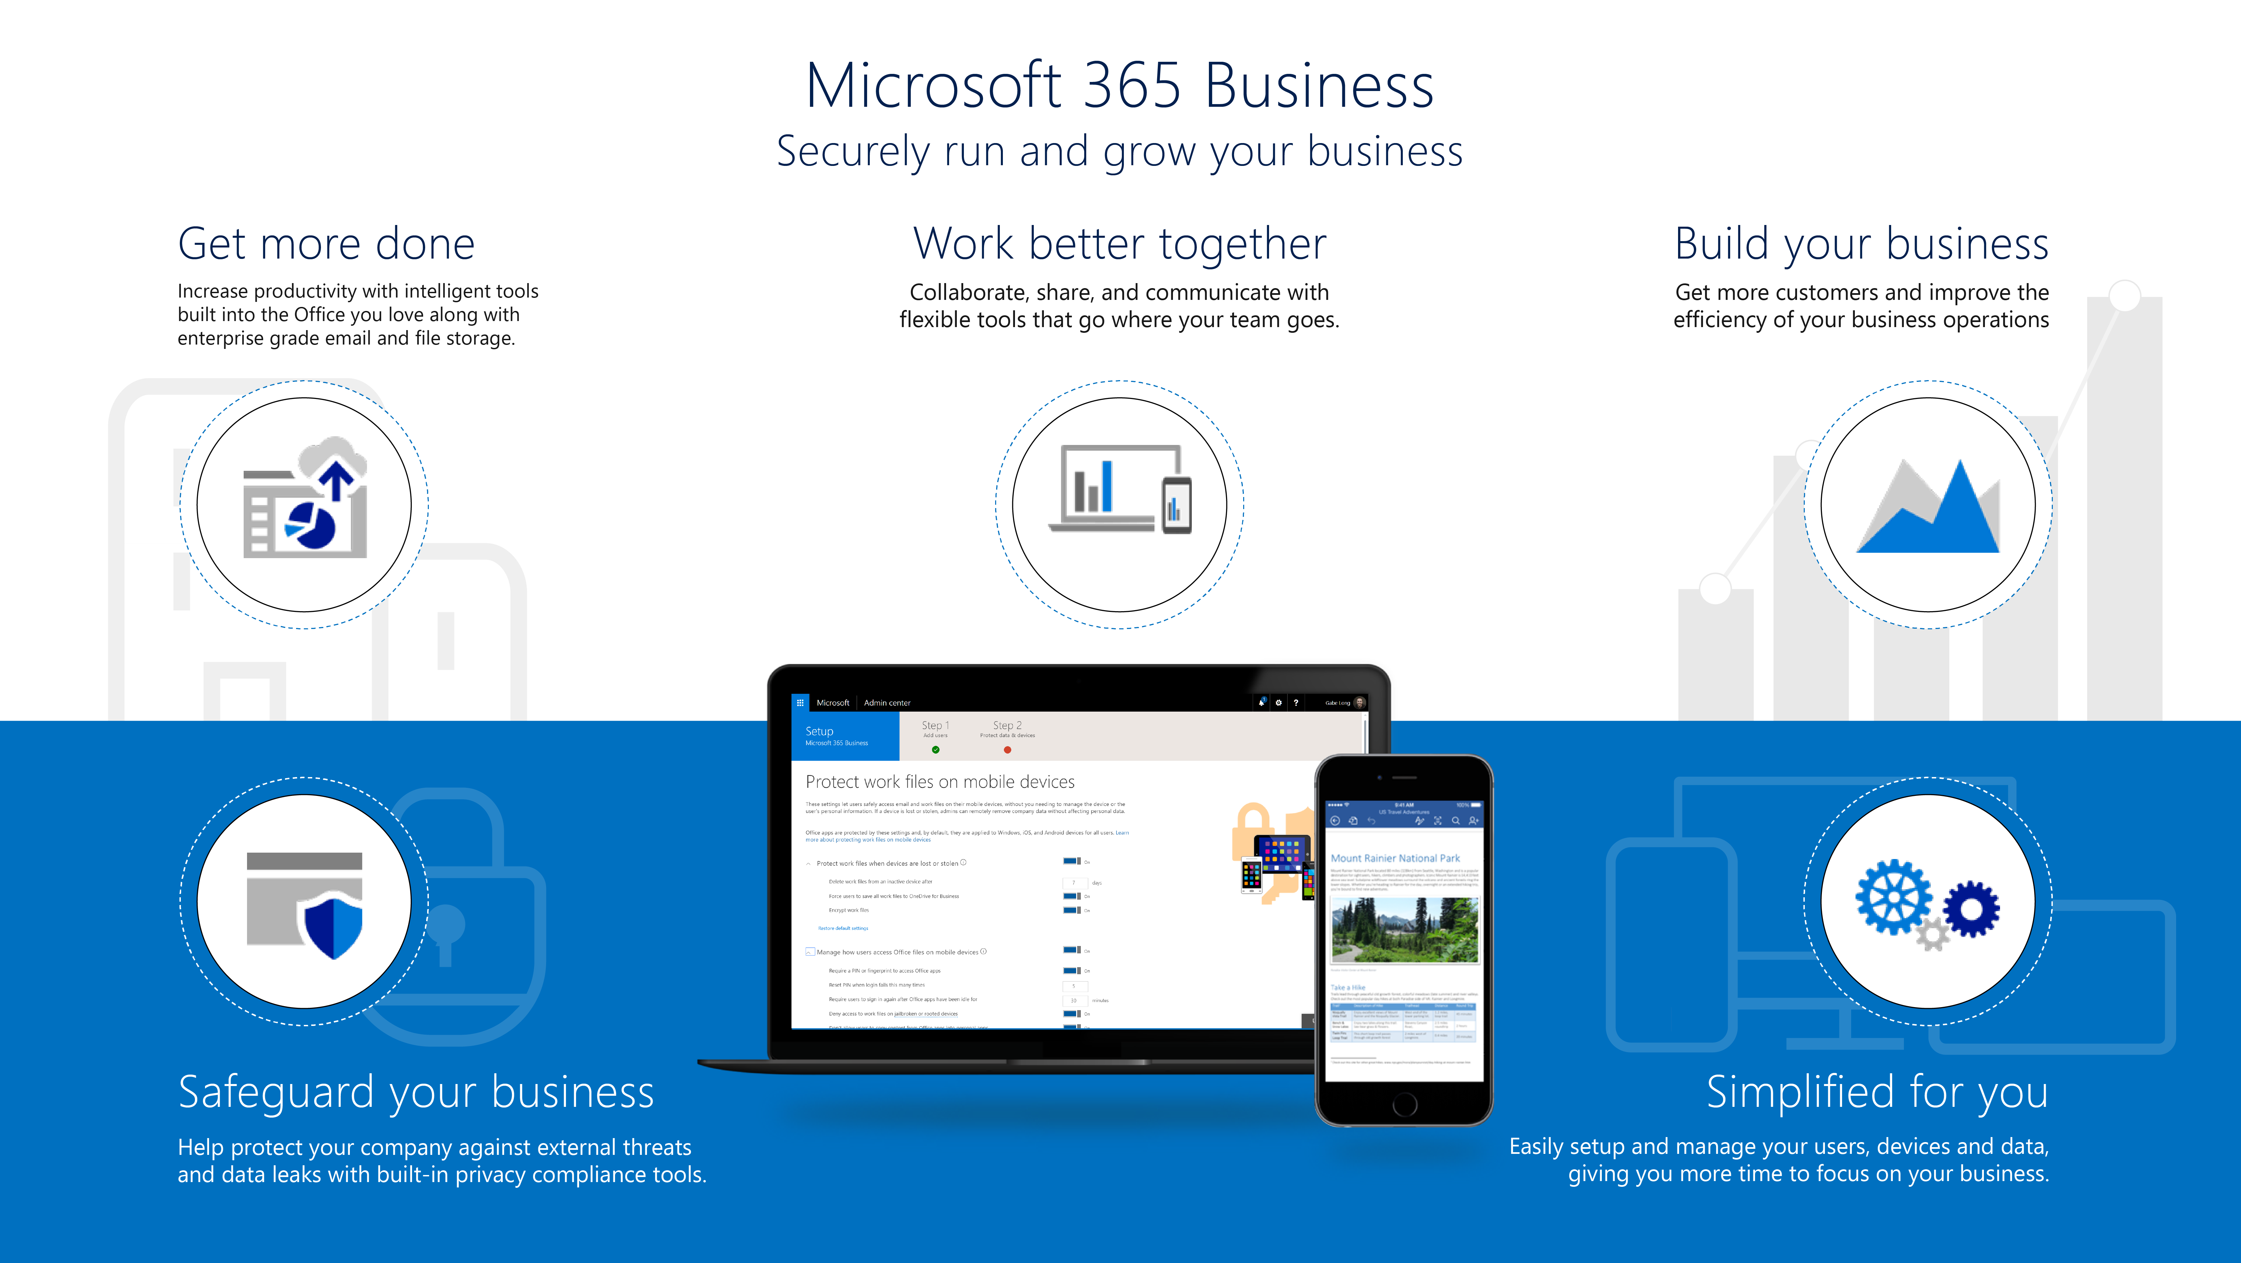
Notes:
Now before we begin, let us take a minute to see what we’re going to cover today in Microsoft 365 Business:
You’re going to Learn how you can get more done with Intelligent tools built into the Office you love along with enterprise grade email and file storage
We’ll show you how you can work better together with the new Microsoft Teams and how you can collaborate as a group with your co-workers, customers and suppliers.
Microsoft 365 Business also includes specific business apps designed to help build the business Like Bookings and Outlook customer Manager for Example. These help you Get more customers and improve the efficiency of your business operations​
We’ll also show how Microsoft 365 Business safeguards your data by Helping protect your company against external threats like phishing and malicious emails. It also includes features to help you protect sensitive information like Social security numbers, Credit card information etc from leaving the organization
Finally, we’ll show you how you can easily enable all of these features along with simplifying device setup so you can unlock the value of your Microsoft 365 Business subscription faster
let’s take a deeper dive in to what you get with your Microsoft 365 Business Subscription

Slide 8
Get more done
Be more productive with AI-powered Office tools and services
Notes:
Increase productivity with intelligent tools built into Office, enterprise-grade email, and cloud file storage

Slide 9
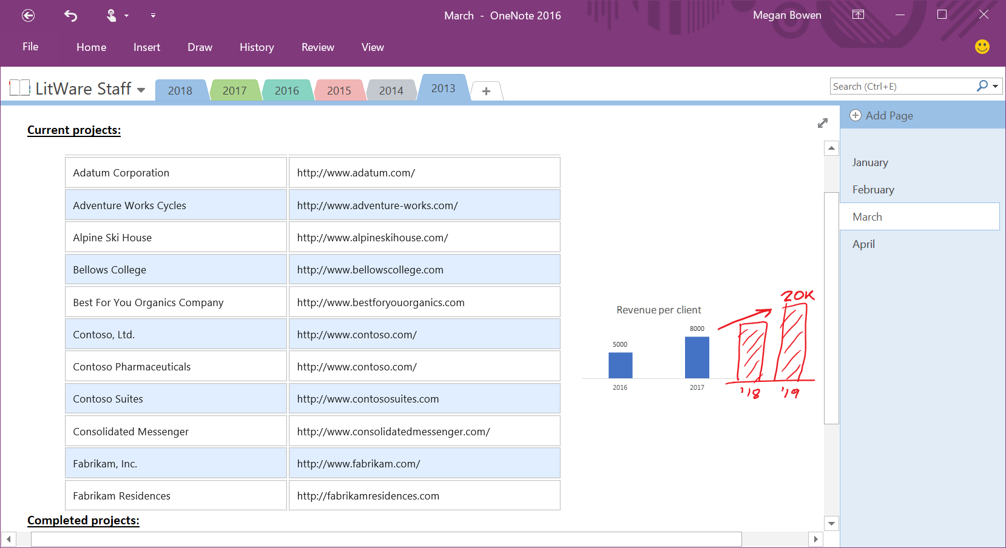
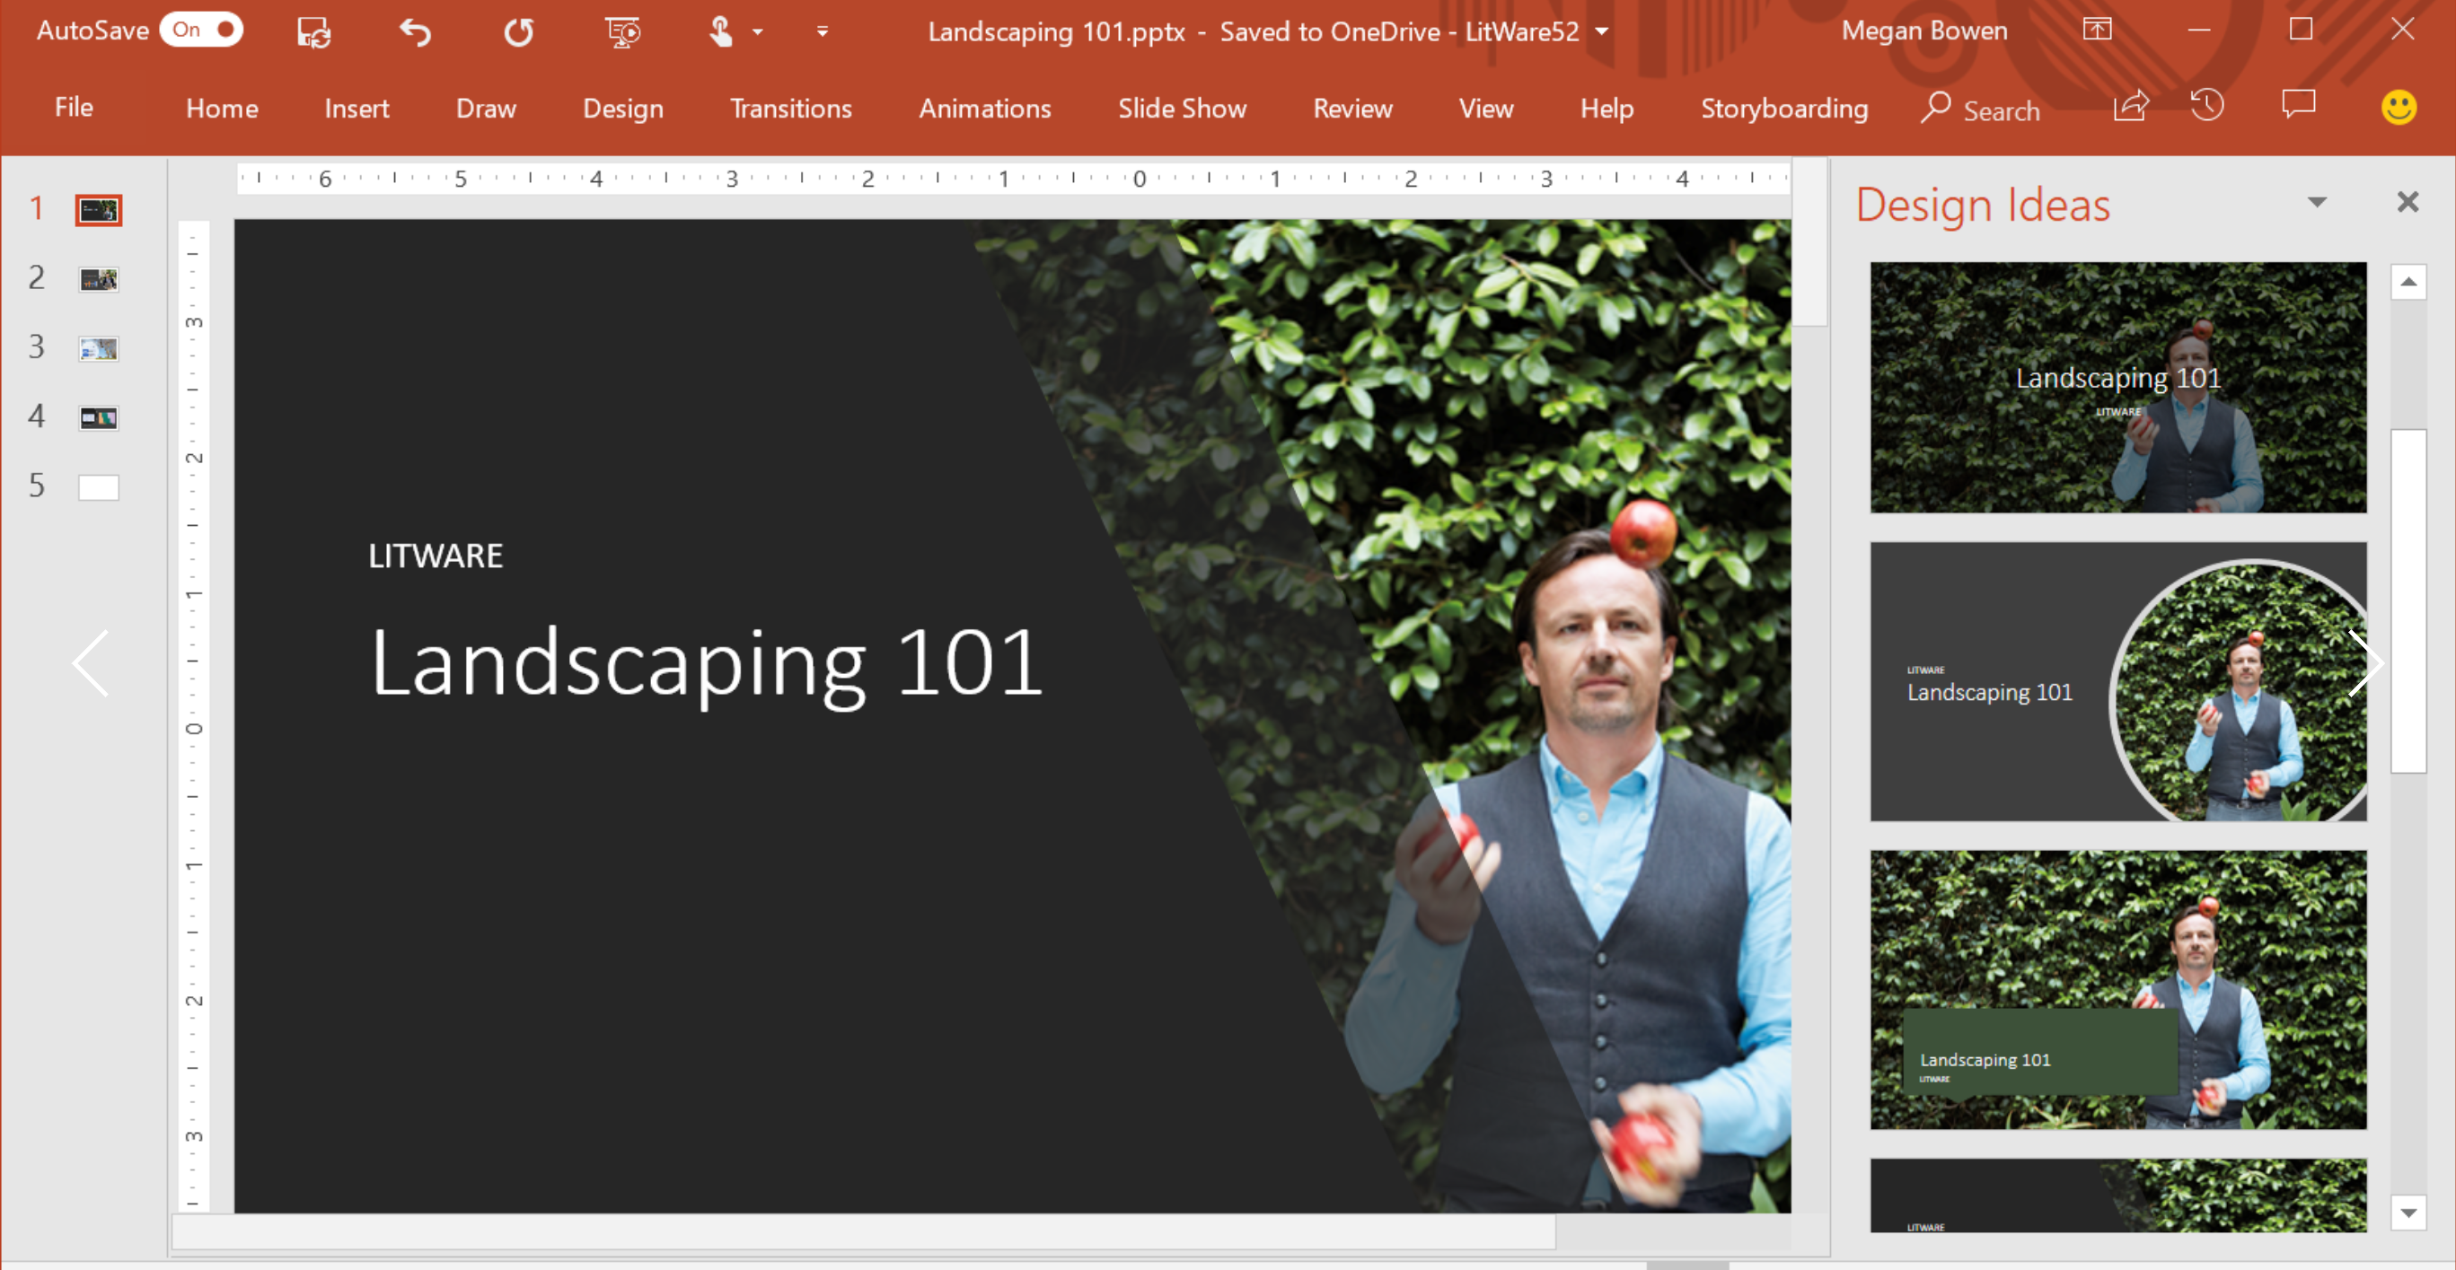
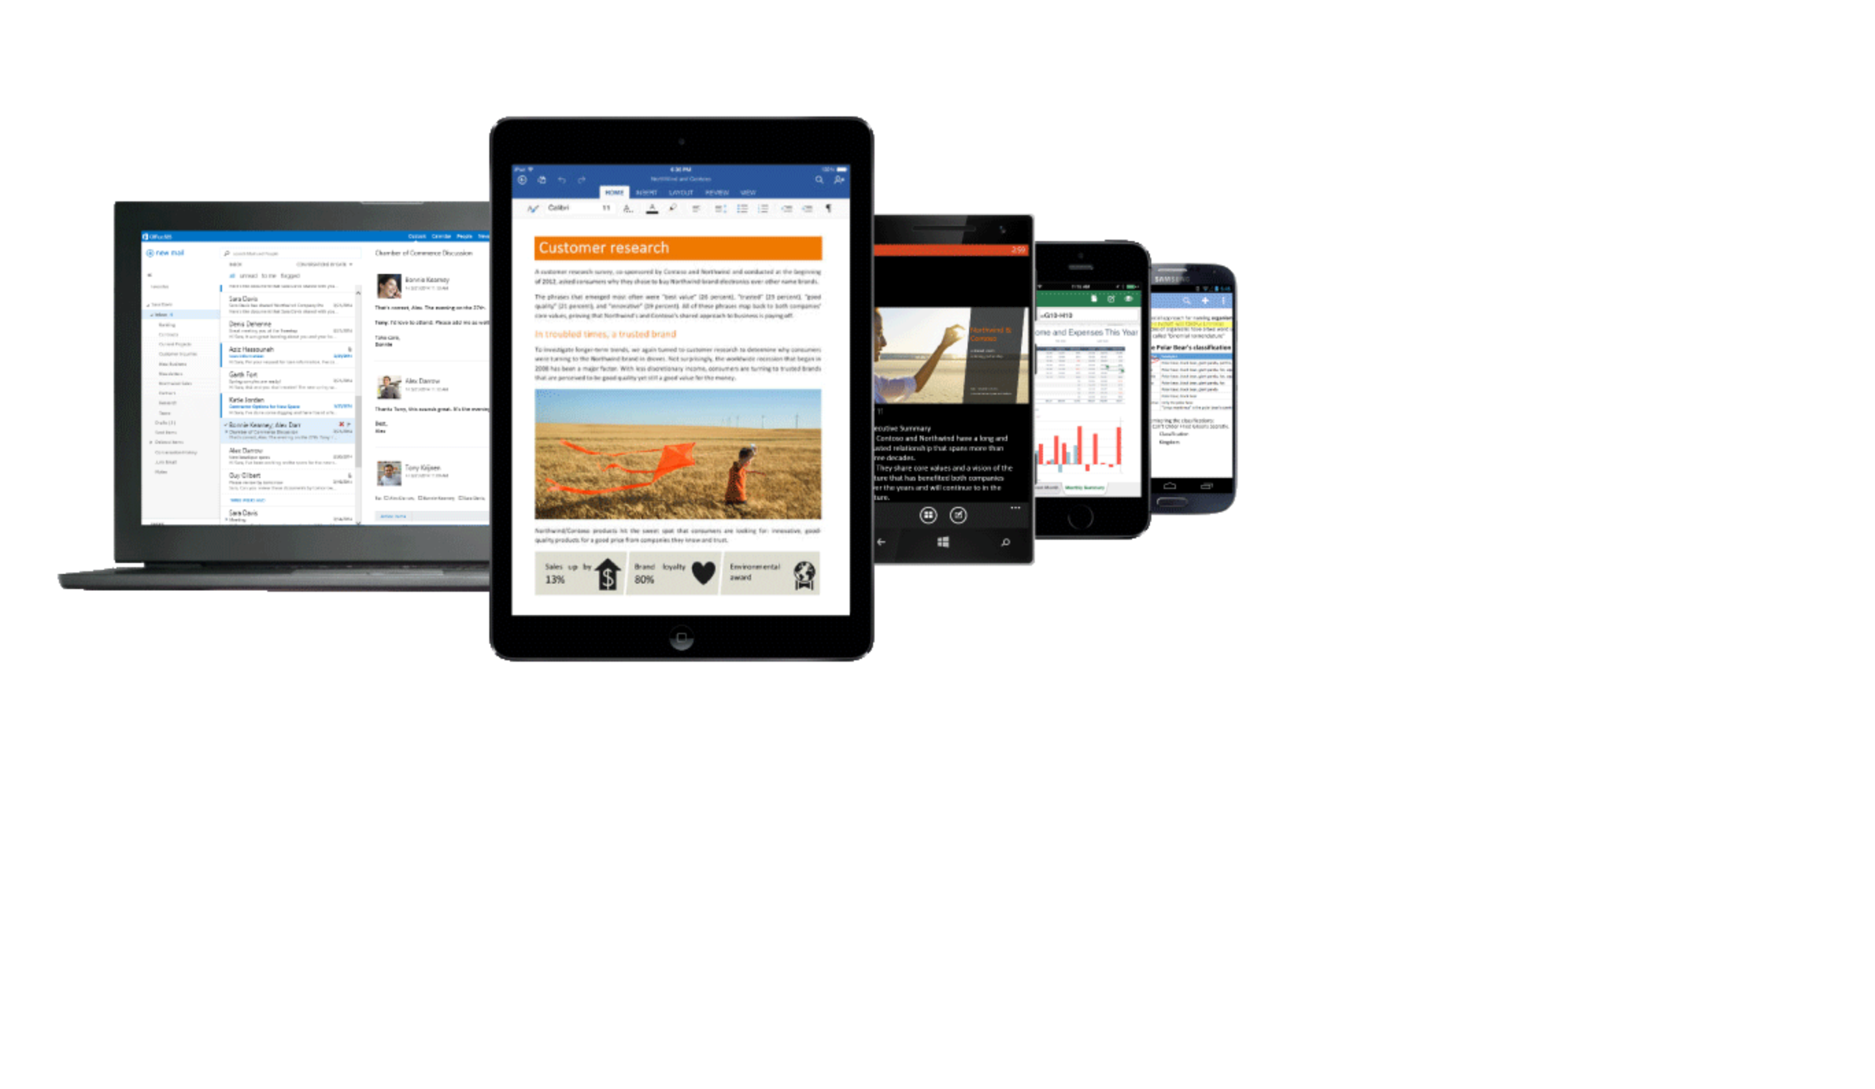
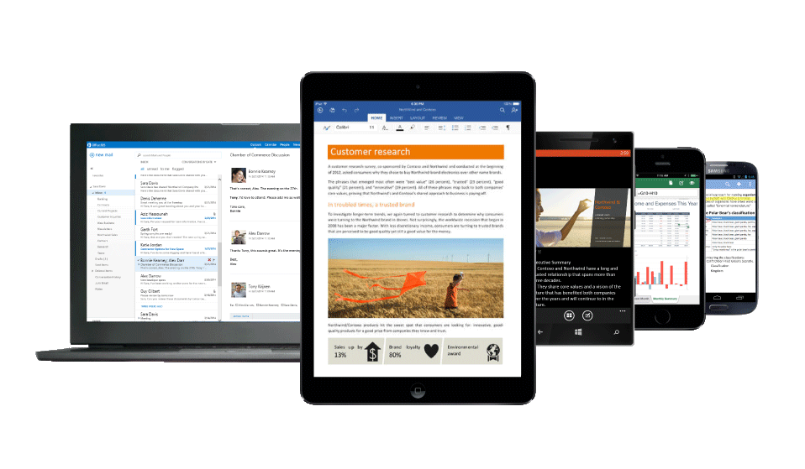
Get more done
Create your best work with intelligent tools​ built in to the Office you love and are familiar with
Get work done on the go with enterprise grade email and calendaring features
Stay on top of all your work with access to all your files with online file storage
Work efficiently with integration to other apps and solutions you use daily​
Notes:
Let’s unpack what we mean by Get More Done.
With Microsoft 365 Business you get enterprise grade email, File storage for documents, a hub for teamwork, and the Office apps all working together so you can increase your productivity and grow your business with confidence.
In Microsoft 365 Business you get the latest Office apps that you love and are familiar with like Word, Excel, PowerPoint, OneNote and more. More importantly you get new features like intelligent recommendation tools. … for example Designer in PowerPoint - that can automatically recommend slide designs based on your content without you having to build the slide. It helps you Create your best work like a pro saving you precious time and effort
You can get work done on the go with enterprise grade email and calendaring features in Outlook. You get a 50 GB mailbox and you don’t have to worry about running out space in your mailbox.
You can also stay on top of your work with access to your files with Online file storage in OneDrive for Business. You get 1 TB of file storage and You can Share your files from anywhere and any device whether at work, at home or on the go.
With email, conferencing, online storage, a hub for teamwork, and the Office apps all working together you can increase your productivity and work more efficiently, saving you time and effort

Slide 10
Work better together
Collaborate with tools that let your team work from anywhere
Notes:
You also get real time collaboration, no matter where the work takes you. You get the ability to manage your schedule and own your day, rather than letting the day own you.
When your employees have that sort of power at their fingertips, they can do more, with each other, to advance the goals of the business. No more crowding around a lone office table. No more project holds because of bad weather. Now employees can work together form anywhere.
This is made possible with best-in-class productivity tools and applications that allow employees to work, meet, share, edit, save, and collaborate, through all their favorite devices, anytime, anywhere.
In short, you get the work done.

Slide 11
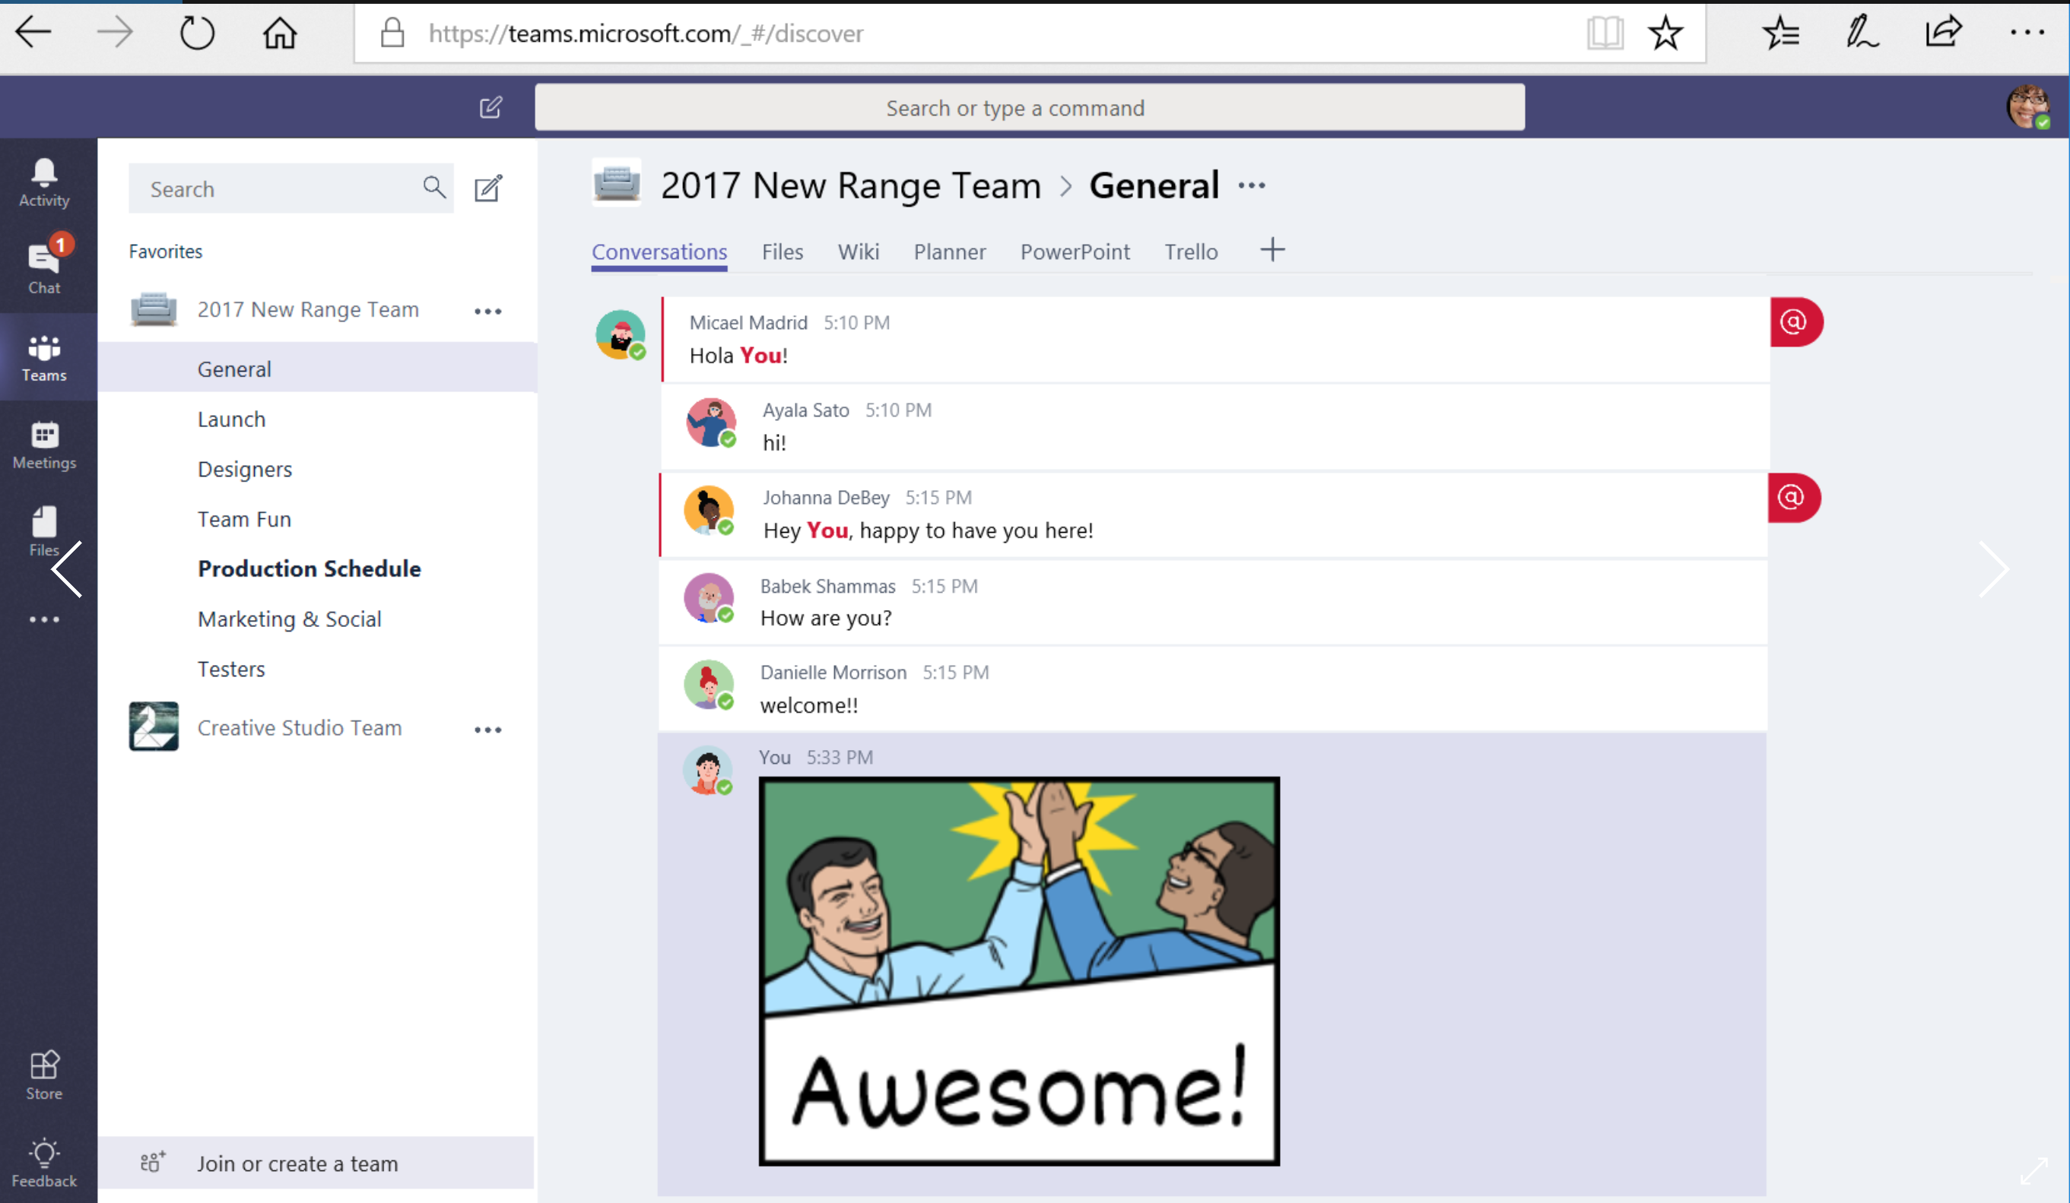
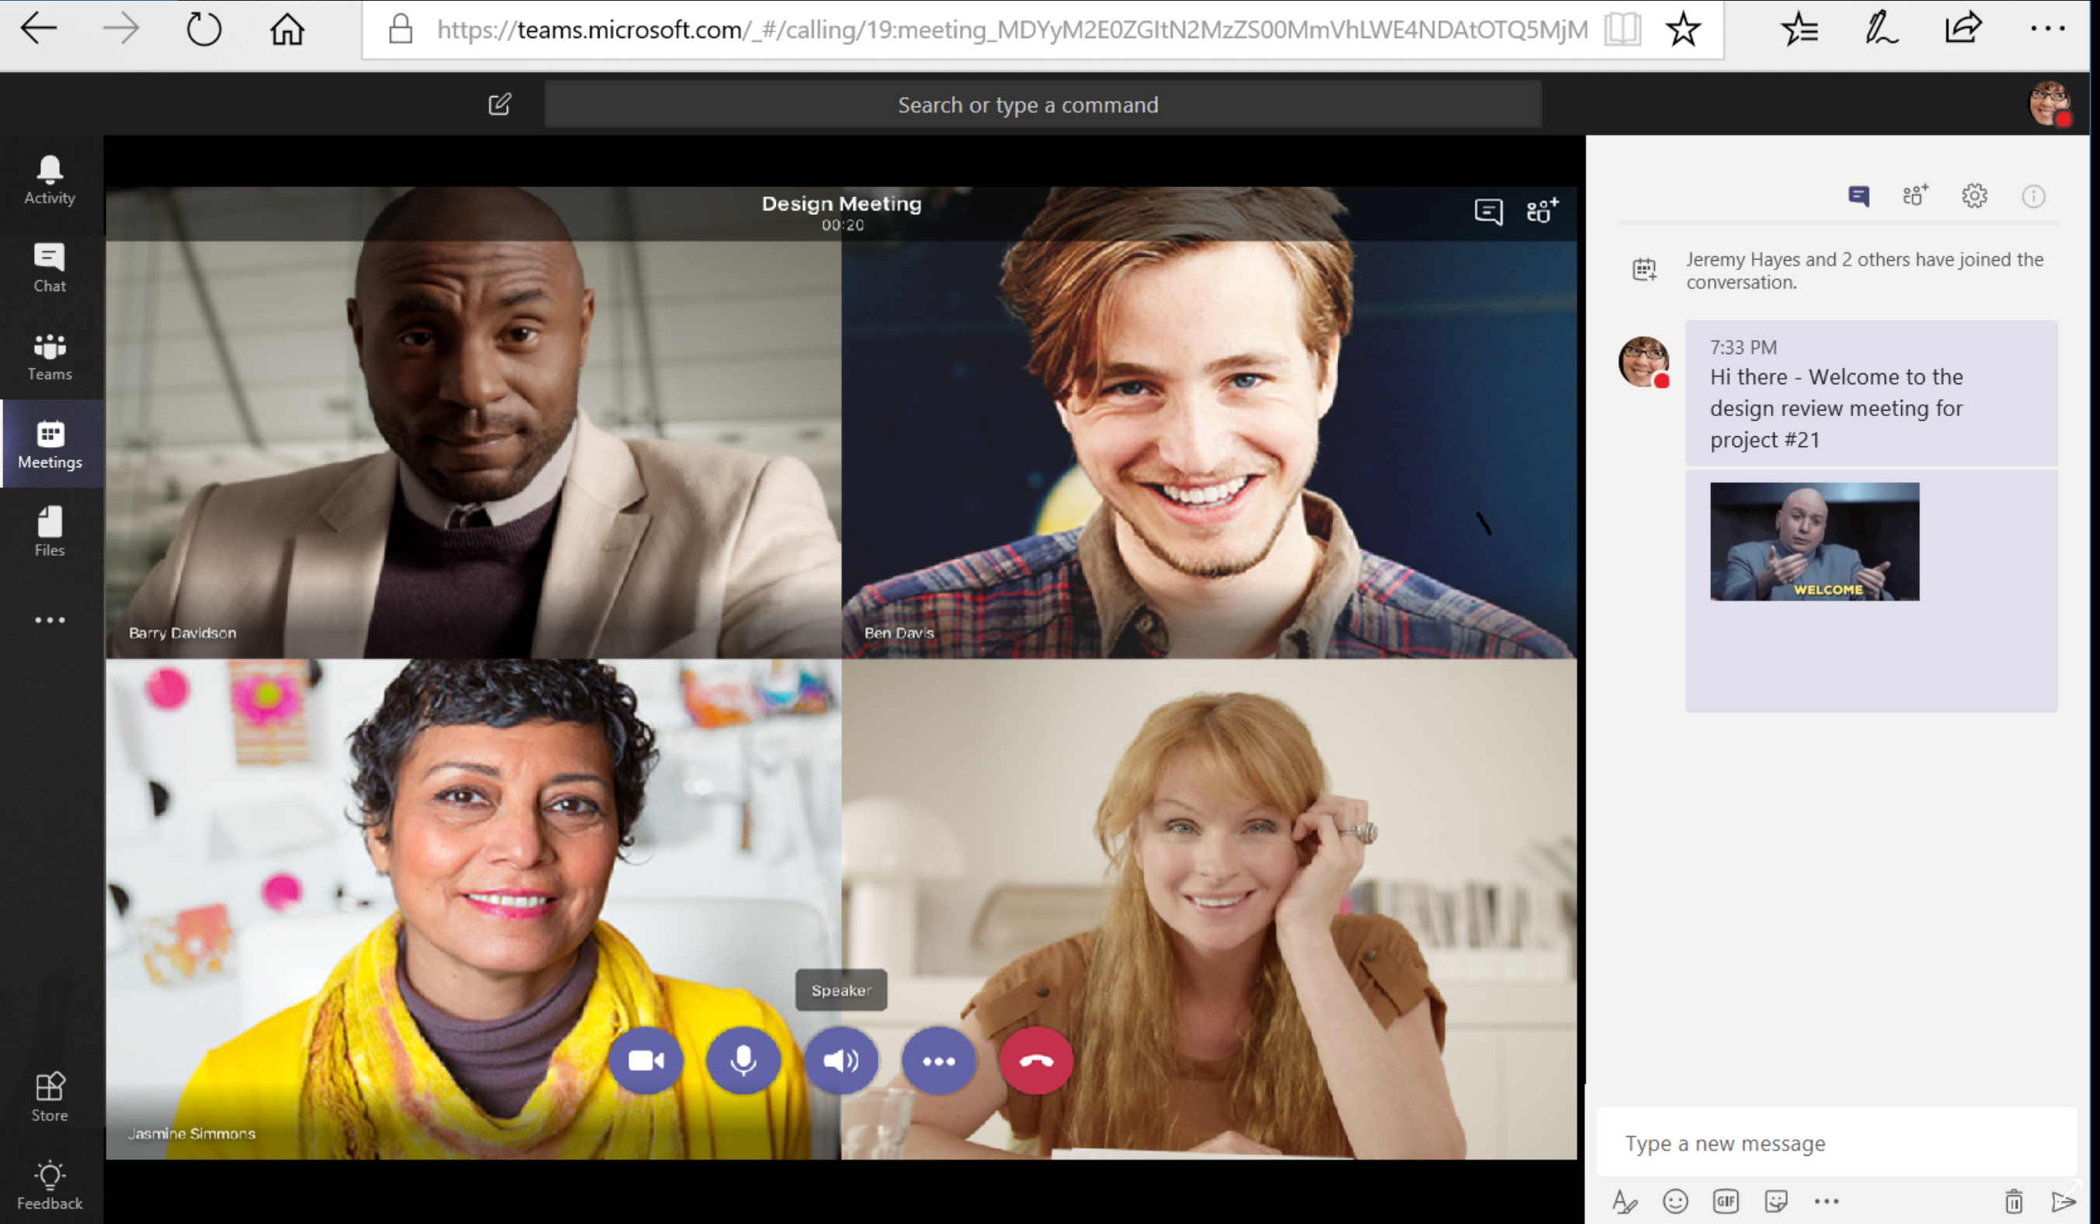
Work better together
Bring together teams and resources, all in one place​
Connect with customers, coworkers, and suppliers
Work anywhere from any device​
Host online meetings to get work done in real-time​
Notes:
With Microsoft 365 Business you can Work Better Together through the power of Microsoft Teams.
Microsoft Teams is a hub for teamwork that brings together all your team’s chats, meetings, files, and apps making it easier for you to collaborate and keep track of group projects involving your co-workers, customers and suppliers.
With state of the art co-authoring capabilities, you can Share and edit your files in real-time with your team from anywhere any device
You can even Host online meetings in Teams to get work done in real-time
With one click, anyone inside or outside your company can join your online meeting
You can even Record meetings and use the whiteboard, to draw out ideas and work together to solve challenges.
By providing your business a central repository that your team can collaborate around, Microsoft Teams greatly simplifies and enhances group collaboration. It helps increasing efficiency by helping your employees and customers get things done faster

Slide 12
Build your business
Get more customers and run your business more efficiently
Notes:
Today, no matter what your small business does, data has never been more valuable. Your business contacts. Your SOWs and invoices. Your accounts information. Your methods and processes. Your templates. Your email.
Technology gives you the ability to access these things, to carry them around on a laptop or a mobile phone, but all of that access exposes them to risk. Employees who don’t understand how to create secure passwords or take precautions, or who forget a device, need guidance. That’s where simplified device management empowers you to take advantage of the enterprise-level security features of Windows 10 Pro.

Slide 13
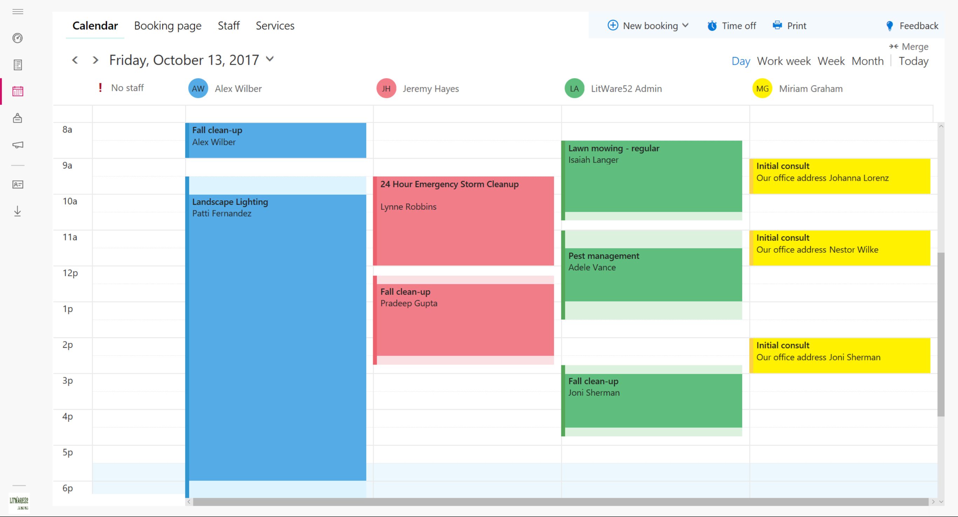
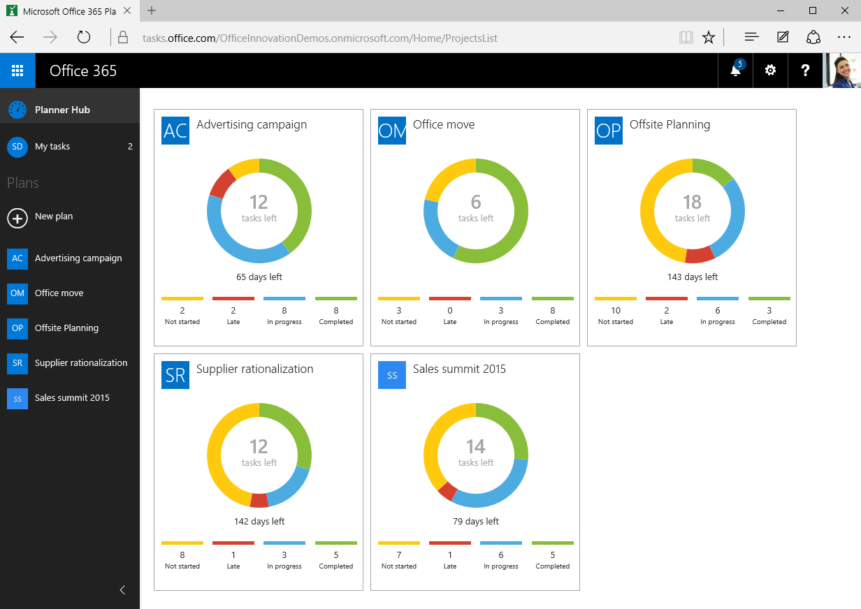
Build your business
Build stronger customer relationships with CRM built right into Outlook
Schedule & manage appointments with your customers with Bookings
Optimize your business processes with Planner
Notes:
In Microsoft 365 Business we have specific apps designed to help you Build your business.
For example You can Track customer interactions and grow relationships with Outlook Customer Manager. You can view customer details, history and track deals in progress within Outlook
Apps like Bookings help you Simplify the process of scheduling and managing customer appointments. It has convenient web-based scheduling that allows your customers to self-schedule appointments with you.
Further more, Apps like Planner make it easy for your team to create new project plans, organize tasks, and get updates on progress.

Slide 14
Safeguard your data
Protect your company against external threats and data leaks
Protection from threats
Protection from data leaks
Control
data access
Notes:
Today, no matter what your small business does, data has never been more valuable. Your business contacts. Your SOWs and invoices. Your accounts information. Your methods and processes. Your templates. Your email.
Technology gives you the ability to access these things, to carry them around on a laptop or a mobile phone, but all of that access exposes them to risk. Employees who don’t understand how to create secure passwords or take precautions, or who forget a device, need guidance. That’s where simplified device management empowers you to take advantage of the enterprise-level security features of Windows 10 Pro.
In addition to Enabling all of these amazing productivity and collaboration features, M365 B gives you peace of mind by Safeguarding your business. It helps protect your company against external threats and data leaks of sensitive business information
And it does this by taking a layered approach to security:
First, you get Protection from sophisticated threats hidden in email attachments and links, and get cutting-edge defenses against zero-day threats, ransomware, and other advanced malware attempts.
Second, you get Protection from data leaks helping you prevent sensitive information like SSNs and customer credit card numbers from being shared outside your business
3rd you get to control and manage access to information. With M365 B, you can control who has access to company information by applying restrictions like Do not Copy and Do Not Forward. You can Enjoy peace of mind by remotely wiping business data on lost or stolen devices without affecting personal information

Slide 15
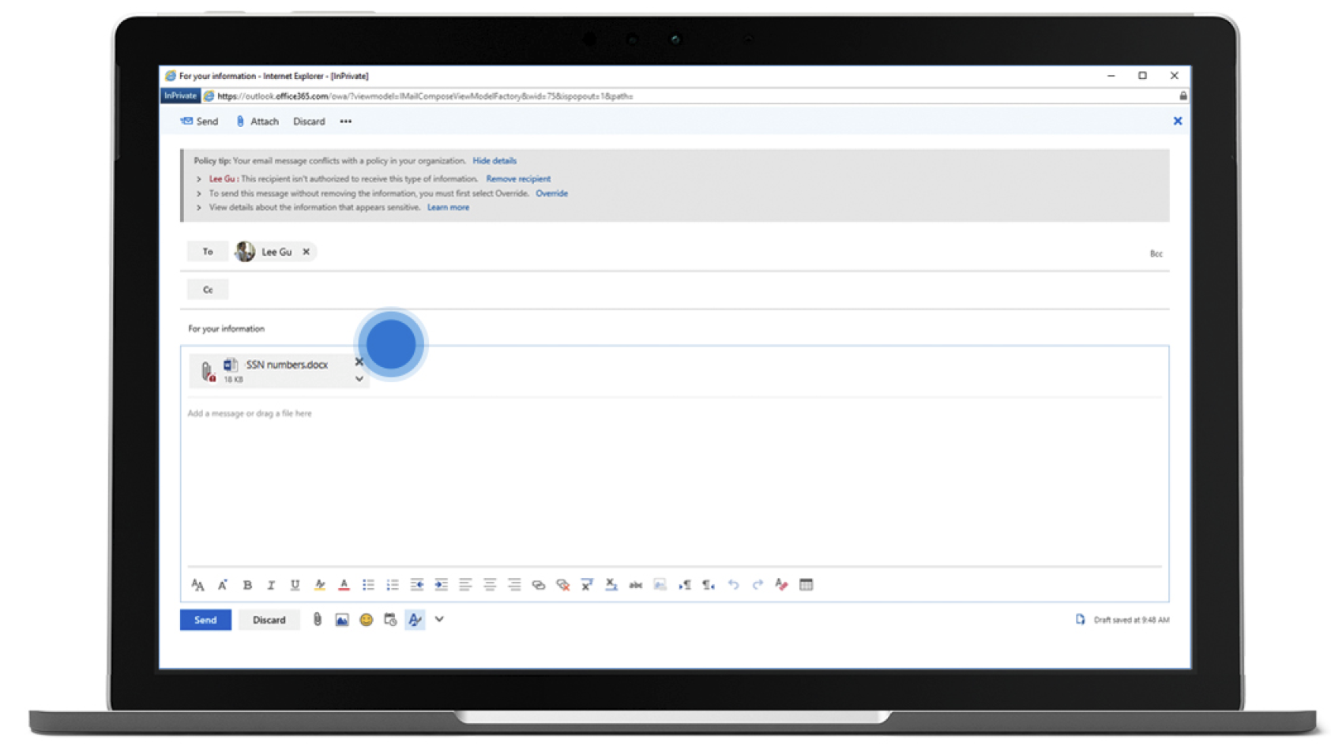
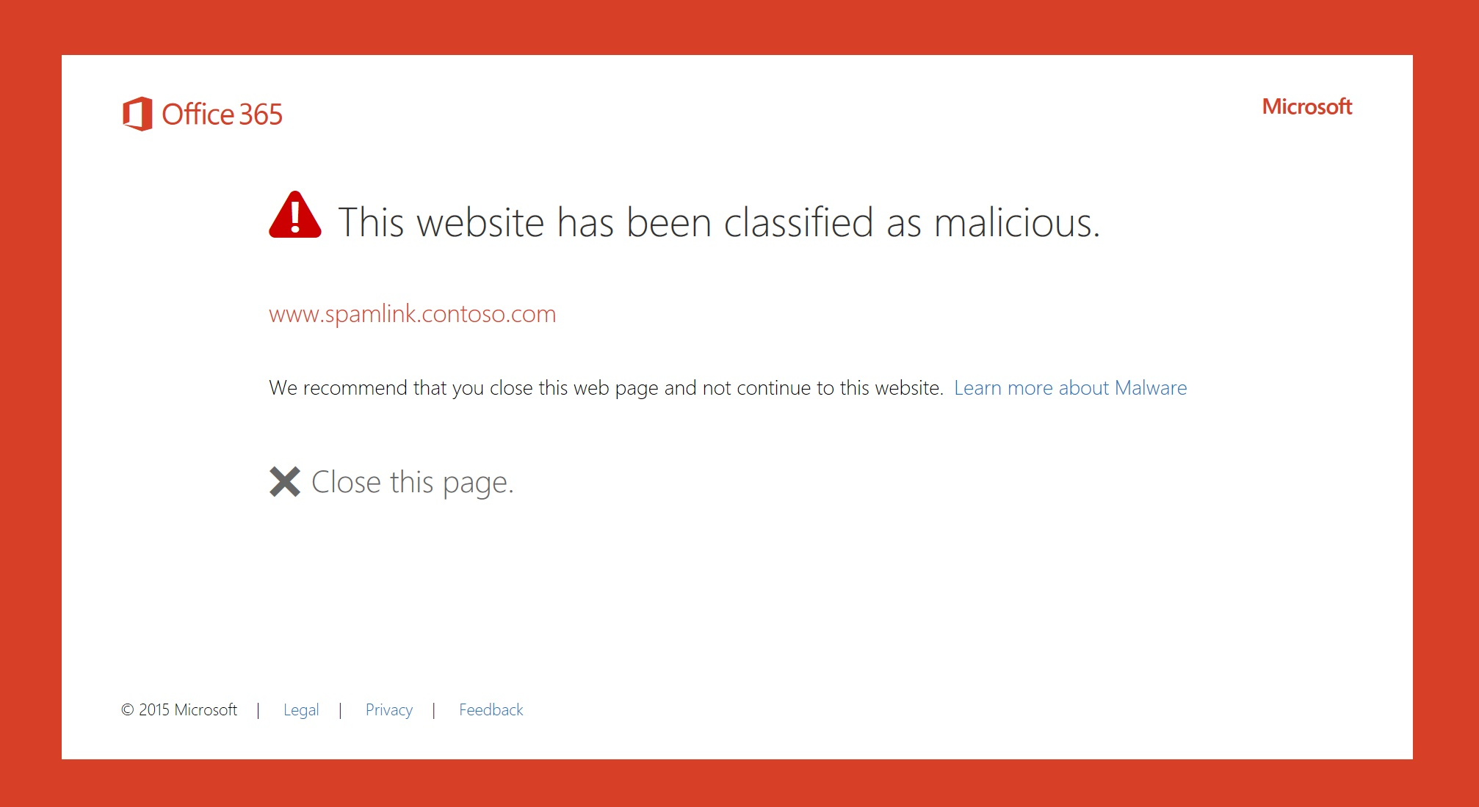
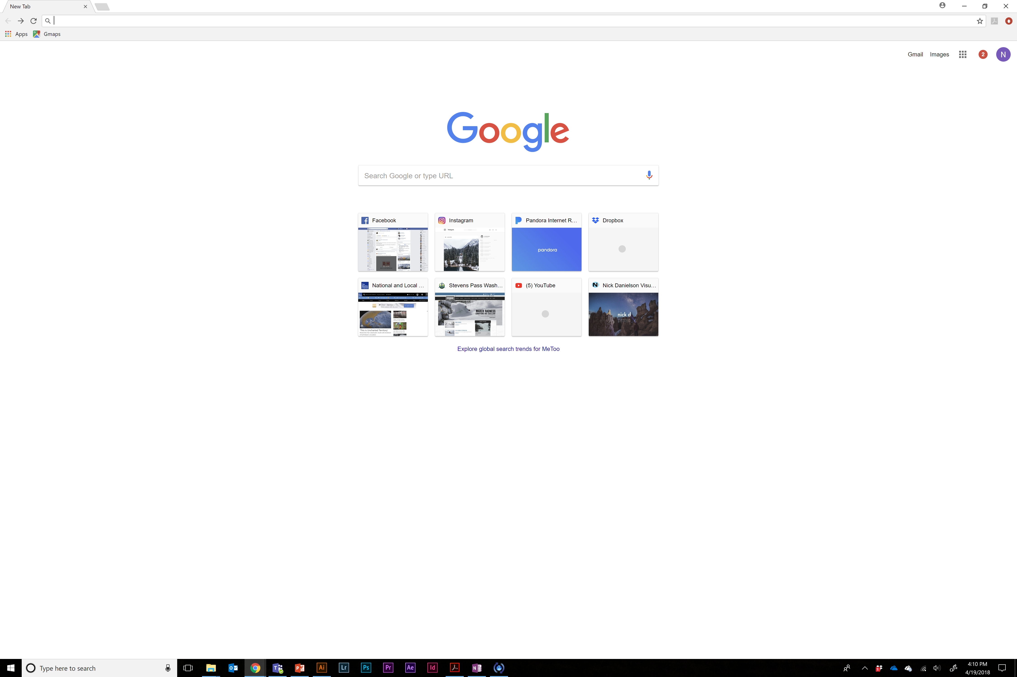
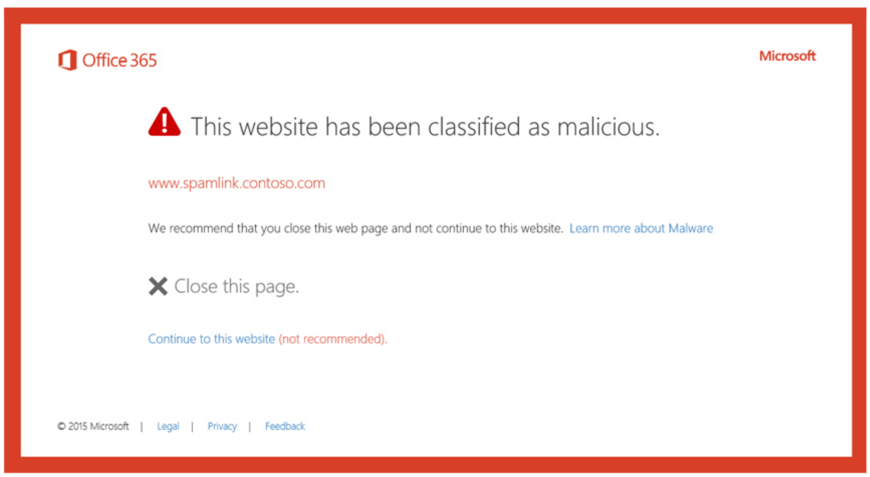
Safeguard your data: Protection from threats
Links are checked in real time to warn you if the destination is a malicious site
AI-powered attachment scanning detects malware previously not seen
Windows devices are monitored for suspicious processes like ransomware
Notes:
The top layer focuses on protecting your business from external threats by giving you access to the same enterprise-grade service and protection but without the need for an enterprise-sized IT department.
Our threat protection tools keep your business free of hazards such as spam, malware, viruses, phishing attempts, malicious links, etc. while helping to protect from sophisticated threats cunningly disguised as email attachments or links, zero-day ransomware, and other advanced threat techniques.
These capabilities come from our built-in malware protection capabilities that not only help you prevent threats, but also alert you if a breach has taken place and notify you when additional actions are required, and from advanced file encryption made possible through our BitLocker technology.
Unfortunately, we live in a day and age when virus and malware attacks are a common occurrence. When successful, these attacks can cause several issues for a company—from loss of customer trust to financial woes resulting from business-threatening downtime and more. ATP helps Protects your business from sophisticated phishing attacks, unsafe attachments, suspicious links, ransomware, and other advanced malware
The Threat Protection Features in Microsoft 365 Business scan each & every attachment coming in via email. It does a comprehensive, real time analysis of the behavior of the file to determine its intent (whether normal or malicious), thereby leading to better intelligent protection against unsafe attachments that are the basis for phishing schemes and ransomware infections
While it would be ideal for employees to understand they shouldn’t click on hyperlinks sent to them from people they don’t know—or messages with other obvious red flags—it’s not realistic to think that all of them will avoid phishing schemes. [Dave edit… replace the previous sentence with: Today’s “bad actors” are more clever than ever. Even your staff who understand that they shouldn’t click on hyperlinks sent from people they don’t know, could be easily fooled by today’s sophisticated phishing schemes.] These features remove the guesswork by doing the check for you and protecting your users from clicking through to malicious or unsafe sites or the system takes users to a warning page before allowing them access to the link.
These Threat Protection capabilities also extend to Device end points helping prevent users from interacting with Ransomware and malicious web locations

Slide 16
Safeguard your data: Protection from data leaks
Apply data loss prevention policies to help keep sensitive information from falling into the wrong hands*
Enforce BitLocker device encryption to protect data if a computer is lost or stolen
Manage all your devices—PCs, Mac, iOS, and Android—with full-featured Intune management
*Data Loss Prevention will be available in Microsoft 365 Business in summer 2018
Notes:
The second layer helps you protect your business data or sensitive customer or employee information from accidental leaks by utilizing Data Loss Prevention capabilities and mobile device management functionality across both iOS and Android devices which protect your sensitive data from being accessed from unauthorized locations or through unauthorized applications.
What you really get, in other words, is peace of mind that a file isn’t going to be magically lost or corrupted. The threat of information loss is what keeps you up at night, but with your files securely backed up in the cloud, and accessible only by you or your employees – even in the event of a lost or damaged device – you will never lay awake worrying about the security of your data again.
Small businesses deal with a variety of sensitive information like Customer credit card numbers, SSN, DOB or even intellectual property that is core to the running of the business. Keeping this information safe can be a challenge because expecting employees to manually check every email or document shared for sensitive information can be hard. The Data Loss Prevention policies in M365 Business help businesses easily identify, monitor, and protect sensitive information through deep content analysis
It Includes preconfigured templates that can help businesses detect specific types of sensitive information being communicated such as Credit Card Numbers, SSN, DOB or even locale-specific personally identifiable information (PII).
It also provides policy tips, which can help educate and prevent end users from accidental sharing of sensitive info by displaying a policy tip in Outlook.
Enforce device encryption with BitLocker to help protect against data theft or exposure if a computer is lost or stolen. Get End to End Intune Device Management across all your devices – PCs, Macs, Mobile devices to protect sensitive information from leaking

Slide 17
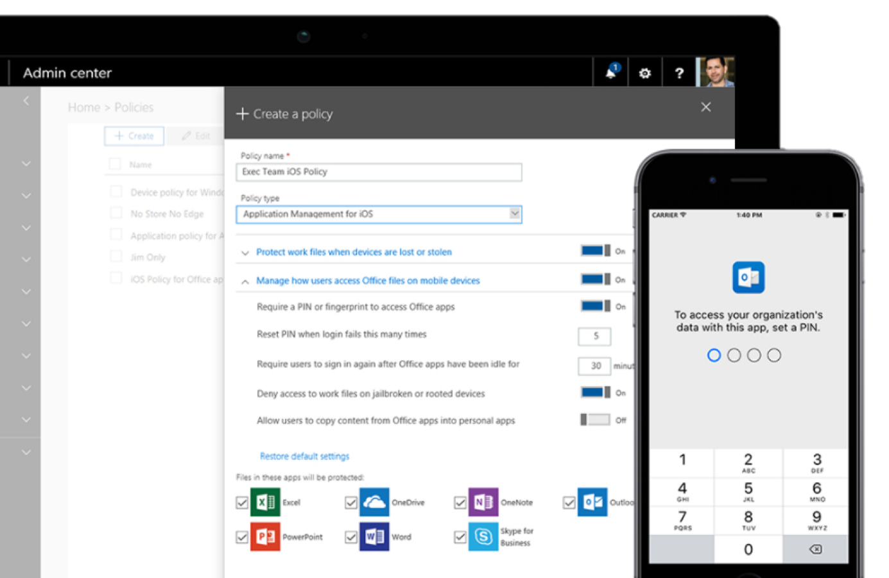
Safeguard your data:
Control data access
Require PIN or fingerprint to access business documents and data
Remotely wipe business data without affecting personal information
​Apply encryption and restrictions like do not forward to emails and documents
Notes:
Controlling and managing access to who has access to content is the 3rd layer of your security strategy. A challenge that small businesses have is controlling & managing who has access to the company’s sensitive information. Enabling these controls without hindering productivity is also hard. Information Protection Policies in M365B provide capabilities to control & manage how information is accessed and making sure that only the right folks have access to the right data
Enjoy peace of mind with features such as:
The ability to communicate and collaborate securely while controlling access to sensitive information with controls like “Do No Forward”; “Do not copy” etc
The ability to classify sensitive information like “Confidential” and enable specific restriction for how classified can be shared outside and inside the business
The ability to securely share sensitive content with authorized external parties through easy to enable encryption controls

Slide 18
Simplified for you
Easy to set up and manage, giving you time back
Notes:
It is easy to look at all these features and wonder how complex it would be to enable these functionalities. In Microsoft 365 business, we have made it Easy to setup and manage your users, devices, and data, giving you time back.
You can easily set policies Quickly onboard a new PC or to refresh an existing PC with automatic Windows 10 setup and configuration helping you get value of your Microsoft 365 Business Subscription faster

Slide 19
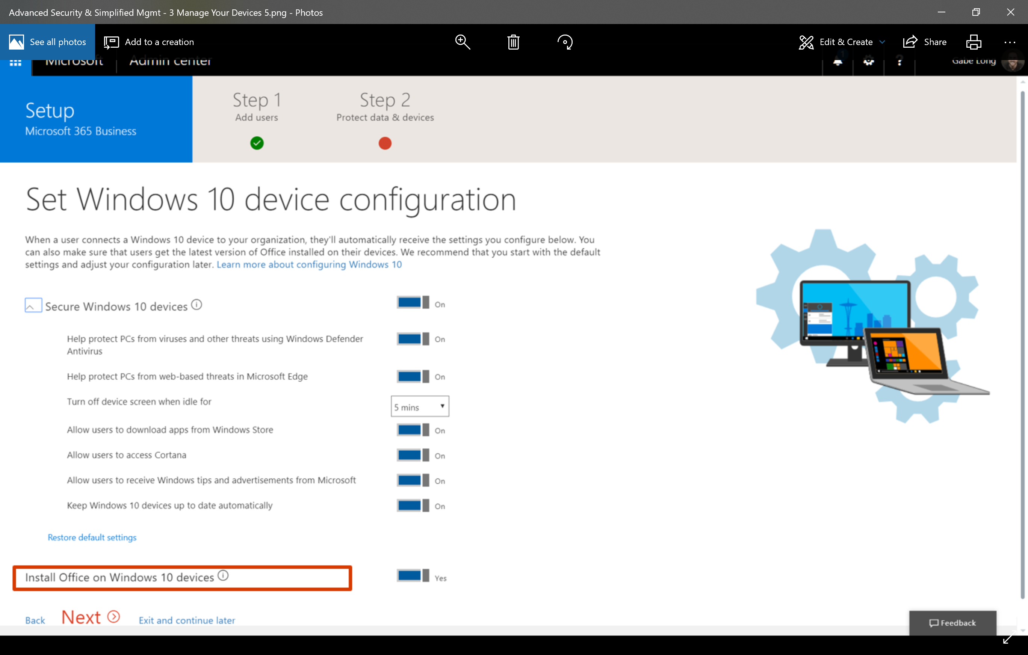
Simplified for you
Get up and running quickly with a step-by-step guided experience
Use a simplified admin center to manage your services, users, and devices
Standardize your security with easy toggles and pre-configured policies
Notes:
One is right to wonder if enabling all of these productivity features will be complex. That’s why we have simplified setup with the Microsoft 365 Business console where you can easily setup the security policies we showed you with simple toggle buttons
You have easy toggles to setup device and data policies
You can also simplify your Windows 10 device setup. There are security policies that you can easily enable like enabling windows defender for all users, so individual users cannot disable anti virus on their machines and make the org unsafe

Slide 20
Our expertise + Microsoft 365 Business
Space for
Partner Logo
We’re the expert in cloud deployment…
Supporting point #1
Supporting point #2
Supporting point #3
We can help you integrate your…
Supporting point #1
Supporting point #2
Supporting point #3
We can manage your security operations remotely so you don’t have to…
Supporting point #1
Supporting point #2
Supporting point #3
Notes:
[Note: This customizable slide is for talking about your company and its value. You can fill it out with your own information and add your company logo.]

Slide 21
Thank you

