Slide 1
Better security starts at the OS with Windows Server 2016
Vinicius Apolinario
Sr. Product Marketing Manager

Slide 2
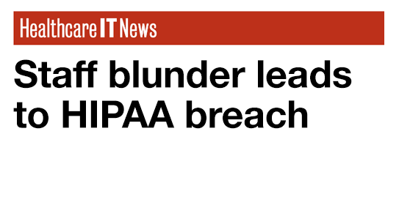
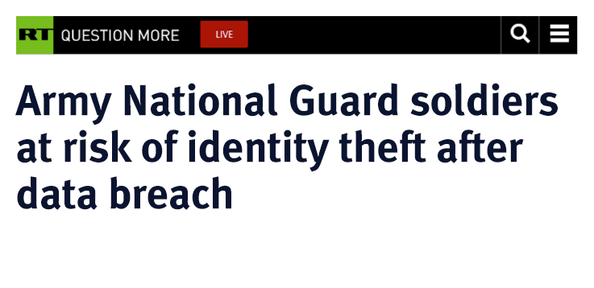
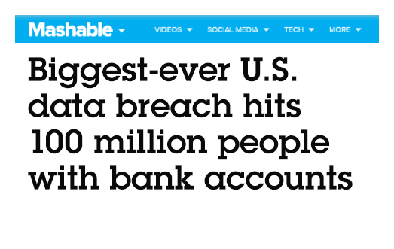
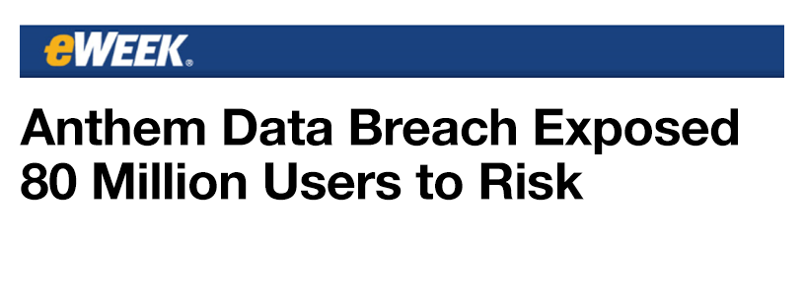
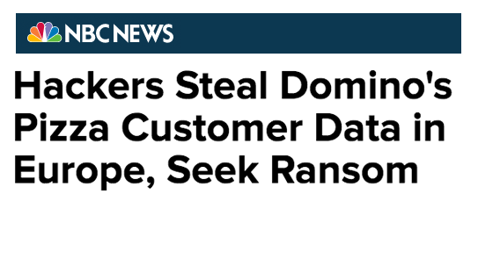
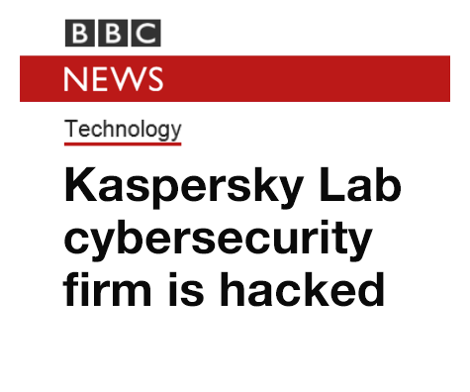
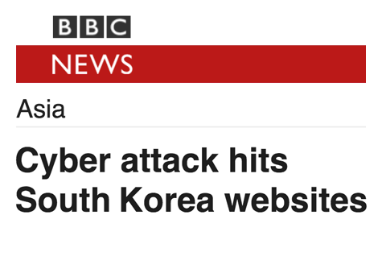
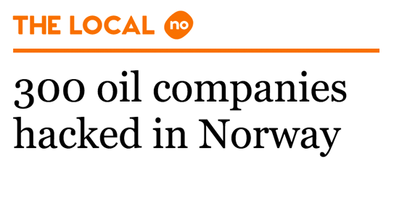
Security is a top priority for IT
Increasing
incidents
Multiple
motivations
Bigger risk
Notes:
In the last several years, breaches have hit government agencies, banks, energy companies, retailers and even a cybersecurity firm. It’s become a daily headline in the news. No one wants to be the next headline.
Increasing incidents
The incidents are growing in both volume and sophistication, 64 percent more security incidents in 2015 than in 2014.
according to the annual Cost of a Data Breach study from IBM and Ponemon.
Multiple motivations
Not that long ago, when we thought of hackers we pictured teenagers in basements causing trouble.
Things changed when organized crime realized there was money to be made in hacking.
Today, there are nations, terrorists and activists all trying to steal secrets for various reasons.
Bigger risk
As these threats become more complex, the cost to companies continues to rise, according to the study, with companies losing $158 per compromised record. Breaches in highly regulated industries were even more costly, with healthcare reaching $355 per record – a full $100 more than in 2013
Companies that continue to rely solely on prevention and detection technologies like firewalls and antivirus products are considered sitting ducks.
In nearly every case, by the time the victims noticed that hackers were inside their systems, their most sensitive information, trade secrets and customer data had already left the building.

Slide 3
Evolution of attacks
Mischief
Fraud and theft
Damage and disruption
Script Kiddies
Organized Crime
Nations, Terror
Groups, Activists
Unsophisticated
More
sophisticated
Very sophisticated
and well resourced
Notes:
If we know all of this, why are attackers still so successful? The issue is that most organizations rely on a security model that stresses building infrastructure defenses to keep the bad guys out, rather than finding them once they’re inside. With ever-growing numbers of mobile devices and remote workers, along with readily available malware toolkits, it’s no longer a matter of if you’ll be breached, but when
In today’s business environment, cyber attacks have become a normal occurrence for companies of all sizes, across all industries. The attacker profile has grown beyond independent actors (script kiddies), and now includes organized crime, nation states, and terror groups.
These groups are not only about going after the biggest companies to steal information for the biggest payoff, they are also focused on interrupting businesses for profit or other malicious intent.
Ransomware is another emerging threat where attackers do not even need to worry about staying hidden on the network as they create swift attacks for ransom from unsuspecting companies. An employee clicks on a malicious URL in an email, which downloads malware that quickly traverses the network and encrypts all of the organization’s file servers or locks employees out of their systems.

Slide 4
“Cyber security is a CEO issue.”
-McKinsey
$3.0 Trillion
$4 Million
$500 Million
Impact of lost productivity and growth
Average cost of a data breach (15% YoY increase)
Corporate liability
coverage.
Cyber threats are a material risk to your business
Source: McKinsey, Ponemon Institute, Verizon
Notes:
Source 1 (HEADING): “Cyber security is a CEO issue”: http://www.mckinsey.com/insights/business_technology/why_senior_leaders_are_the_front_line_against_cyberattacks
Source 2: 243 days for attacker to be present: http://www.fireeye.com/news-events/press-releases/read/fireeye-releases-annual-mandiant-threat-report-on-advanced-targeted-attacks
Source 3: 140 countries developing cyber weapons: Infosec Institue, “The Rise of Cyber Weapons and Relative Impact on Cyberspace”
Source 4: $3 trillion in lost productivity: http://www.mckinsey.com/insights/business_technology/why_senior_leaders_are_the_front_line_against_cyberattacks
Source 5: $4 million cost: Source: https://www-03.ibm.com/press/us/en/pressrelease/49926.wss
According to the 2016 Cost of a Data Breach study from IBM and Ponemon, the average cost of a data breach for companies worldwide continues to increase and is now estimated at $4 million. It’s even higher in the U.S., with the cost per breach is estimated at $7.01 million.
The study examines both direct and indirect costs to companies in dealing with a single data breach incident. Through in depth interviews with nearly 400 companies across the globe, the study factors in costs associated with breach response activities, as well as reputational damage and the cost of lost business.

Slide 5
Attacks ruin reputations
Before: Respected
After: Exposed
Notes:
In today’s business environment, cyber attacks have become a normal occurrence for companies of all sizes, across all industries. The attacker profile has grown beyond independent actors, and now includes organized crime, nation states, and terror groups. These groups are not only about going after the biggest companies to steal information for the biggest payoff, they are also focused on interrupting businesses for profit or other malicious intent.
Ransomware is another emerging threat where attackers do not even need to worry about staying hidden on the network as they create swift attacks for ransom from unsuspecting companies. An employee clicks on a malicious URL in an email, which downloads malware that quickly traverses the network and encrypts all of the organization’s file servers or locks employees out of their systems.
Outside of the cost of an attack or the data that is lost….the biggest hit comes to the Reputation of an organization. Once you lose your customer’s data, your reputation could be the hardest part of an attack to recover from.
BEFORE:
Industry credibility, positive reputation, customer confidence
AFTER:
Loss of credibility, embarrassing information exposed, customer’s lose faith

Slide 6
Attacks devastate budgets
Before: Customers buy
After: You pay up
Notes:
Speaker Note: Use the opening statement on security as the theme for slides 6-12
The Cost of a Data Breach study from IBM and Ponemon, which has tracked cost worldwide found the average consolidated total cost of a data breach grew from $3.8 million to $4 million in 2016. The study also reports that the average cost incurred for each lost or stolen record containing sensitive and confidential information increased from $154 to $158. Companies have put money into crisis management, free credit reports for customers whose data may be at risk, advertising and marketing to win back customer confidence.

Slide 7
Attacks on organizations hurt productivity
Before: Digital collaboration
After: Back to fax
Notes:
Speaker Note: Use the opening statement on security as the theme for slides 6-12
BEFORE: Digital efficiency
Employees efficiently perform the majority of work activities using a desktop computer. (Emails, texts, IM, posting information….)
AFTER: 80s flashback or Sneaker brigade
Employees waste hours a day running back and forth to a fax machine (assuming you still have one)

Slide 8
Attacks hinder external communication
Before: Trusted adviser
After: Outsider
Notes:
Speaker Note: Use the opening statement on security as the theme for slides 6-12
External communication
BEFORE: Trusted adviser
Customers are fine trusting you with their personal information – after all, you know what you’re doing.
AFTER: Don’t ask, we won’t tell
Customers are increasingly reluctant to share information.

Slide 9
Attacks affect the IT security team
Before: Focused
After: Overwhelmed
Notes:
Speaker Note: Use the opening statement on security as the theme for slides 6-12
Security team
BEFORE: Well-chosen and dedicated
Once there was an appropriately sized and dedicated IT Security team
AFTER: Overwhelmed, where to start?
After a breach, the organization may spend more money at the security team, which increases in size. Remediation efforts put in place are likely to require new and expensive products and result in reflex overspending, which can minimize effectiveness.

Slide 10
Attacks wreck internal communication
Before: Transparency
After: Need to know
Notes:
Speaker Note: Use the opening statement on security as the theme for slides 3-9
Internal communication
BEFORE: Transparency
High-business value and medium-business value assets are available for day-to-day business operations
AFTER: Top secret, need to know
Lock down mode! Assets become encrypted and key business IT services rendered useless.

Slide 11
Attacks affect intellectual property
Before: Confident
After: Vulnerable
Notes:
Speaker Note: Use the opening statement on security as the theme for slides 3-9
BEFORE: Corporate secrets are secret
AFTER: Corporate secrets are public knowledge; potential loss of competitive advantage

Slide 12
Attack timeline
Attackers often target AD and IT Admins
to gain access to business assets
  First host compromised
  Domain admin compromised
  Attack discovered
Research and preparation
Attacker undetected (data exfiltration)
Attackers find any weakness, target information on any device or service
You may be under attack (or compromised) and unaware
  24–48 hours
  More than 200 days (varies by industry)
Notes:
Key Message: Microsoft Understands these attacks from firsthand experience helping customers with them
Timeline
Targeted Attacks usually follow a timeline similar to this slide with
(Blue) Research on Company (Using social media, open source intelligence sources, data from previous attacks) and Preparing for the attack
(Yellow) Elevation of privilege attack (typically using credential theft, but also abuse of administrative/management tools and configuration weaknesses)
(Red) Attackers typically exfiltrate data for illicit purposes and go undetected for 200+ days.
This is a general observation based on our incident response team’s experience (which is similar to what is reported by others in industry). Precise numbers are difficult to produce because evidence of the initial “Patient 0” host is frequently lost after such a long period of time.
Because most attacks are discovered by external parties, the variance in time to discover attacker presence usually depends on the organization’s industry (retail will be quick as credit cards are put onto market whereas the loss of other IP like technical designs takes longer to be apparent)
Observations
It is very hard to prevent the research and prep of an attack, this is generally public info. We have to assume that an attacker WILL get into your environment. Once they take over your environment it is almost impossible to get them out.
The focus should be on making it much harder for the attacker to take over the environment and extent that attack timeline weeks or months so that you can detect and respond to the attack before the attacker can take over your environment. Windows Server 2016 is focusing on how to slow down, detect, and prevent these attacks.

Slide 13
Anatomy of an attack
Attack
Browser or Doc Exploit Delivery
Malicious Attachment Delivery
Enter
User
Phishing Attacks
Internet Service Compromise
Establish
Browser or Doc Exploit Execution
Device
Malicious Attachment Execution
Stolen Credential Use
Kernel Exploits
Expand
Kernel-mode Malware
Network
Pass-the-Hash
Endgame
BUSINESS DISRUPTION
LOST PRODUCTIVITY
DATA THEFT
ESPIONAGE, LOSS OF IP
RANSOM
Notes:
Key Message: This slide shows and example of what happens in the 24-48 hour exploit where privilege escalation can happen. Credential theft attacks can happen on just about conventionally secured environment and requires new types of defenses
---------------------
Most attackers use malware toolkits – available to anyone on the internet – to gain access to your network. Once inside, they immediately look to compromise administrator credentials, which typically only takes them between 24 and 48 hours. At that point, with domain administrator credentials in hand, they have free rein to access any nearly any system in your infrastructure. Because they are using valid credentials, they can operate for months before being discovered.
As we discussed in the opening, this leads to business disruption, lost productivity, loss of data and ip and potentially having your systems held ransom.

Slide 14
Different attack vectors
Attack the applications
and infrastructure
Attack the
virtualization fabric
Compromised privileged accounts
Unpatched vulnerabilities
Phishing attacks
Malware infections
Compromised fabric exposes guest VMs
Easy to modify or copy VM without notice
Can’t protect a VM with gates, walls,
locks, etc.
VMs can’t leverage hardware security
(e.g., TPM)
Notes:
Key Message: There are potential attack vectors on the operating system and their respective application as well as an attack vector on the virtualization fabric.
With the evolution of servers to virtual environments, which brings new challenges when trying to protect the datacenter environment.
In addition to the regular attacks already discussed in previous slides, we also have the virtualization fabric that needs to be protected. The virtualization fabric bring new items to be considered when planning for a security strategy:
Administrators have the keys to the kingdom and in the case of sensitive workloads, such as Domain Controllers, virtualization admins can access the secrets inside virtual machines. A compromised fabric administrator can be a malicious administrator or an administrative account that was compromised by an attacker.
A virtual machine is really just a file and virtual disks can be copied to a USB stick or a laptop and be mounted in another environment.
In the past, to protect a server or a sensitive workload, we use to put these servers in a highly secured physical environment that only allowed people would be able to access and have physical access to the assets. In the case of a virtual machine, anyone who have access to the virtualization host will have access to the virtual machine source files, which bring us back to the first statement.
In the last few years, great new capabilities came up such as TPM chips, Secure Boot, UEFI 2.0 and others. The problem is that these features are tied to hardware capabilities that are not exposed to virtual machines.
All of these problems are not specific for Microsoft. Other platforms such as VMware, will have the same issues, however the solutions that will be presented in this deck are unique to Windows Server.

Slide 15
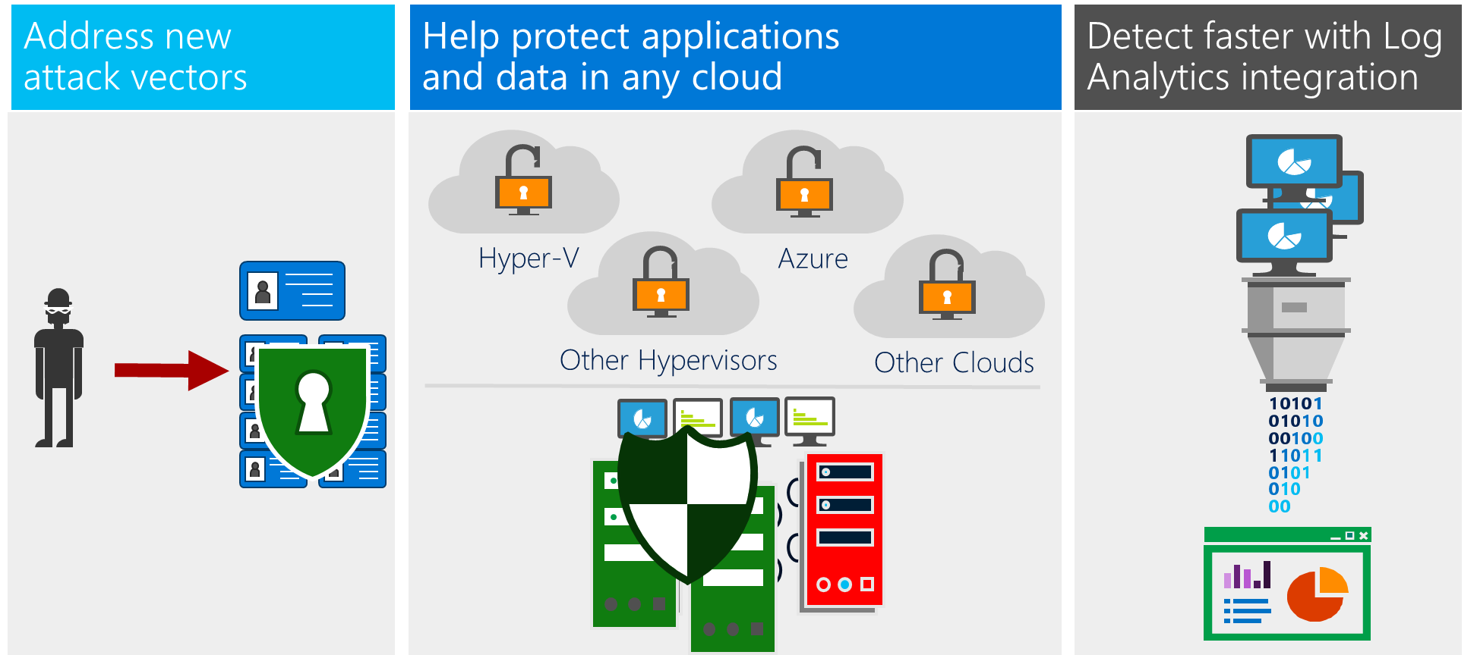
Windows Server 2016: Layers of security
Address emerging
attack vectors
Help protect applications
and data in any cloud
Detect faster with Log Analytics integration
Hyper-V
Azure
Other Hypervisors
Other Clouds
Notes:
Key Message: We want to protect 3 things. 1. Protect privileged identity 2. Protect the OS no matter where it is running on any host 3. Protect the virtual machines from virtualized fabrics. 4. Make a breech detectable so you can respond.

Slide 16

Help protect credentials and privileged access

Slide 17
Challenges in protecting credentials
Social engineering leads
to credential theft.
Most attacks involve gathering credentials (Pass-the-Hash attacks).
Administrative credentials typically provide unnecessary extra rights for unlimited time.
Ben
Mary
Jake
Admin
Domain admin
Typical administrator
Capability
Time
Notes:
Key Message: Identity is the new perimeter that attackers are exploiting to attack your infrastructure. Administrators are usually perpetual admins and full control of the environment, regardless of their role.
Attackers are getting more sophisticated, often using compromised, highly privileged admin credentials to control access.
These credentials make it easy for them to remain undetected for long periods of time or create an instant, devastating attack.

Slide 18
Helping protect privileged credentials
Credential Guard
Prevents Pass-the-Hash and Pass-the-Ticket attacks
by protecting stored credentials through
virtualization-based security.
Remote Credential Guard
Works in conjunction with Credential Guard
for RDP sessions to deliver Single Sign-On (SSO), eliminating the need to pass credentials to the RDP host.
Just Enough Administration
Limits administrative privileges to the bare-minimum required set of actions (limited in space).
Just-in-Time Administration
Provides privileged access through a workflow
that is audited and limited in time.
Ben
Mary
Jake
Admin
Domain admin
Typical administrator
Just Enough and Just in Time administration
Capability
Capability and
time needed
Time
Notes:
Windows Server 2016 provides you with two powerful technologies to help prevent pass-the-hash attacks.
1. Credential Guard prevents admin credentials from being stolen by Pass-the-Hash and Pass-the-Ticket attacks. Remote Credential Guard delivers Single Sign-On for Remote Desktop Protocol (RDP) sessions, eliminating the need to pass credentials to the RDP host.
2. In essence, Remote Credential Guard (RCG) keeps the credential secrets on the client machine so that when a user performs a Remote Desktop logon to a target machine (server or client), the credentials are never available on the target machine so cannot be stolen if that machine is compromised.
To protect priveldged access across your existing environment, use Just Enough Administration and Just-in-Time Administration to ensure attackers can’t access critical data, even if they have comprised admin credentials.
Restricted admin vs. Remote Credential Guard (Q&A):
Q: What’s the difference between Restricted Admins vs Remote Credential Guard and when would you want to use one vs. another?
A: Restricted Admin logs you as an admin on the remote machine –1. You have to be an admin, 2. Logging will look like an admin and not the user, 3. You cannot go out of the remote machine to another machine (say file share),4. supports NTLM
Remote Credential Guard logs you as the user –1. You do not have to be an admin, 2. You are logged on as the user so all the operations will be logged as that user, 3. You can go out to another machine (say file share), 4. Kerberos only
Q: With Remote Credential Guard the Kerberos Service Ticket is still on the remote host, and can be potentially stolen, right? Pass the ticket attack is still possible, right? Is so, why would you want to use Remote Credential Guard vs Restricted Admin? Would using Credential Guard on the remote host help mitigate this?
A: The Service Ticket can be potentially stolen only while the user is active on the remote host. Once the user disconnects, the Service Ticket is no longer usable – see reasons above to the choices between Remote Credential Guard and Restricted Admin – e.g.: if this is for admin only and no need to go out of the machine and you don’t care about logging, you are good to go.

Slide 19

Help protect applications and data in any cloud

Slide 20
Challenges protecting the OS and applications
?
New exploits can attack the OS
boot-path all the way up through applications operations.
Known and unknown threats need to be blocked without impacting legitimate workloads.
?
Notes:
Key Message: The OS and applications are constantly being attacked by both known and unknown threats. You want the OS to protect itself and the applications running on it, while sending signals that it is under attack.
Example threat: Ransomware on university servers locks users away from critical student and research data—until a ransom is paid to the attacker.

Slide 21
Helping protect OS and applications
Device Guard
Ensure that only permitted binaries can be executed from the moment the OS is booted.
Windows Defender
Actively protects from known malware without impacting workloads.
Control Flow Guard
Protects against unknown vulnerabilities
by helping prevent memory corruption attacks.
Notes:
Key Message: Windows Server 2016 has security on by default with Windows Defender in the box that is optimized for server roles and control flow guard protection from common memory corruption attacks.
Device guard helps you whitelist and monitor all the binaries that are allowed to run on your servers so that unauthorized binaries will not be able to execute on the servers. It also provides notification if unauthorized binaries are attempted to execute.

Slide 22

Respond more intelligently with log analytics integration

Slide 23
Challenges turning log files into operational insights
In order to better detect threats the OS need to provide additional auditing information.
Security Information and Event Management (SIEM) systems are only as intelligent as the information provided from the OS.
Notes:
Example threat: Kernel-based malware injected into a law firm server gives an attacker the ability to access client files without being detected.

Slide 24
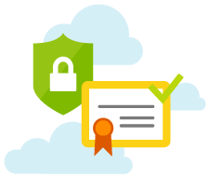
Improved detection
Enhanced Logs
Log new audit events to better detect malicious behavior by providing more detailed information to security operation centers.
Integration with systems management
Operations Management Suite (OMS) and other SIEM systems, can take advantage of this information to provide intelligence reports on potential breaches in the datacenter environment.
Notes:
Security auditing optimized for threat detection: Based on the Microsoft internal security operation center Windows Server 2016 includes targeted auditing to better detect malicious behavior. These include auditing access to kernel and sensitive processes as well as new information in the logon events. These events can then be streamed to threat detection systems such as the Microsoft Operations Management Suite to alert on malicious behavior.

Slide 25

Help protect the virtualization fabric

Slide 26
Challenges protecting virtual machines
Any compromised or malicious fabric administrators can access guest virtual machines.
Health of hosts not taken into account before running VMs.
Tenant’s VMs are exposed to storage and network attacks.
Virtual machines can’t
take advantage of hardware-
rooted security capabilities such as TPMs.
Host OS
Customer
Customer
Guest VM
Guest VM
Healthy host?
Storage
Hypervisor
Hypervisor
Fabric
Fabric
Notes:
Goal: Continue with the premise of: “Making Virtual machine security on par with the physical machine security”
Show the differences today between virtual machines and physical machines
If you cannot log into the physical machine you need to go and grab the machine physically and take it out
A VM you can just pick up from storage, network or if you can log into the host
We work to change this equation with Shielded virtual machines so that a VM is as secure as a physical machine.
Virtualized environments are particularly at risk. Virtual machines don’t have the hardware-rooted security capabilities of physical servers. Since virtual machines are instantiated from files that can be copied and modified, any attacker that is able to access the fabric storage, network, or compute resources immediately has unchecked privileges for all virtual machines. An attacker can simply copy your SQL and domain controller VMs into a USB drive and walk out with your crown jewels.
Example threat: Attacker compromises fabric admin credentials at a bank, giving him access to virtualized Active Directory Domain Controllers and SQL databases where
client account information is stored.

Slide 27
Helping protect virtual machines
Shielded Virtual Machines
Use BitLocker to encrypt the disk and state
of virtual machines protecting secrets from compromised admins and malware.
Host Guardian Service
Attests to host health releasing the keys required to boot or migrate a Shielded
VM only to healthy hosts.
Generation 2 VMs
Supports virtualized equivalents of
hardware security technologies (e.g., TPMs) enabling BitLocker encryption for Shielded Virtual Machines.
Building perimeter
Computer room
Hyper-V
Hyper-V
`
Physical machine
Virtual machine
Shielded virtual machine
Server
Administrator
✓
✓
*
✗
Storage
Administrator
✗
✓
✗
Network
Administrator
✗
✓
✗
Backup
operator
✗
✓
✗
Virtualization-host
administrator
✗
✓
✗
Virtual machine
✗
✓
✓
✓
Should have
access and does
✗
Should not have
access and doesn’t
✓
Should not have
access but does
*Configuration
dependent
Notes:
Key Message: A shielded VM is just like any other VM, but it is protected from a compromised fabric. You can back it up, live migrate it, just like normal VM….but it is encrypted.
A shielded VM has a virtual TPM and it is encrypted with BitLocker with the key residing in the virtual TPM. The virtual TPM is then encrypted as well so you can move the VM between machines while maintaining its encrypted state .
When a shielded VM lands on a trusted host, the virtual TPM key will be provided to the host so the host can decrypt the virtual TPM in a location that isn’t accessible to the host administrator. This location is called Virtualized-Based-Security. The virtual TPM is then presented to the VM which can then read the bitlocker key and run.
Any Generation 2 VM can be a shielded VM starting with Windows Server 2012 and Windows 8 and up.
Graphic: Normal VM’s – any administrator can have access to the virtual machines on the fabric. Shielded VM’s - only VM administrators have access to the VM’s

Slide 28


Shielded Virtual Machines
Works with Host Guardian Service
Cloud/Datacenter
Hyper-V Host 1
Host OS
Guest VM
Guest VM
Guest VM
Hypervisor
Please sir, may I have some keys?
Hyper-V Host 2
Host OS
Guest VM
Guest VM
Fabric Controller
Hypervisor
Hyper-V Host 3
Host OS
Guest VM
Guest VM
Key Protection
Hypervisor
Host Guardian Service
Notes:
Powering up a VM works – with WS2016 and SVM, host requests key from Host Guardian service, and releases key.

Slide 29
Shielded Virtual Machines
Works with Host Guardian Service
Cloud/Datacenter
Key release criteria
(TPM-mode)
Known physical machines
Trusted Hyper-V instance
CI-compliant configuration
Hyper-V Host 1
Host OS
Guest VM
Guest VM
Guest VM
Hypervisor
Hyper-V Host 2
Sure, I know you and you look healthy
Host OS
Guest VM
Guest VM
Fabric Controller
Hypervisor
Hyper-V Host 3
Host OS
Guest VM
Guest VM
Key Protection
Hypervisor
Host Guardian Service

Slide 30
“
Shielded Virtual Machines remove a hosting obstacle and are a huge competitive differentiator. No one but Microsoft has this technology now.
“
Philip Moss
Chief Product Officer
Acuutech
Notes:
Acuutech provides IT services to UK based businesses with international operations, particularly in Asia. Organization has built services around network infrastructure and hosting solutions (cloud computing.)

Slide 31

Protect with just enough OS

Slide 32
Challenges in protecting new apps
Developers are protecting by making use of packaging and deployment tools such as containers.
Containers share the same kernel which limits isolation and exposes compliance and regulatory risks.
Reduce the risk by providing only the components required by application to run.
VM
VM
VM
VM
VM
Shared Hardware (Hypervisor Isolation)
Container
Container
Container
Container
Container
Shared Kernel (User Mode Isolation)
Notes:
Containers are being largely adopted by developers and bring a huge amount of innovation so IT can respond to business needs more agile. However, both Linux and Windows Server containers share the same kernel, which means a security risk. The workaround used today is to have containers on VM, since VMs have hardware isolation via hypervisor. However, this workaround breaks the promise of agility that Containers should provide.
Example threat: A line-of-business application developer downloads code from the public internet to integrate into her application. The downloaded code includes malware that can track activity in other containers through the shared kernel.

Slide 33
Windows Server 2016 approach
Hyper-V containers
Provide hypervisor isolation for
each container with no additional coding requirements.
Helps align with regulatory requirements for PCI and PII data.
Nano Server
Reduce the attack surface by deploying a minimal “just enough” server footprint.
VM
VM
VM
VM
VM
Shared Hardware (Hypervisor Isolation)
Hyper-V Container
Hyper-V Container
Hyper-V Container
Hyper-V Container
Hyper-V Container
Shared Platform (Hypervisor Isolation)
Notes:
Hyper-V containers solve the current security risk for lack of isolation between containers and other containers as well as the underlying operating system they are running on. Hyper-V Containers ensure that code running in one container object remains completely isolated. The Hyper-V Container object cannot impact other container objects or the host operating system, or vice versa, because it is a separate virtualized container.
Nano Server application servers provide a purpose-built OS on which the OS deployment will provide “just enough” server footprint to support the application, resulting in more performance and security.
Nano based Hyper-V host are optimized to run the Hyper-V workload so that they minimize attack surface, increase availability, and reduce resource usage with “just enough OS” .

Slide 34

Windows Server 2016 security summary

Slide 35

Windows Server 2016 security summary

Virtualization Fabric
Protecting virtual machines Shielded VMs (Server 2012, 2016 guests) Virtual TPM for Generation 2 VMs Guarded fabric attesting to host health Secure boot for Windows and Linux Hyper-V platform Nano based Hyper-V host Virtualization-based security Distributed networking firewall Secure containers Hyper-V containers Containers hosted in a Shielded VM
Infrastructure and applications
Privileged identity Credential Guard Remote Credential Guard Just In Time administration Just Enough administration Threat resistance Control Flow Guard Device Guard Built in anti-malware Threat detection Enhanced threat detection
Notes:
Key message: Windows Server 2016 layers of security introduces both Hyper-V based security as well as OS breach resistance so that your OS, application and identity is better protected.
Windows Server 2016 helps protect privileged access, helps resist attacks, and provides better detection and helps protect your virtual machines from a compromised fabric.
-----------------------------------------------------------------------
During the last several years, cybersecurity is consistently rated as a top priority for IT. This is no surprise for anyone as top companies and government agencies are publically called out for being hacked and failing to protect themselves and their customer’s and employee personal information.
On the other hand, attackers are using readily available tools to infiltrate large organization and remain undetected for a long period of time while conducting exfiltration of secrets or simply attacking the infrastructure and making ransom demands.
Windows Server 2016 delivers layers of protection that help address emerging threats and make Windows Server 2016 an active participant in your security defenses. These include the new Shielded VM solution that protects VMs from attacks and compromised administrators in the underlying fabric, extensive threat resistance components built into the Windows Server 2016 operating system and enhanced auditing events that will help security systems detect malicious activity.
Protecting virtual machines
Shielded VMs provides protection for the data and state of the VM against inspection, theft and tampering from administrator privileges. Shielded VMs works for Generation 2 VMs that provide the necessary secure boot, UEFI firmware and virtual TPM (vTPM) 2.0 support required. While the Hyper-V hosts must be running Windows Server 2016 the guest operating system in the VM can be Windows Server 2012 or above.
Guarded Fabric: Shielded VMs can only run on Guarded hosts. These hosts need to pass an attestation check to make sure they are locked down and comply with the policy that enables Shielded VMs to run on them. This functionality is implemented through a new Host Guardian Service deployed in the environment which will store the keys required for an approved Hyper-V host that can prove their health to run shielded VMs
Secure boot for Linux: While Windows VMs had secure boot for some time, the team focused on enabling Secure Boot on Linux so that we can increase the security of the Linux OS when running on Hyper-V
Hyper-V platform
Nano based Hyper-V host: Nano Hyper-V hosts are optimized to run the Hyper-V workload so that they minimize attack surface, increase availability, and reduce resource usage with “just enough OS” .
Virtualization Based Security: Achieving isolation from administrator attacks, Virtualization Based Security provides the building block for our new threat resistance security and Shielded VMs by enabling storing secrets and applying protections that are enforced by the Hypervizor and are outside of the administrator control.
Secure containers
Hyper-V containers: To solve the current security risk for lack of isolation between containers and other containers as well as the underlying operating system they are running on, Hyper-V Containers ensure that code running in one container object remains completely isolated. The Hyper-V Container object cannot impact other container objects or the host operating system, or vice versa, because it is a separate virtualized container.
Containers hosted in a Shielded VM: Using nested virtualization, you can further secure your containers from a compromised fabric by hosting them in a Shielded VM
Privileged Identity
Compromised privileged identity is the most prevalent attack vector today. Microsoft provides customers with a plan of how to secure their Privileged Identity: http://aka.ms/privsec
There are two major concepts that were integrated into Windows Server 2016 and are also available for downlevel OS.
Just In Time Administration: Move from perpetual administration to time based administration. When a user needs to be an administrator, they go through a workflow that is fully audited and provides them with administration privilege for a limited amount of time after which that privilege gets revoked.
Just Enough Administration: Administrators should only be able to do their role and nothing more. For example: A File Server administrator can restart services but should not be able to browse the data on the server.
Credential Guard: Based on Windows 10, Credential Guard use Virtualization Based Security to protect credentials on the system from being stolen by compromised administrator or malware.
OS Threat Resistant Technologies
Windows Server 2016 includes integrated threat resistance technologies that range from blocking external attackers trying to exploit vulnerabilities (Control Flow Guard) to resistance to attacks by malicious users and software that gained administrator access to the server (Credential Guard and Device Guard).
Control Flow Guard: Serves as a safeguard by preventing common attack vectors in case the system has unknown vulnerabilities. Control Flow Guard (CFG) is a highly-optimized platform security feature that was created to combat memory corruption vulnerabilities. By placing tight restrictions on where an application can execute code from, it makes it much harder for exploits to execute arbitrary code through vulnerabilities such as buffer overflows
Device Guard: Uses Virtualization Based Security to ensure that only allowed binaries can be run on the system.
Built in anti-malware: Windows Defender is installed and functional on Windows Server 2016. Windows Defender has been optimized to run on server supporting the various server roles and integrated with PowerShell for malware scanning.
OS Enhanced threat detection:
Security auditing optimized for threat detection: Based on the Microsoft internal security operation center Windows Server 2016 includes targeted auditing to better detect malicious behavior. These include auditing access to kernel and sensitive processes as well as new information in the logon events. These events can then be streamed to threat detection systems such as the Microsoft Operations Management Suite to alert on malicious behavior.

Slide 36
Windows Server 2016 vs. VMware
Included
Not Included
Capability | Windows Server 2016 Datacenter Edition | VMware vSphere 6 | Notes
Shielded Virtual Machines |  |  | Helps protect VMs from malicious fabric admins and malware at-rest and in-flight.
Host health attestation |  |  | VMware offers only through a third party at additional cost.
VM state encryption |  |  | VMware offers only through a third party at additional cost.
Virtual TPM device for VMs
Per-VM encryption keys
Per-VM disk encryption with secure key release |  |  | VMware offers only through a third party at additional cost.
VM encryption keys protected from malicious fabric admins, host malware
VM support for Windows Secure, Measured Boot
VM support for Linux Secure Boot
Integrity-checked template disk provisioning
Based on public information available on www.vmware.com as of July, 2016.

Slide 37


Help protect Active Directory, admin privileges
2-4 weeks
1-3 months
6+ months
First response to the most frequently used attack techniques.
3
Unique Local Admin Passwords
for Workstations http://Aka.ms/LAPS
4
Unique Local Admin Passwords for Servers http://Aka.ms/LAPS
Active
Directory
Azure Active Directory
1
Separate Admin account for admin tasks
2
Privileged Access Workstations (PAWs)
Phase 1 – Active Directory admins
http://Aka.ms/CyberPAW
Notes:
These capabilities will build on the mitigations from previous phases and move your defenses into a proactive posture. While there will never be perfect security, this represents the strong protections against privilege attacks currently known/available today.
For more information: http://aka.ms/privsec
1. Modernize Roles and Delegation Model
Why: Reduce Security Risk and operational friction
What: Redesign Roles and Delegation model to adhere to the tier model rules (aka.ms/tiermodel), manage cloud privileges, and capitalize on JIT/JEA capabilities
How: Do this your self or engage Microsoft Services to assist with scoping an engagement that makes sense for your organization. Contact your account team or TAM for more information.
2. Smartcard or Passport Authentication for all admins
Why: Increase the assurance level and usability of administrator authentication
What: Require strong authentication for all admin accounts in your on-premises AD (including those federated for cloud services)
How: Follow guidance at
• Microsoft Passport - http://aka.ms/Passport
• Virtual Smartcards – http://www.microsoft.com/en-us/download/details.aspx?id=29076
• 3rd party multi-factor authentication
3. Admin Forest for domain administrators
Why: Provide the strongest protection for domain administrators with no security dependencies on the
What: The strongest protection for domain administrators can
How: Engage Microsoft Services to scope an Enhanced Security Administrative Environment (ESAE) engagement. Contact your account team or TAM for more information.
For an overview of the ESAE Admin Forest approach see http://aka.ms/esae
4. Device Guard Policy for DCs (Server 2016)
Why: Lock down your domain controllers so that only approved and signed applications and drivers can run on these machines.
What: Device Guard for kernel (drivers) and user mode (applications) allows only authorized executables to run on the machine.
How: Create a Device Guard policy based on a baseline domain controller machine. Sign the Device Guard policy and apply the Device Guard policy to all domain controllers
5. Shielded VMs for virtual DCs (Server 2016 Hyper-V Fabric)
Why: Protect virtualized domain controllers from attack vectors that exploit a virtual machine’s inherent loss of physical security
What: Use this new Server 2016 Hyper-V capability to prevent the theft of Active Directory secrets from Virtual DCs by fabric administrators and attackers/malware impersonating them. Generation 2 VMs using this feature can protect the data and state of a shielded VM against inspection, theft, and tampering.
How: Use Guarded fabric functionality per the guidance provided at: http://aka.ms/ShieldedVMs

Slide 38



Help protect Active Directory, admin privileges
2-4 weeks
1-3 months
6+ months
Build visibility and control of administrator activity, increase protection against typical follow-up attacks.
2
Time-bound privileges (no permanent admins) http://aka.ms/PAM; http://aka.ms/AzurePIM
3
Multi-factor for elevation
6
Attack Detection
http://aka.ms/ata
9872521
Active
Directory
Azure Active Directory
1
Privileged Access Workstations (PAWs)
Phases 2 and 3 – All Admins and additional hardening (Credential Guard, RDP Restricted Admin, etc.)
http://aka.ms/CyberPAW
4
Just Enough Admin (JEA)
for DC Maintenance
http://aka.ms/JEA
5
Lower attack surface of Domain and DCs http://aka.ms/HardenAD
Notes:
These capabilities will build on the mitigations from previous phases and move your defenses into a proactive posture. While there will never be perfect security, this represents the strong protections against privilege attacks currently known/available today.
For more information: http://aka.ms/privsec
1. Modernize Roles and Delegation Model
Why: Reduce Security Risk and operational friction
What: Redesign Roles and Delegation model to adhere to the tier model rules (aka.ms/tiermodel), manage cloud privileges, and capitalize on JIT/JEA capabilities
How: Do this your self or engage Microsoft Services to assist with scoping an engagement that makes sense for your organization. Contact your account team or TAM for more information.
2. Smartcard or Passport Authentication for all admins
Why: Increase the assurance level and usability of administrator authentication
What: Require strong authentication for all admin accounts in your on-premises AD (including those federated for cloud services)
How: Follow guidance at
• Microsoft Passport - http://aka.ms/Passport
• Virtual Smartcards – http://www.microsoft.com/en-us/download/details.aspx?id=29076
• 3rd party multi-factor authentication
3. Admin Forest for domain administrators
Why: Provide the strongest protection for domain administrators with no security dependencies on the
What: The strongest protection for domain administrators can
How: Engage Microsoft Services to scope an Enhanced Security Administrative Environment (ESAE) engagement. Contact your account team or TAM for more information.
For an overview of the ESAE Admin Forest approach see http://aka.ms/esae
4. Device Guard Integrity Policy for DCs (Server 2016)
Why: Lock down your domain controllers so that only approved and signed applications and drivers can run on these machines.
What: Device Guard for kernel (drivers) and user mode (applications) allows only authorized executables to run on the machine.
How: Create a Device Guard policy based on a baseline domain controller machine. Sign the Device Guard policy and apply the Device Guard policy to all domain controllers
5. Shielded VMs for virtual DCs (Server 2016 Hyper-V Fabric)
Why: Protect virtualized domain controllers from attack vectors that exploit a virtual machine’s inherent loss of physical security
What: Use this new Server 2016 Hyper-V capability to prevent the theft of Active Directory secrets from Virtual DCs by fabric administrators and attackers/malware impersonating them. Generation 2 VMs using this feature can protect the data and state of a shielded VM against inspection, theft, and tampering.
How: Use Guarded fabric functionality per the guidance provided at: http://aka.ms/ShieldedVMs

Slide 39
Help protect Active Directory, admin privileges http://aka.ms/privsec
2-4 weeks
1-3 months
6+ months
Build visibility and control of administrator activity, increase protection against typical follow-up attacks.
1
Modernize Roles and Delegation Model
5
Shielded VMs for virtual DCs (Server 2016 Hyper-V Fabric)
http://aka.ms/shieldedvms
Active
Directory
Azure Active Directory
2
Privileged Access Workstations (PAWs)
Phases 2 and 3 – All Admins and additional hardening (Credential Guard, RDP Restricted Admin, etc.)
http://aka.ms/CyberPAW
3
Admin Forest for Active Directory administrators
http://aka.ms/ESAE
4
Device Guard Policy for DCs (Server 2016)
Notes:
These capabilities will build on the mitigations from previous phases and move your defenses into a proactive posture. While there will never be perfect security, this represents the strong protections against privilege attacks currently known/available today.
1. Modernize Roles and Delegation Model
Why: Reduce Security Risk and operational friction
What: Redesign Roles and Delegation model to adhere to the tier model rules (aka.ms/tiermodel), manage cloud privileges, and capitalize on JIT/JEA capabilities
How: Do this your self or engage Microsoft Services to assist with scoping an engagement that makes sense for your organization. Contact your account team or TAM for more information.
2. Smartcard or Passport Authentication for all admins
Why: Increase the assurance level and usability of administrator authentication
What: Require strong authentication for all admin accounts in your on-premises AD (including those federated for cloud services)
How: Follow guidance at
• Microsoft Passport - http://aka.ms/Passport
• Virtual Smartcards – http://www.microsoft.com/en-us/download/details.aspx?id=29076
• 3rd party multi-factor authentication
3. Admin Forest for domain administrators
Why: Provide the strongest protection for domain administrators with no security dependencies on the
What: The strongest protection for domain administrators can
How: Engage Microsoft Services to scope an Enhanced Security Administrative Environment (ESAE) engagement. Contact your account team or TAM for more information.
For an overview of the ESAE Admin Forest approach see http://aka.ms/esae
4. Device Guard Policy for DCs (Server 2016)
Why: Lock down your domain controllers so that only approved and signed applications and drivers can run on these machines.
What: Device Guard for kernel (drivers) and user mode (applications) allows only authorized executables to run on the machine.
How: Create a Device Guard policy based on a baseline domain controller machine. Sign the Device Guard policy and apply the Device Guard policy to all domain controllers
5. Shielded VMs for virtual DCs (Server 2016 Hyper-V Fabric)
Why: Protect virtualized domain controllers from attack vectors that exploit a virtual machine’s inherent loss of physical security
What: Use this new Server 2016 Hyper-V capability to prevent the theft of Active Directory secrets from Virtual DCs by fabric administrators and attackers/malware impersonating them. Generation 2 VMs using this feature can protect the data and state of a shielded VM against inspection, theft, and tampering.
How: Use Guarded fabric functionality per the guidance provided at: http://aka.ms/ShieldedVMs

Slide 40
Just-in-Time Administration compliance mapping
JIT Security and Compliance Capability | ISO 27001: 2013 | PCI DSS 3.1 | FedRAMP; NIST 800-53 Revision 4
Controlling Logical Access Privileges and Implementing Least Privilege Access | A.9.1 – Business requirement of access control A.9.1.2 – Access to networks and network services A.9.2.2 – User access provisioning A.9.2.3 – Management of privileged access rights A.9.4.1 – Information access restriction A.9.4.5 – Access control to program source code | 7.1 – System components and cardholder data access restricted to job-based needs 7.1.2 – User ID access based on least privileges 7.1.3 – Assigning access to job function and classification 7.1.4 – Documented approval of access privileges 7.2.2 – Assigning privileges to job function and classification 7.2.3 – Default “deny-all” setting 12.5.4 – Administer user accounts 12.5.5 – Monitor and control all access to data | AC-2 – Account Management AC-3 – Access Enforcement AC-6 – Least Privilege AC-6 (1) – Authorize Access to Security Functions AC-6 (2) – Non-Privileged Access for Non-Security Functions AC-6 (5) – Privileged Accounts AU-9 (4) – Audit Access by Subset of Privileged Users CM-5 – Access Restrictions for Change CM-5 (1) – Automated Access Enforcement CM-5 (5) – Limit Production / Operational Privileges
Access Logging / Monitoring / Auditing | A.12.4.1 – Event logging A.12.4.3 – Administrator and operator logs | 10.2.2 – Logging actions by root privileges individual 10.2.5 – User changes logging | AC-2 – Account Management AC-2 (4) – Automated Audit Actions AC-2 (12) – Account Monitoring AC-6 (9) – Auditing Use of Privileged Functions AU-2 – Audit Events AU-12 – Audit Generation CM-5 (1) – Automated Access Enforcement
Notes:
Optional slide: This table describes how companies looking for these certification can use JIT to support it.

Slide 41
Hyper-V Shielded VM compliance mapping
Hyper-V Shielded VM Security and Compliance Capability | ISO 27001: 2013 | PCI DSS 3.1 | FedRAMP; NIST 800-53 Revision 4
Enforcing Separation of Duties | A.6.1.2– Segregation of duties | 6.4.2 – Separation of duties between test and production environments | AC-5 – Separation of Duties
Implementation of Least Privilege Access and Partitioning Tenant Functionality | A.9.2.3 – Management of privileged access rights A.12.1.4 – Separation of development, testing, and operational environments | 6.4.1 – Test and Production Environment Separation 7.2 – User access control on need-to-know basis 7.2.3 – Default “deny-all” setting | AC-6 – Least Privilege AC-6 (10) – Prohibit Non-Privileged Users from Executing Privileged Functions SC-2 – Application Partitioning
Protecting Information Stored in Shared Resources | None | 8.7 – Restricted access to databases containing cardholder data | SC-4 – Information in Shared Resources
Protection of Data at Rest | A.8.2.3 – Media Access | 3.4 – Verifying stored PAN is unreadable 3.4.1 – Disk encryption usage and access control 6.5.3 – Insecure cryptographic storage | SC-28 – Protection of Information at Rest SC-28(1) – Protection of Information at Rest
Security Function Verification and Integrity Monitoring | None | 11.5 – Change-detection mechanism deployment | SI-6 – Security Function Verification SI-7 – Software, Firmware, and Information Integrity
Notes:
Optional slide: This table describes how companies looking for these certification can use Shielded VMs to support it.

Slide 42
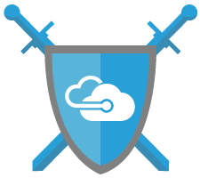
Next steps
Download Windows Server 2016 Today!
www.microsoft.com/WindowsServer2016
Visit the Datacenter & Private Cloud Security Blog:
blogs.technet.microsoft.com/datacentersecurity/
Move to a secure virtualization infrastructure:
http://www.microsoft.com/vmwareshift

Slide 44
How better security starts at the OS
Enterprises need to: | Example threat: | Windows Server 2016 helps:
Protect admin credentials | A Pass-the-Hash attack provides an attacker with admin credentials on a hospital network, which the attacker uses to access confidential patient data. | Just Enough Administration Just-in-Time Administration Credential Guard Remote Credential Guard for Remote Desktop Protocol (RDP) sessions
Protect servers, detect threats and respond in time | Ransomware on university servers locks users away from critical student and research data—until a ransom is paid to the attacker. | Device Guard Control Flow Guard Windows Defender
 | A line-of-business application developer downloads code from the public internet to integrate into her application. The downloaded code includes malware that can track activity in other containers through the shared kernel. | Hyper-V containers Nano Server
Quickly identify malicious behavior | Malware tries to access the credential manager on a Windows server to gain access to user credentials. | Enhanced Logging Microsoft Operations Management Suite Log Analytics
Virtualize without compromising security | Attacker compromises fabric admin credentials at a bank, giving him access to virtualized Active Directory Domain Controllers and SQL databases where client account information is stored. | Shielded Virtual Machines BitLocker Host Guardian Service

Slide 45

Appendix

Slide 46
Before
After
$
Breaches cost a lot of money (Average $4M based on Ponemon Institute) | Customers pay for your services. | You pay customers compensation to keep them using your services.
Productivity | Employees efficiently perform work activities. | Employees waste hours a day using manual processes.
Overspending reflex | Appropriately sized and dedicated IT Security team. | IT Security team exponentially increases in size and remediation efforts require new and expensive products.
$
$
$
$
$
$
$
$
$
$
$
$
$
$
$
$
$
$
$
$
$
$
$
$
Notes:
Use this to illustrate the before and after of an attack. These are speed and feed slides – just to set the stage for the rest of the presentation.
<Intro>
In today’s business environment, cyber attacks have become a normal occurrence for companies of all sizes, across all industries. The attacker profile has grown beyond independent actors, and now includes organized crime, nation states, and terror groups. These groups are not only about going after the biggest companies to steal information for the biggest payoff, they are also focused on interrupting businesses for profit or other malicious intent.
Ransomware is another emerging threat where attackers do not even need to worry about staying hidden on the network as they create swift attacks for ransom from unsuspecting companies. An employee clicks on a malicious URL in an email, which downloads malware that quickly traverses the network and encrypts all of the organization’s file servers or locks employees out of their systems.

Slide 47



$
Before
After
Industry reputation | Industry credibility, positive reputation, customer confidence. Corporate secrets are secret. | Loss of credibility, embarrassing information exposed, customer’s lose faith.
Ransomware | HBI/MBI assets available for day-to-day business operations. | Assets encrypted and key business IT services rendered useless.
Customer trust | Customers happy to trust you with their personal information. | Customers reluctant to share information with you.
Corporate secrets are public knowledge; potential loss of competitive advantage.

Slide 48
Alignment with regulatory compliance
PCI DSS 3.1 | ISO 27001:2013 | FEDRamp
3.4 – Verifying stored PAN is unreadable 3.4.1 – Disk encryption usage and access control 6.4.2 – Separation of duties between test and production environments 6.4.1 – Test and Production Environment Separation 6.5.3 – Insecure cryptographic storage 7.1 – System components and cardholder data access restricted to job-based needs 7.1.2 – User ID access based on least privileges 7.1.3 – Assigning access to job function and classification 7.1.4 – Documented approval of access privileges 7.2.2 – Assigning privileges to job function and classification 7.2.3 – Default “deny-all” setting 8.7 – Restricted access to databases containing cardholder data 10.2.2 – Logging actions by root privileges individual 10.2.5 – User changes logging 11.5 – Change-detection mechanism deployment 12.5.4 – Administer user accounts 12.5.5 – Monitor and control all access to data | A.6.1.2– Segregation of duties A.8.2.3 – Media Access A.9.1 – Business requirement of access control A.9.1.2 – Access to networks and network services A.9.2.2 – User access provisioning A.9.2.3 – Management of privileged access rights A.9.4.1 – Information access restriction A.9.4.5 – Access control to program source code A.12.1.4 – Separation of development, testing, and operational environments A.12.4.1 – Event logging A.12.4.3 – Administrator and operator logs | AC-2 – Account Management AC-2 (4) – Automated Audit Actions AC-2 (12) – Account Monitoring AC-3 – Access Enforcement AC-5 – Separation of Duties AC-6 – Least Privilege AC-6 (1) – Authorize Access to Security Functions AC-6 (2) – Non-Privileged Access for Non-Security Functions AC-6 (5) – Privileged Accounts AC-6 (9) – Auditing Use of Privileged Functions AC-6 (10) – Prohibit Non-Privileged Users from Executing Privileged Functions AU-2 – Audit Events AU-9 (4) – Audit Access by Subset of Privileged Users AU-12 – Audit Generation CM-5 – Access Restrictions for Change CM-5 (1) – Automated Access Enforcement CM-5 (5) – Limit Production / Operational Privileges SC-2 – Application Partitioning SC-4 – Information in Shared Resources SC-28 – Protection of Information at Rest SC-28(1) – Protection of Information at Rest SI-6 – Security Function Verification SI-7 – Software, Firmware, and Information Integrity
Windows Server 2016 can now directly help address certification requirements
Helps you more easily comply with government and industry regulations for protecting data, such as HIPPA, SOX, ISO 27001, PCI, and FedRAMP.
Notes:
Improved protection of vulnerable infrastructure and credentials through OS security gives organizations a way to get out in front of attackers before they can cause damage. It also helps you more easily comply with government and industry regulations for protecting data, such as HIPPA, SOX, ISO 27001, PCI, and FedRAMP. Using the new built-in security components, Windows Server 2016 can now directly help address certification requirements for these regulations, such as managing access privileges, protecting data in shared resources, and security auditing. This is not surprising, given that these regulations and Windows Server 2016 have a shared goal in combatting care the cyber threats that undermine corporate security.

