Slide 1
Purpose: A presentation-ready narrative introducing Microsoft 365 Business to SMB customers. Audience and guidance: This narrative is relevant for anyone who sells to customers with 1-300 users. (BDM, Owner, etc.). This presentation is designed for you to customize with your own storytelling. It includes examples that are common, but use your knowledge of your customers in examples and tell stories that will be relevant to them. IMPORTANT: if you choose to share this presentation with your customer, be sure to delete the [Slide Objective and Key Takeaways] and [Talk Track] portions from each of the speaker notes, leaving behind only [Messaging].
Delete me

Slide 2
Introducing Microsoft 365 Business
Name
Title
Notes:
Thanks for getting together with us. I want to talk to you about how Microsoft 365 Business can help your organization and how we, as your partner, can help you realize its full value. After we talk about what Microsoft 365 Business is, I’ll show you a demo of it in action and we’ll talk about our next steps. Sound good?
I want to help you make your people as productive as they can be and to help protect your data—across devices—from both external and internal security risks.
My goal here is to be sure that you have a cost-effective solution that works for your business —and that you feel good about it.

Slide 3
The reality of SMB today
50%
43%
50% more time in collaborative activities¹
37% of the global
workforce is mobile²
43% of cyber-attacks target small business³
¹ Harvard Business Review, January-February Issue 2016, ‘Collaborative Overload’
² Strategic Analytics, Global Mobile Workforce Forecast, 2015-2020, November 2015
³ Small Business Trends, CYBER SECURITY STATISTICS – Numbers Small Businesses Need to Know, Jan. 3, 2017
Notes:
Let me paint a picture for you of challenges that I’ve heard from many customers and through published research.
Employees are spending much more time together working together in formal and informal meetings, phone calls and ad hoc interactions than they have in the past 20 years.
Many of those same folks are also mobile. They may be traveling for work, working from home or working from another locations but they need to access to company networks and the information they contain.
…And while unfortunate, bad actors know that small businesses are likely to have less-defended IT infrastructures that make them a target for cyber attacks be it ransomware, viruses, or straightforward hacks into network. 43 percent of cyber attacks target small businesses of less than 100 users.
Only a portion of those small businesses (14%) rate their ability to mitigate cyber risks, vulnerabilities, and attacks as highly effective and the chances of an SMB surviving a cyberattack are dim.
So SMBs are facing a dynamic workplace in which they need to ensure their employees have the tools to streamline collaboration, support employees remotely and protect their business from internal and external threats. Sounds like an expensive proposition but it doesn’t have to be.
[Alternative data points. Use these as substitutions if they are more relevant for your customer.]
And we know, on average, SMB owners spend 33 hours a month doing administrative tasks—that’s almost a full work week on admin stuff!
Techaisle, Global Small Business Study , April 2016
Like many of our customers, they are inundated with different solutions, different apps (14+ on average according to an Osterman Research survey*), and they don’t always work together. “There’s always an app for that” and it’s difficult to determine what’s best for you, what actually works, and how to manage it all.
*Osterman Research, 2014 “The Benefits of Vendor Consolidation and Centralized IT Management”
We understand that you have limited resources; your employees are wearing many hats and are always on the go. You need to be able to run and grow your business from anywhere without interruption, without security concerns.
We want to help you and your team work better together, be more productive with mobile solutions, and in a secure environment so that you can focus your time on the things that matter and not IT complexity.
* Harvard Business Review, January-February Issue 2016, ‘Collaborative Overload’
** Techaisle, 2015 SMB ‘Mobility Adoption Trends Study’
***Strategic Analytics, Global Mobile Workforce Forecast, 2015-2020, November 2015
† Small Business Trends, CYBER SECURITY STATISTICS – Numbers Small Businesses Need to Know, Jan. 3, 2017

Slide 4
 | What is Microsoft 365 Business? An integrated solution bringing together best-in-class productivity tools, security and device management
 | A holistic set of business productivity and collaboration tools Word, Excel, PowerPoint, Outlook, OneNote, Publisher, and Access Exchange, OneDrive, Skype for Business, Microsoft Teams, SharePoint Business apps from Office (Bookings, Outlook Customer Manager, MileIQ¹, Listings¹, Connections¹, Invoicing¹)
 | Enterprise-grade device management and security capabilities App protection for Office mobile apps Device management for Windows 10 PCs Consistent security configuration across devices Protection of company data across devices Windows Defender, always-on and up-to-date
 | Simplified device deployment and user setup Single admin console to setup and manage users and devices Auto-installation of Office apps on Windows 10 PCs Always up-to-date Office + Windows 10 Streamlined deployment of PCs with Windows AutoPilot
{1} Available in US, UK, and CA
Notes:
Microsoft has been building solutions for SMBs for a long time though in many instances you had to know how to make them work together. What we are talking about today takes away a lot of that extra work.
This is where Microsoft 365 Business comes in. Microsoft 365 Business is an integrated solution bringing together productivity tools, security, and device management. It enables you to bring your business fully to the cloud delivering the best that Microsoft has to offer to run and grow your business.
At its core, Microsoft 365 Business is:
the latest versions of your Office apps, installed on all your devices
your data, protected across both company-owned and personal-owned devices
and everything’s always kept up-to-date
Microsoft has been building solutions for the Enterprise for over 40 years, and we’re bringing Enterprise-grade capabilities redesigned to work for you and support your small business.

Slide 5
Microsoft 365 Business
Empower your team, safeguard your business, and simplify IT management with a single solution, purpose-built for your business.
Achieve more together
Anywhere it matters
Always-on security
Simplified for business
Notes:
This is one solution, designed for your business to empower employees, safeguard your business data, and simplify your IT
Microsoft 365 Business enables you to achieve more together, anywhere it matters with always on security that you can trust.

Slide 6
Achieve more together
Create great work with Word, Excel, and PowerPoint
Meet Cortana, your new digital personal assistant
Connect with customers, coworkers, and suppliers
Bring together everything your team needs, in one place
Notes:
In your course of business every day, how do your people work together or connect with customers? Is it some combination of meetings, phone calls and email? What about remote employees or people in the field?
[Use the answers to the above to have a conversation to illustrate the three points about collaboration]
It goes without saying that for almost every business, how you work together is critical. Not just among co-workers, but also with your customers. What makes Microsoft 365 Business so special is that these kinds of connections are easy enough for anyone to understand and use—from email, to chat, to online meetings.
Let me ask you another question. How do you work together on documents now? This can mean different things to different people, even within a small group. [pause and react]. With most of the people I talk to, it’s emailing files back and forth—and that works, but it can lead to confusion, versioning issues, and of course, the downsides of email, like losing things to spam filters, or mistakenly sending attachments to the wrong people. We’ve all been there. With Microsoft 365 Business, all of this gets a lot better so you can create, share, and work on the same document at the same time with your co-workers.
I can’t overstate the power of being able to work together without having to think about where people are or the practical considerations of how they are supposed to engage with shared documents. This ability to connect regardless of device and no matter where people are working, can make an immediate, positive impact on how your people do their jobs. And when you are doing this, it’s reassuring to know that you are always accessing the right versions of your documents, regardless of device.
[optional question] How often do you find yourself in a situation where you need to work without the internet? Maybe when you’re traveling? Microsoft 365 Business provides online and offline access with automatic syncing of your work documents, giving you the flexibility to keep going even if you don’t have internet access, confident that your work is preserved.
When you are on the go, you’ll be able to stay connected and in sync. With Outlook, Skype, SharePoint, and OneDrive you can connect with people via email, instant messaging and online meetings anywhere you have an Internet connection. And, critically, switching among devices, accessing and editing files and connecting with your co-workers and customers—all of it is happening securely, keeping your information and your people protected.

Slide 7
Anywhere it matters
Work together with coworkers, from anywhere
Stay engaged with your teams, from your favorite device
No Wi-Fi, no problem. Edit offline and sync later
Take your work with you, with secure cloud storage
Notes:
How often do you find yourself working from home or while you are traveling? Do you have employees working from home or in remote offices? Microsoft 365 Business is built with mobility in mind, to enable you and your people to work effectively wherever you are. Or, think about this: we’ve all been in the situation where we’re away from the office and we need access to an Excel file or a presentation. That’s an awful feeling and it can stop you in your tracks. The point is, whether you’re sitting at your desk in your home office, or parked in your car, or working in an airport concourse, you want to have easy access to that document you were working on in your hotel room last night.
With Microsoft 365 Business, all your Office documents are kept up to date and accessible from anywhere—including your calendars, email, and contacts. You can create, edit, and share files anytime, from your PC, mobile phone, or tablet—with a consistent, easy experience.

Slide 8
Always-on security
Help protect against security threats
Safeguard company data across PCs, phones and tablets
Enable solid security, with simplified management
Get the latest Office 365 and Windows 10 updates
Notes:
As we’ve discussed, you have some new machines and some older ones running different versions of Windows. With Microsoft 365 Business, we can ensure that you have the latest, most secure versions of both Windows and Office 365 helping ensure your company data is protected—even on your employees’ personal-owned devices. This will become clear in a few minutes when I demonstrate Microsoft 365 Business in action. You’ll see how you can handle different kinds of devices within your business more securely. You don’t need a bunch of extra complexity standing in your way. Microsoft 365 Business has streamlined device and application management so you get the advantages of an always up-to-date platform without extra IT complexity distracting you or your people from running your business.
Now, I see [or assume] that you have your personal iPhones or Android phones here. Is it also safe to assume that you and your employees have work email in your phones? So, what happens if one of your employees decides to leave the organization? I expect you’d be concerned with a former employee still having your company data on their personal phone.
What we can do is make sure that when anyone leaves your organization or loses a device, you are going to be able to protect the company data. And that employee is going to have peace of mind that her pictures and her text messages remain on her device. That’s their personal device. Some people don’t even add their work email to their personal device because they think you—management—can see everything.
Now you can say to any employee, “hey look, I’m going to protect my company data on your device, but if you leave I can’t wipe your device. I don’t have access to your pictures, or your texts, Facebook, or anything like that, but I can remove company information.” This further reduces your risk profile and is easy for both you and your people.
And since Microsoft 365 Business is cloud-delivered and enabled, you can count on automatic updates to keep your apps and devices current with the latest and greatest security protection and features from Microsoft. Remember, Microsoft provides software and services to over 85% of Fortune 500 companies. That kind of scale is meaningful for you even though you aren’t a multinational company. Microsoft has invested enormously in this area to the benefit of this product—for you—and not just giant companies.

Slide 9
Simplified for business
Manage users & devices with a single console
Quickly setup new employees to get them going
Simplify with a single login for all devices
Notes:
Microsoft 365 Business makes IT easier to manage for your company. Manage all your IT services in one place and minimize the work so you can focus on what matters: your business.
With Microsoft 365 Business, you don’t have to deal with a complex IT process to get people set up. It simplifies this process, so your employees can get to work quickly.
Microsoft 365 Business offers streamlined device and application management. You will save time by easily configuring security features and settings in one place.
It also simplifies and secures access with a single login for all services and devices, making it easier for you to access your work, anywhere, on your devices.
With Microsoft 365 Business, we will be your trusted advisor and ensure you have the best solutions to give you peace of mind.

Slide 10
Our expertise + Microsoft 365 Business
Space for
Partner Logo
We’re the expert in cloud deployment…
Supporting point #1
Supporting point #2
Supporting point #3
We can help you integrate your…
Supporting point #1
Supporting point #2
Supporting point #3
We can manage your security operations remotely so you don’t have to…
Supporting point #1
Supporting point #2
Supporting point #3
Notes:
[Note: This customizable slide is for talking about your company and its value. You can fill it out with your own information and add your company logo.]
You said you have Windows 7 devices. Let's make sure we have a new device strategy for you. What I'm going to present to you are three different options; Bronze, Silver, and Gold. Three different packages. They all include support. Here's what I have within these three packages. It's all wrapped around your productivity and your business.

Slide 11
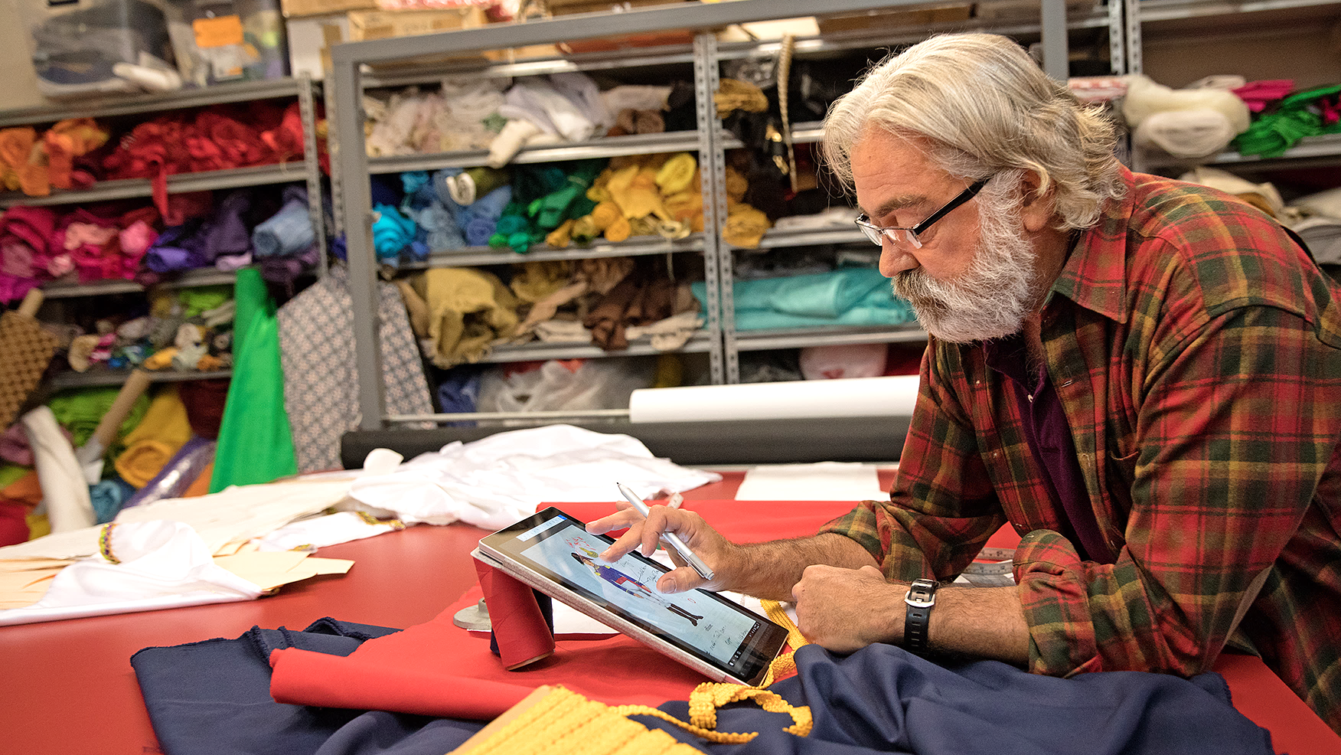
One solution, designed for your business
Achieve more together
Anywhere it matters
Always-on security
Simplified for business
Notes:
Working with Microsoft, we are here to create a better way for you to bridge the gap between productivity software, IT management, and devices with an integrated solution that’s just right for a business like yours.
There are four things I hope you to take away from this presentation:
#1 With Microsoft 365 Business you and your employees can work together more effectively with people both inside and outside your company so you improve the productivity of your team.
#2 You get a solution that allows you and your people to be productive anywhere it matters and across device platforms.
#3 It will help ensure you’ve got always-on security—to protect your business.
#4 and you are going to get all of that simply, without burdening you with IT worries.
Transition: Now, let’s see Microsoft 365 Business in action!

Slide 12
Demo

Slide 13
Thank you

Slide 14
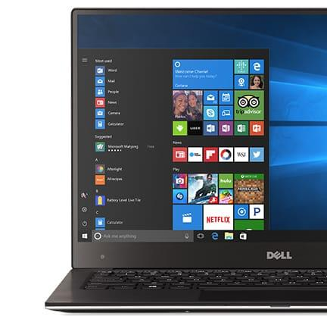
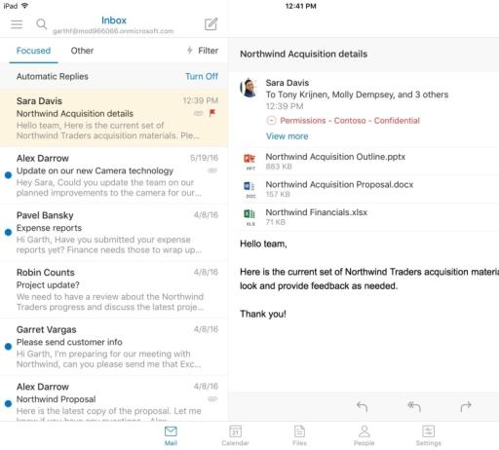
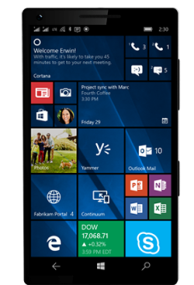
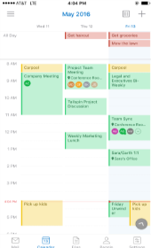
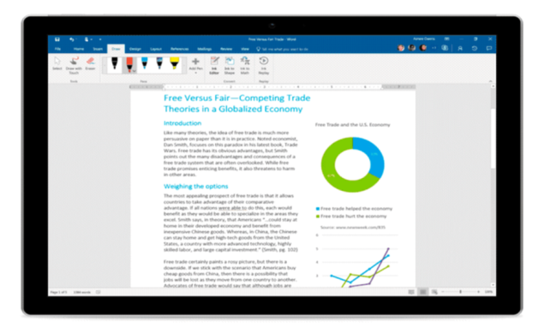
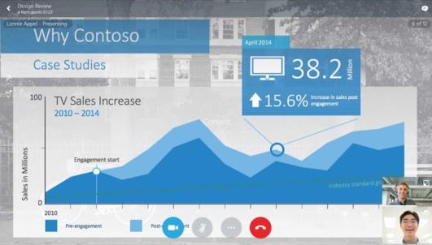
Email, schedule, meet, and chat
Stay connected and in sync with co-workers and customers wherever you are via email, phone, online meetings, and IM.
Get professional looking email powered by Microsoft Exchange to facilitate collaboration to keep you in sync with your customers and coworkers, 24/7.
Add audio/video conferencing to a new or existing meeting with just one click using Outlook with Skype for Business integration.
Use Office 365 Groups to give your teammates access to a shared inbox, calendar, file repository, and notebook.

Slide 15
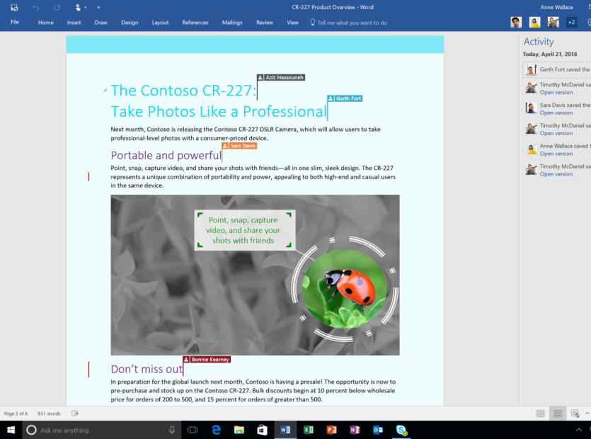
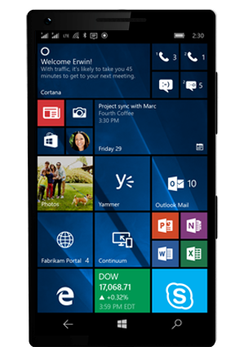
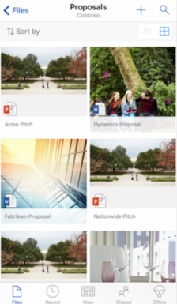
Create and collaborate
Create, share, and co-author Word documents, Excel spreadsheets, and PowerPoint presentations with coworkers.
Get access to the latest version of your documents from your favorite devices, anywhere you have an internet connection. OneDrive for Business enables online and offline access and automatic syncing of files to reflect the most recent edits.
SharePoint is an easy drag and drop intranet for documents and files.

Slide 16
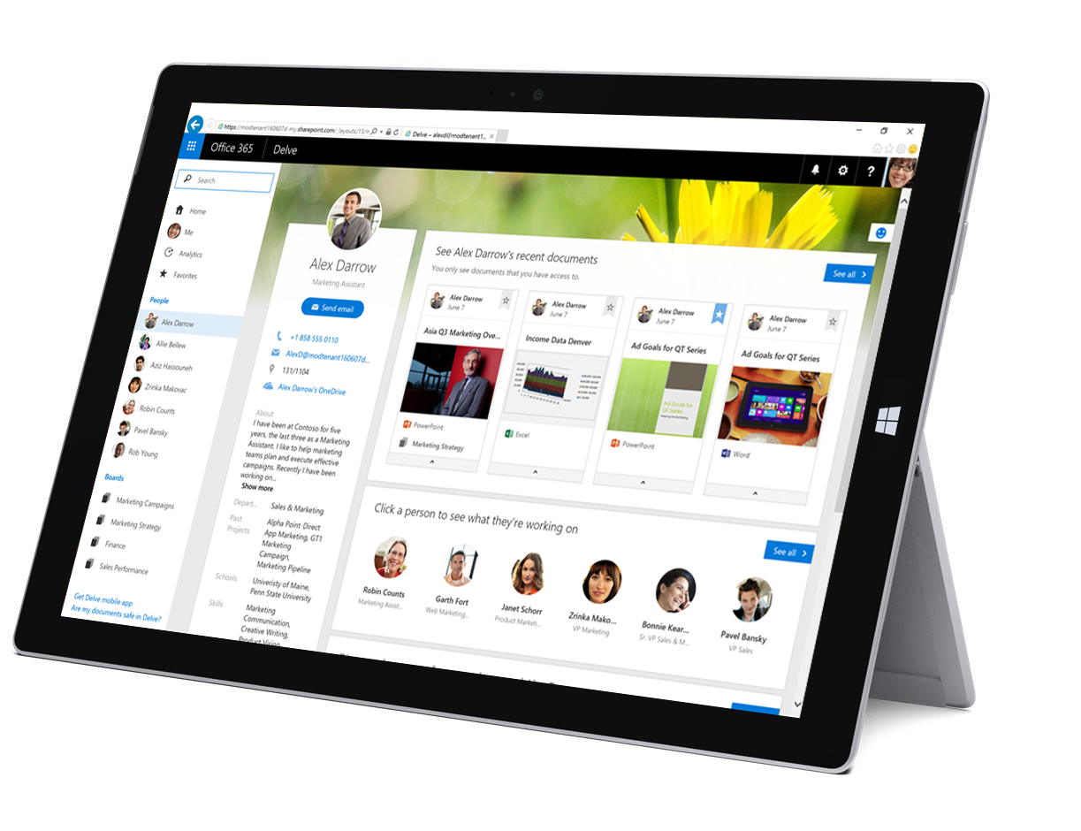
Stay a step ahead
Let personal digital assistant Cortana make life easier by helping you handle crucial tasks and get things done.
Feel confident you are helping your teams be as efficient and effective as possible with Delve, the Office 365 app that enables your co-workers to find the latest files that were shared with them within your organization.

Slide 17
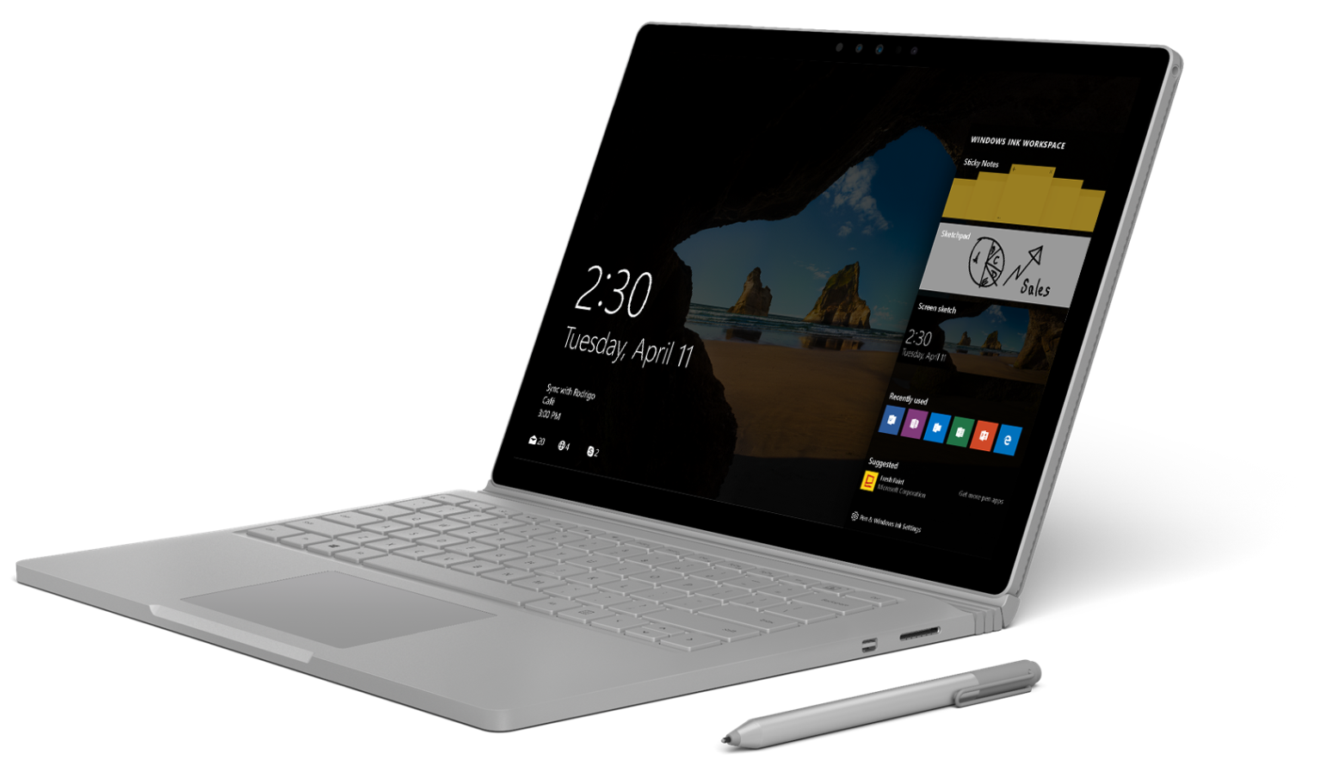
Turn thoughts into action
Interact with devices in new ways – choose from voice, digital pen, touch, gesture, Windows Ink, or Microsoft Edge to turn thoughts into actions in the way that feels and works best for you.
Start fast, stay focused and finish first with new tools to keep you productive such as Start Menu, Live Tiles, Virtual Desktop, Snap Assist, Tablet Mode.

Slide 18
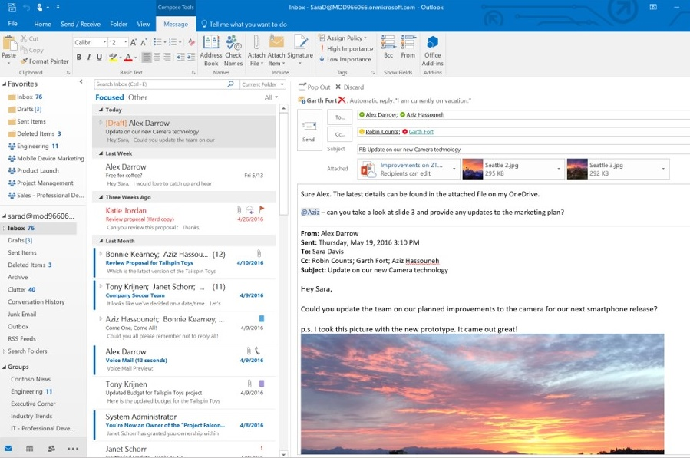
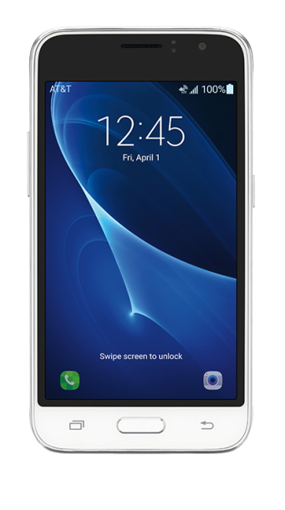
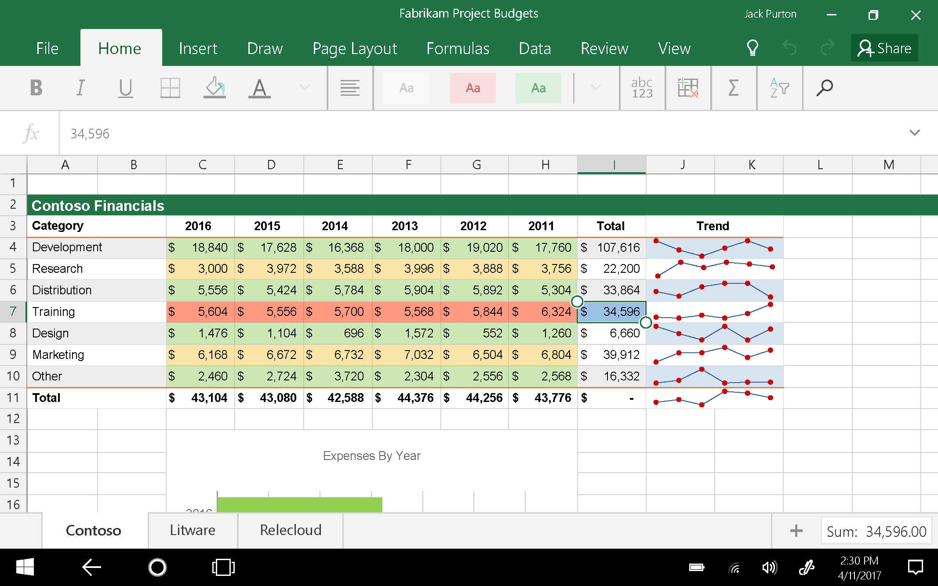
Stay productive on the go
Use the best-in-class productivity tools so you can work across all of your favorite devices (including Windows, Mac, iOS, and Android).
Use OneDrive for Business to create, access, and edit your documents whenever you need them.

Slide 19
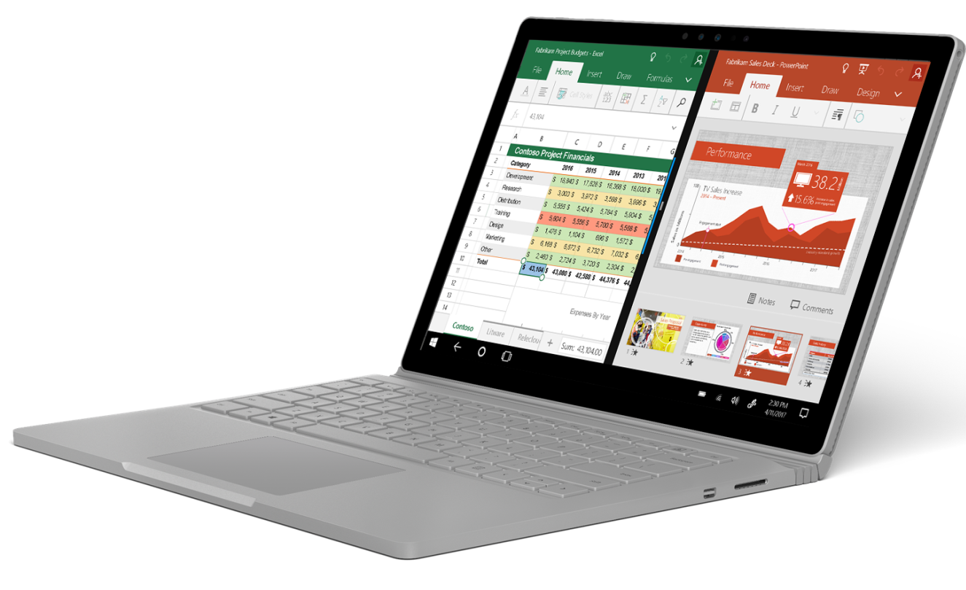
Sync files automatically and work offline
Use familiar tools you know and love, including Word, PowerPoint, and Excel.
Create, share, and edit Word, Excel, PowerPoint documents any time, anywhere.
Access and edit documents offline; when you're back online updated files sync automatically. Pick up where you left off on your document when switching devices.

Slide 20
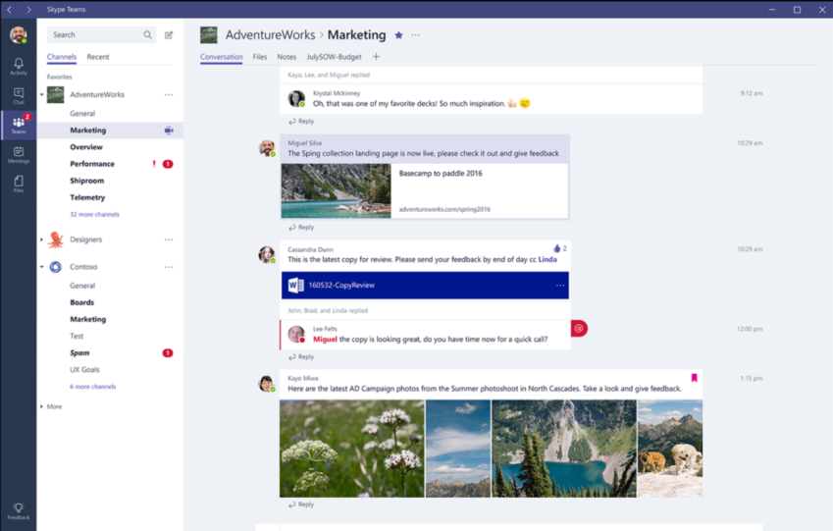
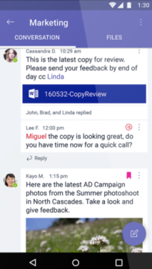
Work together anywhere
Access your emails, contacts, and calendars across your devices even when offline with Outlook to help you stay connected to customers or coworkers.
Connect with customers and coworkers using Skype for Business to instant message to answer quick questions, or host or join an online call or video meeting from your favorite device. Easily present, share and collaborate on documents (or a virtual whiteboard) within the meeting space.
Outlook Groups and Microsoft Teams are also available any time you’re online to help you and your teams work together collaboratively wherever, whenever.

Slide 21
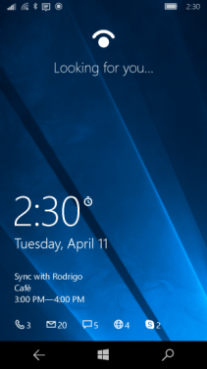
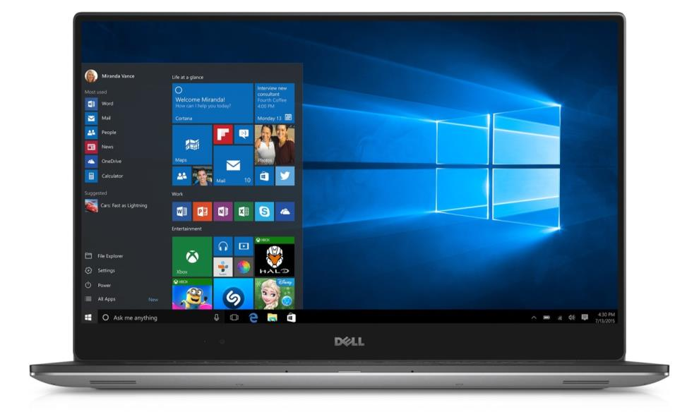
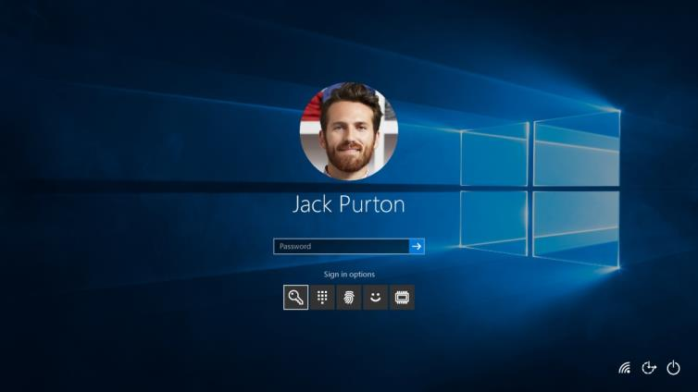
Security that travels with you
Protect your data and devices against malware, malicious attacks, and device loss or theft. BitLocker, BitLocker to Go, and Windows Information Protection help protect business data on mobile devices by ensuring all business data is encrypted and accessible only by authorized users.
Further protect Windows 10 devices from unauthorized access using Windows Hello multi-factor authentication to strengthen your users’ device credentials.
Perform a remote Selective Wipe of company data easily on lost or stolen devices.

Slide 22
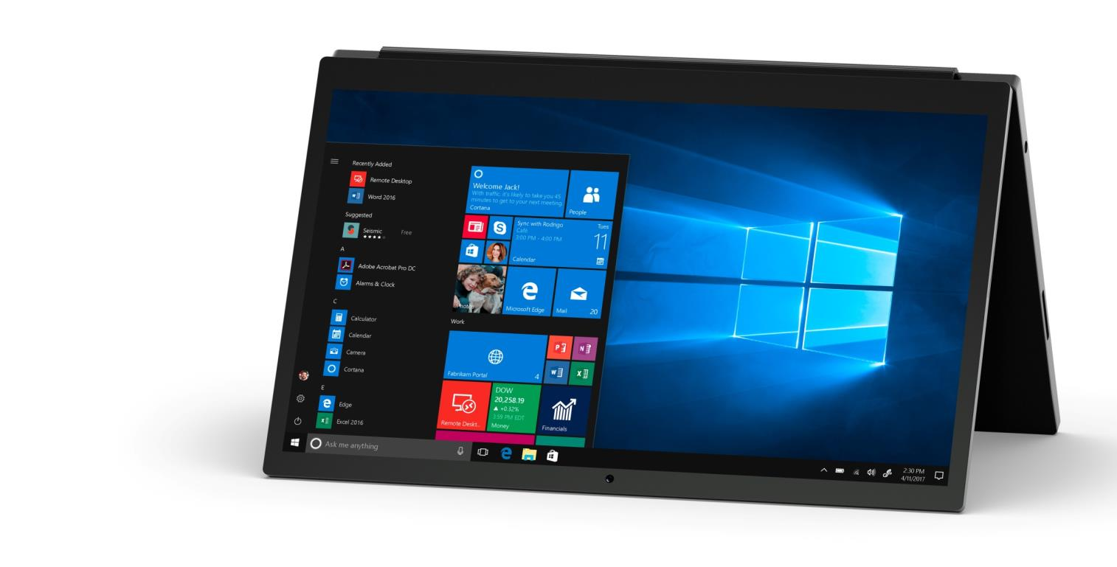
Reduce your security risk
Centralize control of your company data on personal devices.
Reduce your risk profile with security features for SMB customers.
Apply a consistent security configuration profile, across managed devices.
Establish a baseline of security policies across managed devices.
Configure devices consistently to help ensure that your data and devices are protected from malware and external threats.

Slide 23
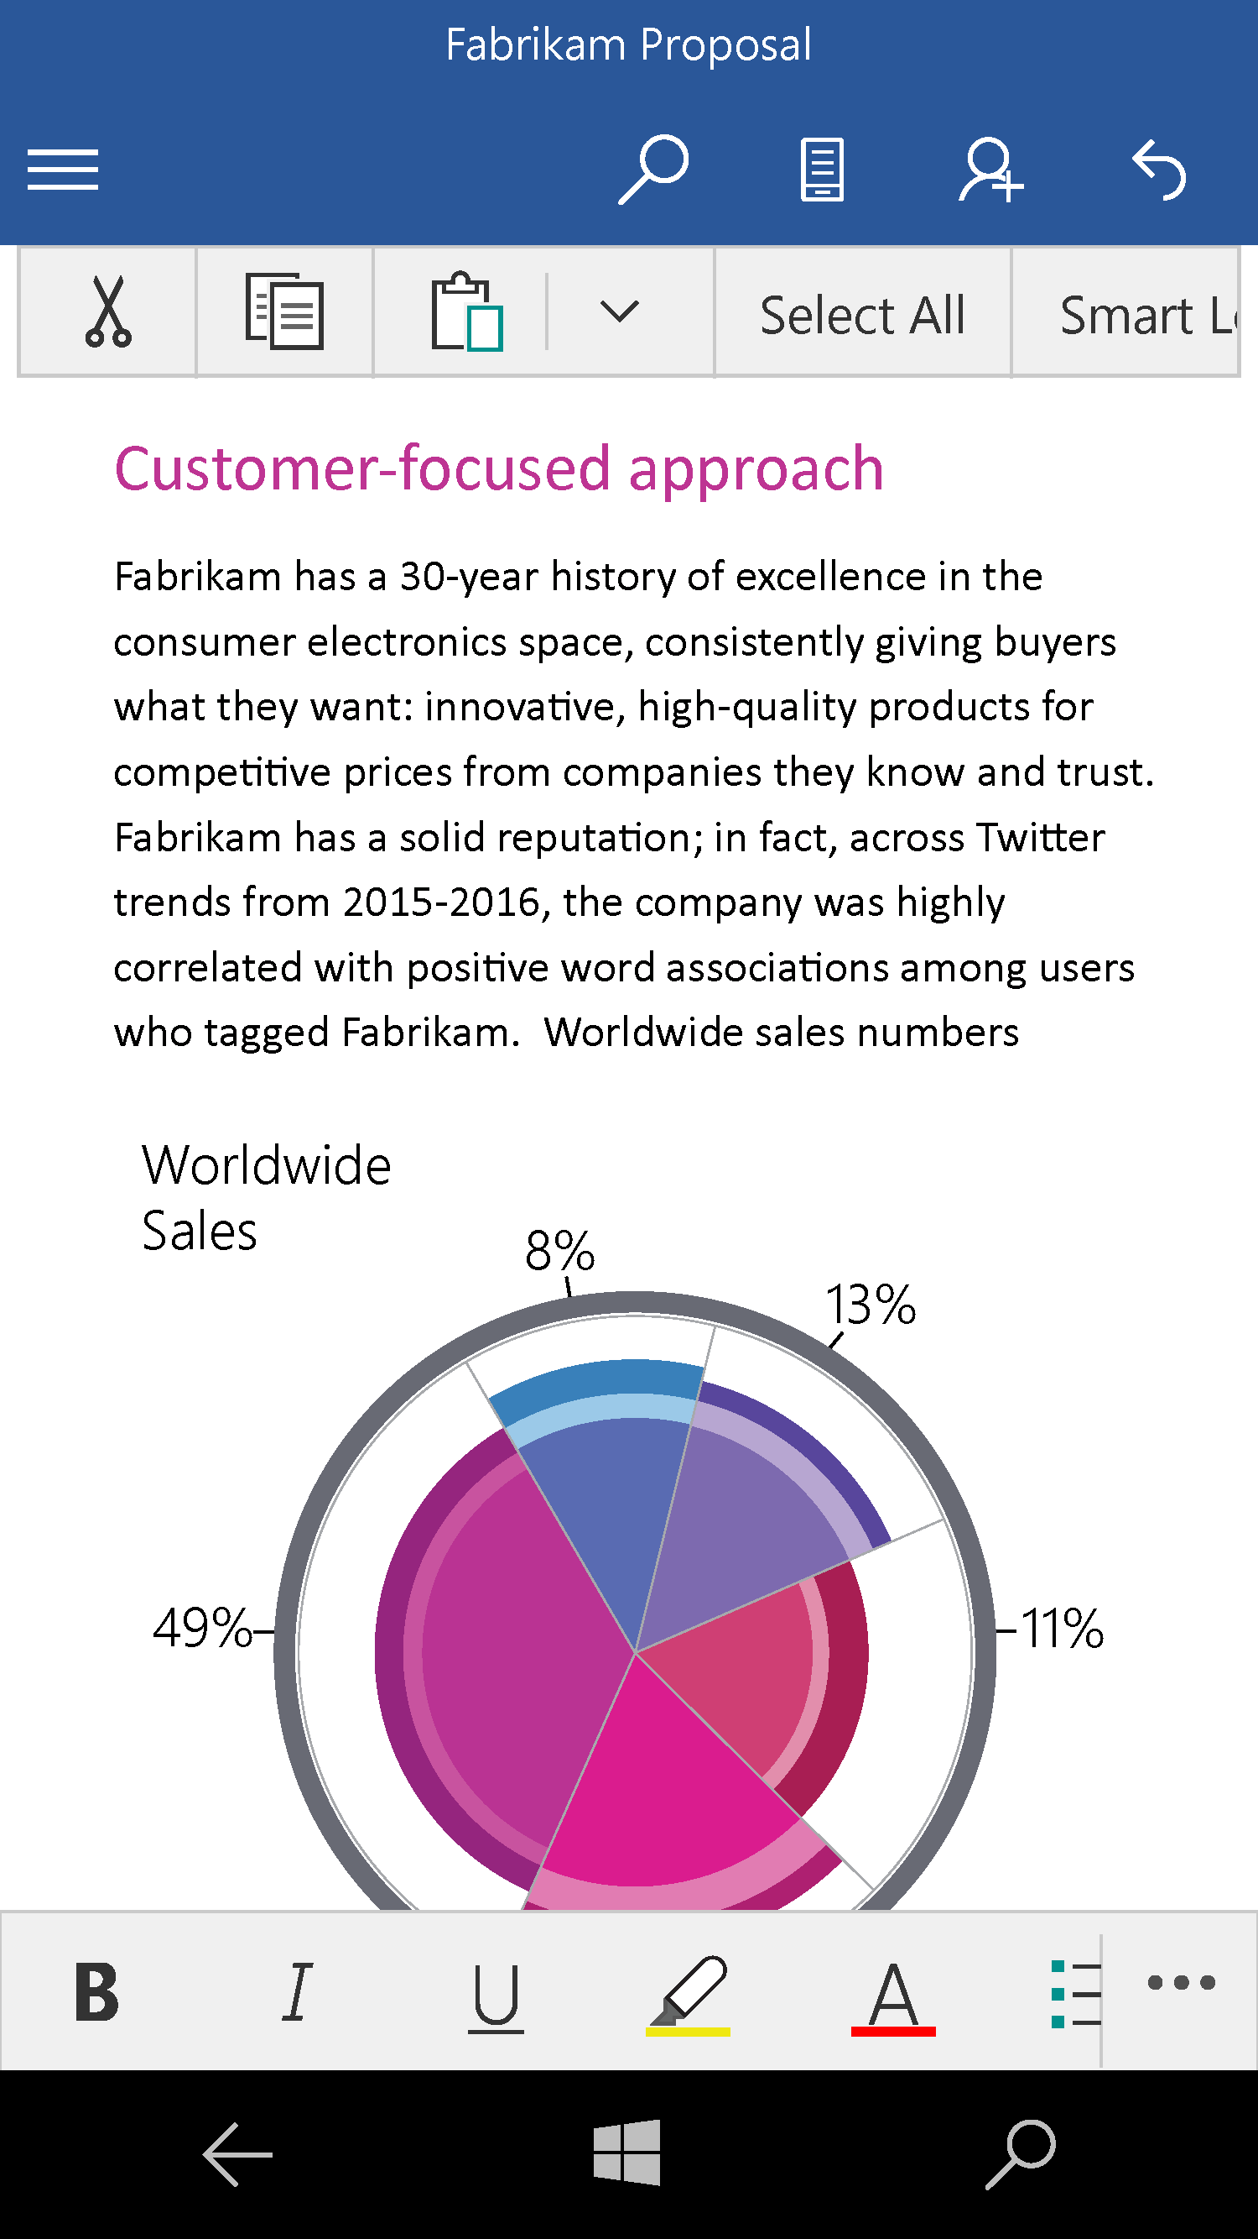
Help protect your devices, data, and people
Know that lost or stolen devices are protected with Windows 10 built-in encryption capabilities like BitLocker and BitLocker to Go.
Help prevent accidental data leaks by securely separating business information from personal information with Windows Information Protection, and perform a remote Selective Wipe of business data on demand while leaving personal data untouched.
Make sure employees always have access to files while confining company information to Office apps, using App Protection for Office mobile apps capabilities for personal iOS, and Android devices.
Make accessing Windows 10 devices more convenient, simple, and secure by using Windows Hello biometric authentication2 to unlock devices with a look or a touch.
Help make sure that devices boot securely and that only trusted software can run during start-up with Windows Trusted Boot used in combination with the PC industry hardware standard, UEFI Secure Boot.
Enforce Windows Defender to always be on from within the admin console.

Slide 24
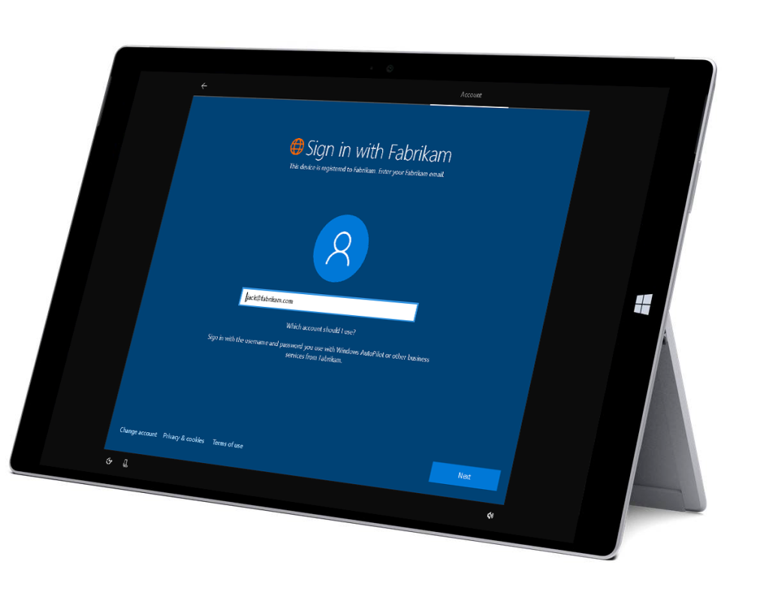
Get up and running fast
Save time by easily configuring security features and settings on Windows 10 devices with Mobile Device Management, fully automating your Windows installation with Windows AutoPilot, and enabling or disabling Windows Store or Cortana on company-owned devices with Enhanced Manageability.
Reduce hardware costs and simplify management by running multiple operating systems on one Windows device as virtual machines (VMs) with Client Hyper-V.
Deploying and managing Microsoft 365 Business is straightforward – advanced IT expertise is required to set up new devices with all the Office apps your employees need. You can add and remove users in minutes, and call if you need support.

Slide 25
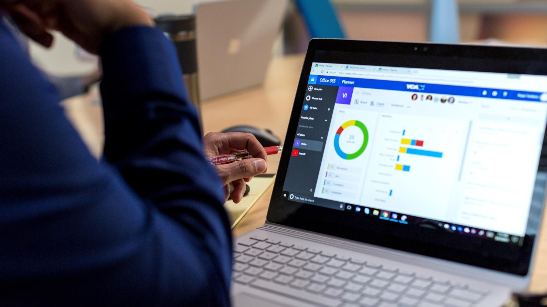
Stay up to date
Keep devices up to date with the latest security updates and feature innovations, at a pace that is right for you, with Windows Update for Business. Ensure minimal disruptions for specialized, mission-critical business devices with Deferred Updates.
Avoid time consuming wipe and reload processes and get users and devices up and running quickly with seamless upgrades from Windows 7 or 8/8.1 Professional to Windows 10 Pro.
As a cloud-based solution, Office 365 is consistently, automatically updated with new features and capabilities to ensure you’re always working with the latest, best-in-class productivity tools.

