Slide 1

Running and Managing Linux in Azure
Anurag Gupta
Program Manager

Slide 2
Key Takeaways
Azure provides a competitive offering for running Linux and Open source workloads
Operations Management Suite (OMS) provides powerful Linux management capabilities
Linux and Open Source is a real business opportunity for Microsoft and you

Slide 3
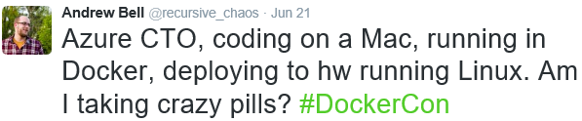
Microsoft + Linux story
1 in 3 VMs in Azure are Linux
2016
Linux Mgmt. with OMS
Linux VMs Day 1 on Azure
SQL Server on Linux
+
Docker Containers in Azure
RHEL on Azure
2009
Linux on Hyper-V
System Center UNIX/Linux

Slide 4
Running Linux Workloads in Azure

Slide 5





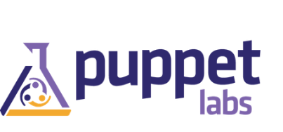

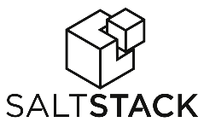

































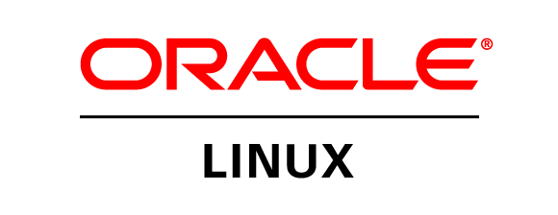


Azure is an open cloud
Public Cloud
DevOps
Clients
Management
Applications
PaaS &
DevOps
App Frameworks
& Tools
Databases &
Middleware
Infrastructure

Slide 6

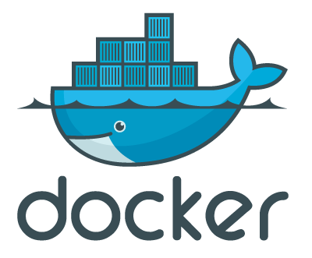
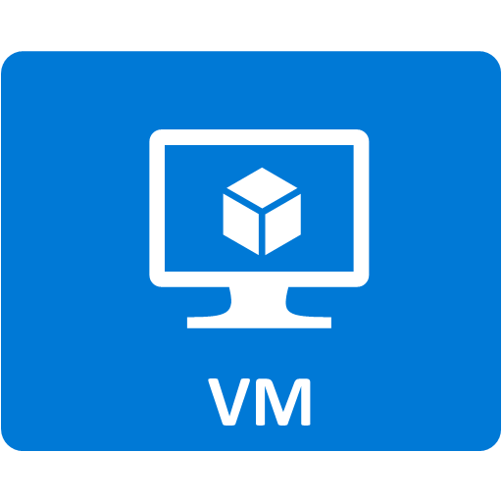







Linux images in Azure
Public Cloud
Azure
Marketplace
Docker Hub
Integration
Endorsed +
Partner stacks +
Community
Discrete containers
Supporting your developers’ needs
Custom
VHD
Pre-existing images
Purpose built
KVM
VMWare
Hyper-V
Packer + Azure CLI

Slide 7







Linux images in the Azure Marketplace
Public Cloud
Azure Endorsed Linux Distributions
  Published, maintained and supported by partners, curated & tested by Microsoft
  Most endorsed distros maintain repos in each Azure region for fast updating
  Standard Images
      Customers can contact Linux vendor/partner for Linux support
      Azure-related platform issues supported by Microsoft
      Limited support for Linux issues -- from Microsoft
  Premium Images
      Microsoft engages the Linux vendor/partner on behalf of the customer for support
      Includes updates, patches, and support through 24x7 web, email, chat and phone
      Available for Red Hat Enterprise Linux and SUSE Linux Enterprise Server
Red Hat
Enterprise Linux
CoreOS
Ubuntu
OpenLogic
CentOS-based
SUSE Linux
Enterprise
Server
openSUSE
Oracle
Linux

Slide 8

Azure PaaS: services running on Linux
Public Cloud
Historically, Azure services have run on Windows
App Service, HDInsight,
Machine Learning,
Batch, Azure AD,
DocDB, SQL Azure,
etc.
Now Azure is offering some services on Linux
  Standard Ubuntu Linux images used in Azure datacenters
  Configured to meet Azure security, and compliance requirements
  Internal Azure operational tools now handle Windows and Linux
Monitor
Diagnose
Patch
Audit
Azure Operations
Linux

Slide 9
Big compute and HPC
Public Cloud
More broadly accessible, radically
easier, and more cost-effective
  Enterprise ready infrastructure
  Choice of VM’s—commodity to high-performance
  IaaS and PaaS, Windows and Linux
  On-premises, hybrid, and cloud-only
  Choice of job scheduler: grid engine, LSF, PBS, etc.
  Azure Batch provides job scheduling as-a-service
Media transcoding
Rendering
Image analysis and processing
Builds
Test execution
Fluid dynamics
Monte Carlo simulations
Engineering stress analysis
SLES 12 and CentOS 7 images
with Infiniband
RDMA driver available
now!
Small orgs with no
on-premises servers
100,000’s of VM’s:
Do things not previously possible
Managed
Scale
Elastic
Pay for use
Existing scenarios
New possibilities

Slide 10

Azure Container Service
Public Cloud
Get a cluster of VMs pre-configured to run containers
  Containers are in Docker container format
  GA now for Linux containers, running on Ubuntu Linux VMs
  Private preview for Windows containers, running on Windows VMs
Scale/orchestrate using Mesos DC/OS or Docker Swarm
Exposes standard API endpoints
  Use your favorite popular open source tooling
  Full portability to migrate containers to and from Azure

Slide 11
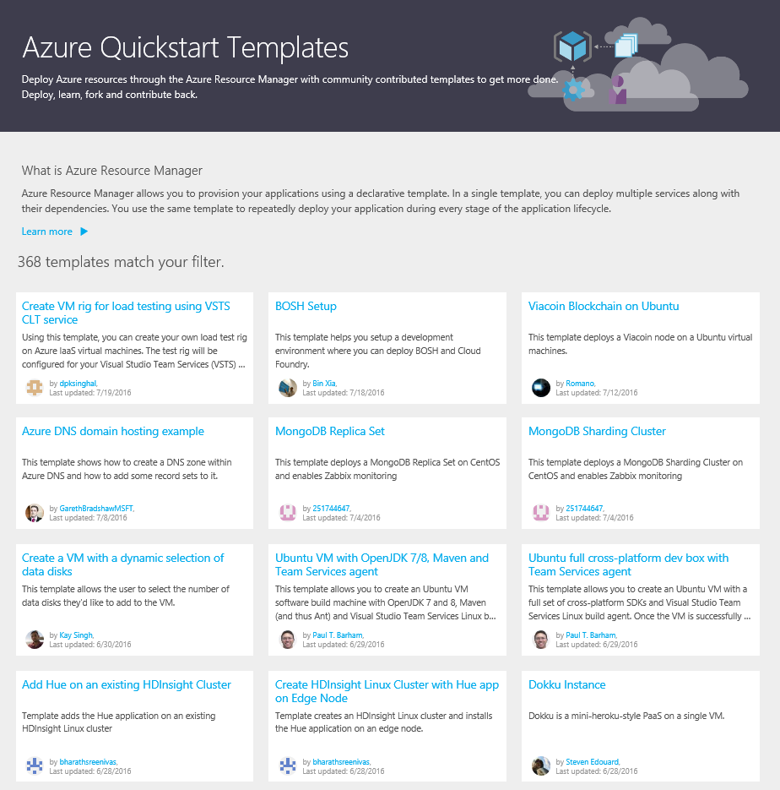
Azure Resource Manager
Fast, replicable deployments to your Azure account
Multi-entity Linux-based solutions including data clusters and more
Over 350 (and growing) templates available on GitHub

Slide 12
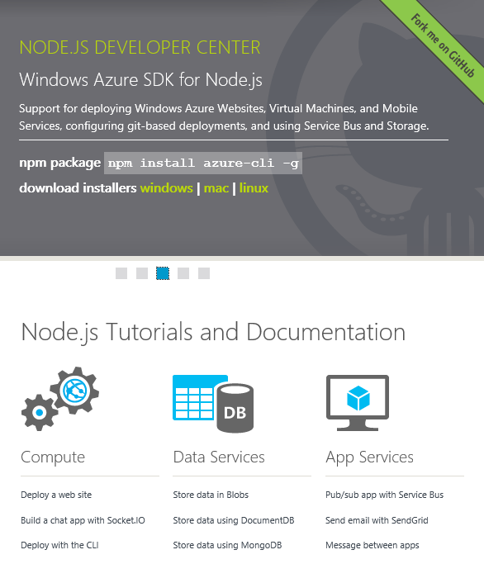
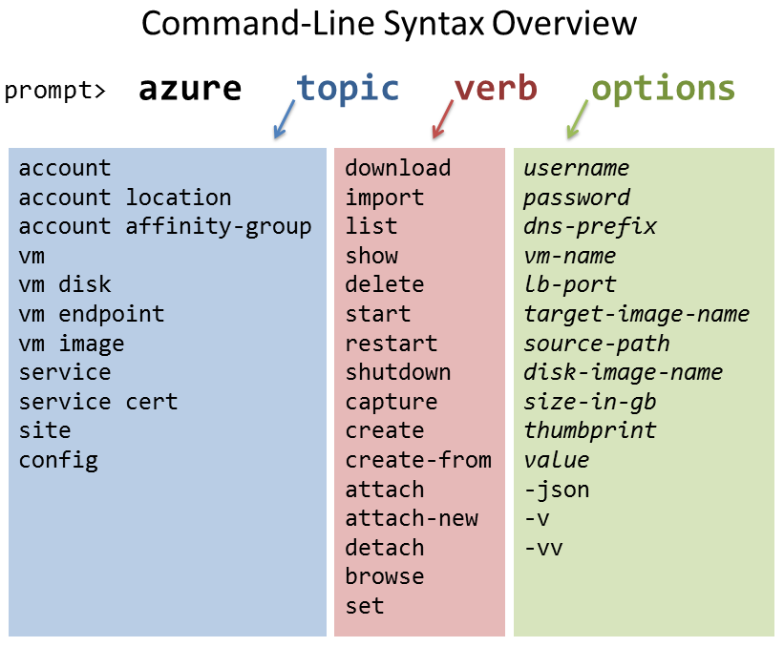
Azure SDK and Scripting
Public Cloud
  node.js-based Azure CLI
  Automate Azure activities from your
  Windows, Linux, or Mac OS X computer

Slide 13
Azure Demo

Slide 14
Managing Linux in Azure

Slide 15
Why is Linux Management important to us?
% of SC customers with Linux
Top Customer Challenges
1
Too many tools
2
Separate teams for Linux
3
Lack of Linux monitoring in Azure

Slide 16
Operations Management Suite
Log analytics
Automation
Availability
Security
Gain visibility across your hybrid enterprise cloud
Orchestrate complex and repetitive operations
Increase data protection and application availability
Help secure your workloads, servers, and users

Slide 17
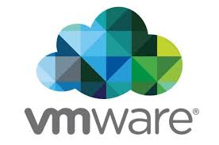







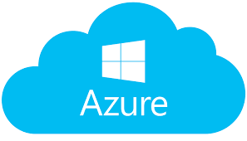
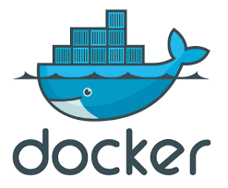


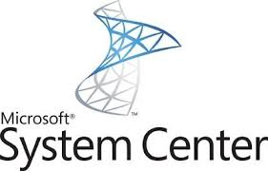




Our Approach with OSS
Integrations/Collectors
OMS Service
Real-time search
Patching
Linux Solutions
Community Gallery
Configuration
Change Tracking
Monitoring
App Solutions
Security
Audit
Data Protection
Dashboards
Solution Platform

Slide 18





Supported Linux distributions
6.x 32/64-bit
7.x 32/64-bit
8.x 32/64-bit
5.x 32/64-bit
6.x 32/64-bit
7.x 64-bit
5.x 32/64-bit
6.x 32/64-bit
7.x 64-bit
2013.09 – 2015.09
12.x 32/64-bit
14.x 32/64-bit
15.x 32/64-bit
16.x 32/64-bit
alpha
beta
stable
10.x 32/64-bit
11.x 32/64-bit
12.x 64-bit
5.x 32/64-bit
6.x 32/64-bit
7.x 64-bit
Notes:
18

Slide 19
Capabilities available today
Platform Investments
Syslog + Metrics
Nagios + Zabbix + SCOM
Azure Linux IaaS Extension
Extensibility
Custom Logs and Data
LogStash + FluentD
Kafka
Solutions
Security & Audit
Patching Insights
Firewall Security Events
HDInsights

Slide 20
Sign-Up for Free Trial @ Microsoft.com/OMS

Slide 21
Demo

