Slide 1
What is New in
Office
Thomas Kjer

Slide 2


Office 2019
Release
October 2nd

Slide 3
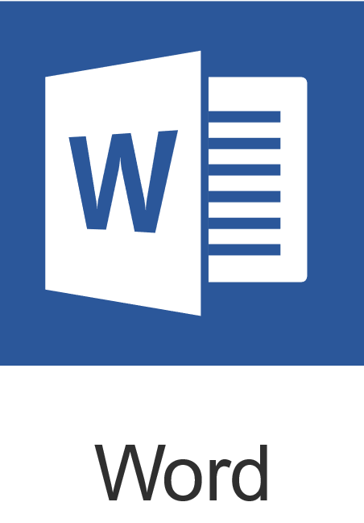
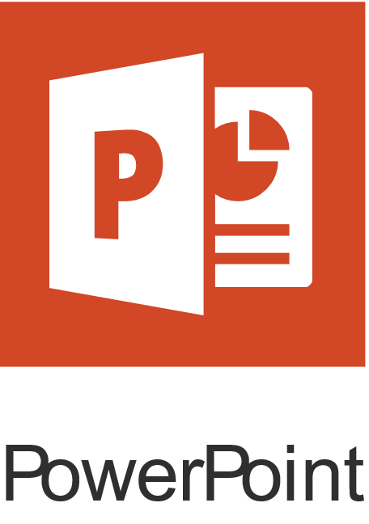
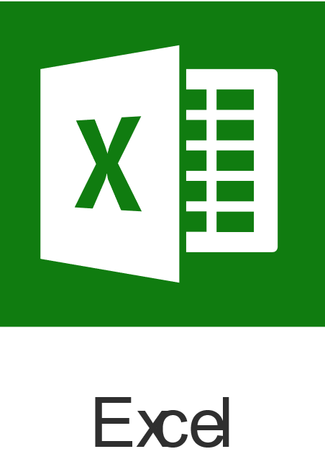
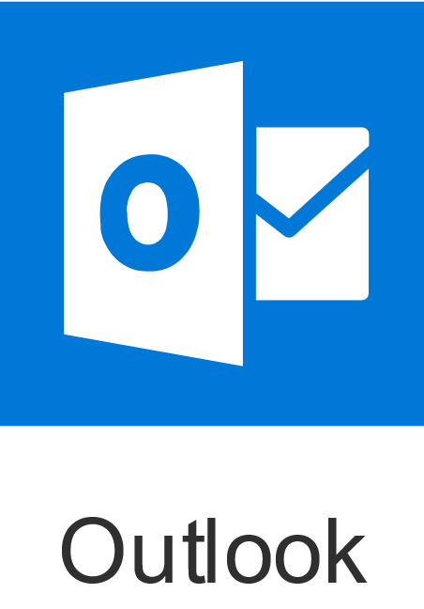
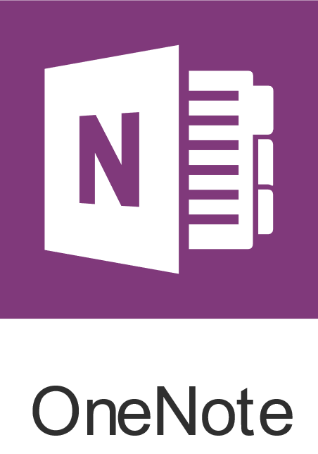
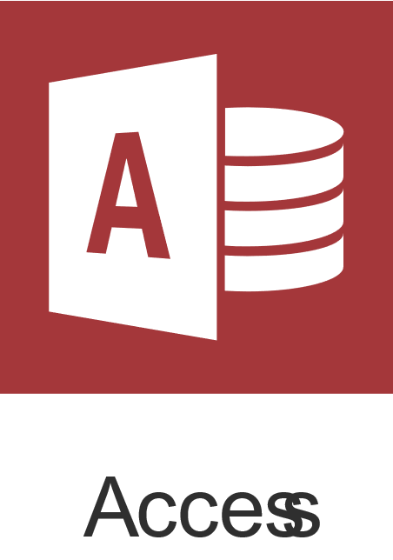

What’s included
  Office Apps
Get the classic Office apps on one PC or Mac
Office Professional 2019 includes Access and Publisher (for PC only)
  Word
  PowerPoint
  Excel
  Outlook
  OneNote
  Access
  Publisher

Slide 4
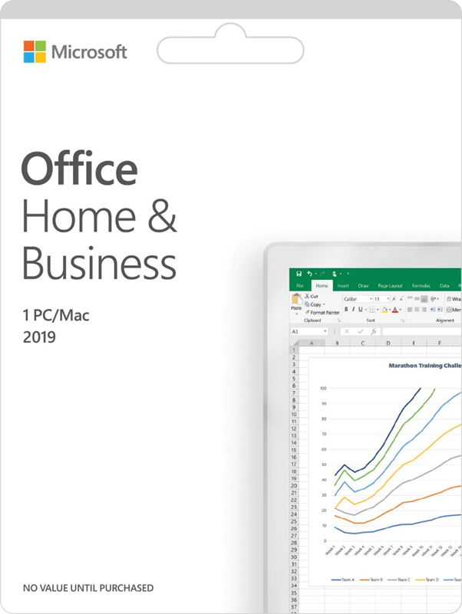
Office 2019
Release includes Home & Student, Home & Business
Collapsing Windows and Mac SKUs
Supported on Windows 10 only
Office 365 will continue to be most feature rich product, most notably cloud powered innovation
Changes from Office 2016 | Office 2019
SKUs | Collapse Win & Mac versions
OneNote | UWP only
Word, Excel, PowerPoint, Outlook | Insert and format SVG
Inking Updates | Ink effects
PowerPoint | Morph & Zoom
Word | Word Translator
Excel | 2D Map & Funnel Charts
Outlook | Focused Inbox & @mentions
Previously limited to Office 365 subscribers, but included in Office 2019 for value prop completeness

Slide 5
Key barriers to upgrade:
Most legacy Office users are happy with their current version or cite expense as an issue.
Reasons for not upgrading to the latest version of Office | Legacy Install Base (n=2,487)
Happy with current version
Too expensive
Will upgrade with new computer purchase
Don’t need Office
Waiting for next version
Don’t want to re-learn new version
Not worth the effort to install
Unsure new version is compatible with files
Computer incapable of running
Incompatible with other people’s files
Other
I believe I already have the latest version of Office
Happy with current version
55%
Too expensive
32%
Q39. Which of the following describes why you have not upgraded the latest version of Office on the personal computer you use most often?
Study: Office 365 Upsell Profiling Offers (June 2016)
Source: Office Legacy Customer Insights – Consumer, November 2017
Note: Office version data is self reported
Notes:
First, let’s evaluate some reasons why customer’s do NOT purchase Office.
The most common reason people give for not purchasing is – they will continue using software they currently own. We’ll address this objection further in a few minutes.
“I’m fine with Office 2013 (or an older version).”
1. Built for teamwork
2. New Chart Types in Word, PowerPoint, and Excel
3. Faster, easier ways to get data into Excel
4. Modern Attachments in Outlook
5. Smart Lookup in Word, PowerPoint, Excel, and Outlook
6. Tell Me in Word, PowerPoint, Excel, Outlook, Project, Visio, and Access

Slide 6
Office 2019
The most important takeaway…
Office 365 is our hero!
Release not launch
  Different from how we treated the launch of Office 2016
Alternative to O365
  Support consumers not ready for a subscription offering
Updates to Office 2019
  There will not be feature parity with Office 365
Notes:
This time around, we are not threating this as a launch. Meaning no major campaigns coming – just quitly swapped to 2019.
It is still a great alternative for those not ready to get onboard cloud storage, subscriptions or CSP solutions.
And even though we have made updates to Office 2019 – you still get more with O365. (which we are going to talk more – right now)

Slide 7

Office 365
Business Premium

Slide 8
Bringing Office 365 to small business owners
The best of Office
  Includes fully installed Office applications across devices plus business-class email, file storage, and tools for modern teamwork.
New apps for business
  Business owners want more time to focus on their passion.
  Office 365 Business Premium includes new apps that help owners run and grow their businesses.
Engineered for reseller sales environments
  Transactional offers need to be as simple for business as they are for home and personal use.
  Previously only available through commercial solution resellers, we have made it easy to get started for customers purchasing Office with a device.
Office 365
Business Premium

Slide 9
Who is it for?
Small businesses between 1 and 24 employees
Small businesses that often doesn’t have a dedicated technical staff
Probably business owner buying
Customer is most likely purchasing a PC or other device
Notes:
Like I said before, we are really focusing on giving options for the small SMB’s in Market.

Slide 10
What’s in Office 365 Business Premium?
  Premium business services and essential business apps
  All the Premium Office apps*
  1 User
  Works on Windows, Mac, iOS and Android**
  Exclusive monthly upgrades and new features included
  * Publisher and Access are for PC Only
  **Applications vary by platform and device. iOS and Android require separate app download.
Notes:
Skype for Business, Exchange, SharePoint,
Microsoft Teams, Yammer
5 phones, 5 tablets and 5 PC/Mac’s

Slide 11



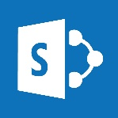

Premium business services
Business class email and calendaring
Exchange
Online conferencing and communications
Skype
File storage and sharing
OneDrive
Intranet and team websites
SharePoint
Project-based collaboration
Teams
And much more
Notes:
Let's take a closer look at the premium business services included with Office 365 Business Premium.
First, there is business class email and calendaring, powered by Exchange Online:
What do we mean by business class?
Exchange is the email service most of the corporate world uses and relies upon.
Exchange allows you to keep not just your email, but also your calendar and contacts remain in sync across all your devices. If you are using gmail, yahoo mail, or email provided by your web hosting provider (POP3 or IMAP), you won’t get all three synced across your devices.
As a business owner, you have tons of control over how your employees use Office 365 email… whether its limiting who emails are sent to, or received from; preventing people from accidentally sending out confidential information, or making sure important emails are kept for safe recording keeping.
Next is online communications and conferencing, powered by Skype for Business
Skype for Business has more features than the personal version of Skype. Along with calling and chatting with other employees, business users can do the following:
Schedule online meetings and conference calls with multiple users (from within Outlook)
View the availability of other Skype for Business users in their company
Share information on screen with meeting attendees
Record meetings and share the recordings with others
There is also file sharing and storage with OneDrive
Just like with the personal version, each user gets 1TB of online storage.
Plus, business owners have a lot more control over how that storage is used with Office 365 Business Premium, they can:
Limit who employees can share files with
Limit what files they can share
Track employees sharing what files and who with
Business customers also get a company intranet (employee-facing website) where they can also quickly create team and project sites with SharePoint Online.
It’s a great way to share company information like policies, procedures, and announcements
Employees can search everything on the site, so information is far easier to locate
Employees can also quickly create internal websites for their teams or special projects
Built-in security and management features mean you have lots of control over how sites are created and information is shared
Also provides company-wide file storage with the ability to share externally
And, they also get project-based collaboration and communications tools like Team.
Chat, schedule meetings, have conversations, share files, and more
Connects to the rest of Office 365 and lots of external services
Along with employees, you can invite customers, partners, or vendors – and they don’t need an Office 365 license to participate
And these are just a few of the many available services. There are more, like Yammer, Planner, etc. Plus you have tons of control over how they are used in your company. Refer to the [Fact sheet] for additional details on all the services included. Point out to customers that with the subscription, they get any new products that are also part of the Business Premium subscription automatically.

Slide 12

Business apps
Lightweight CRM
Outlook Customer Manager
Schedule and appointment management
Bookings
Notes:
Now let’s take a look at the essential business apps. These are the apps, and services, that most small businesses need. In fact, there is a pretty good chance your business customers may already be paying for similar apps (or even some of these) for their business already.
Outlook Customer Manager helps businesses track and grow their customer relationships.
Replaces ….
Let’s you share customer information with the whole team
Keeps all your customer information in one place – emails, calls, meeting notes, tasks, etc.
Bookings helps them simplify how customers schedule and manage appointments.
Replaces ….
Provides an online appointment booking page
Has a private calendar for blocking time
Sends automatic reminders

Slide 13
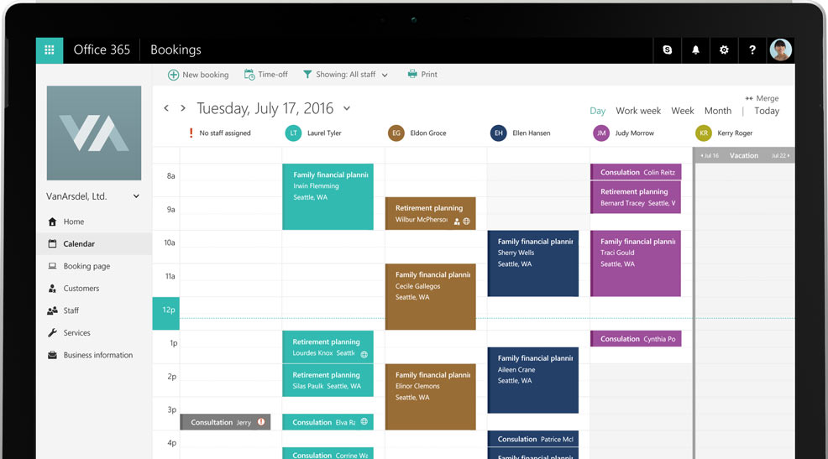
Microsoft Bookings
Manage your customers’ appointments
Microsoft Bookings is an online and mobile app for small businesses who provide services to customers on an appointment basis
Decrease no-shows – Automatic confirmations and reminders to customers and staff
Manage your appointments anywhere – Bookings mobile app gives you control anywhere
Be where your customers are – Connect Bookings to your business’ Facebook Page so your customers can book directly there
Notes:
Online and Mobile App – perfect for SMB
Decrease no-shows
Automatic confirmations and reminders to customers and staff.
Manage your appointments from anywhere
Bookings mobile app gives you control anywhere.
Be where your customers are
Connect Bookings to your business’s Facebook page so your customers can book from there

Slide 14
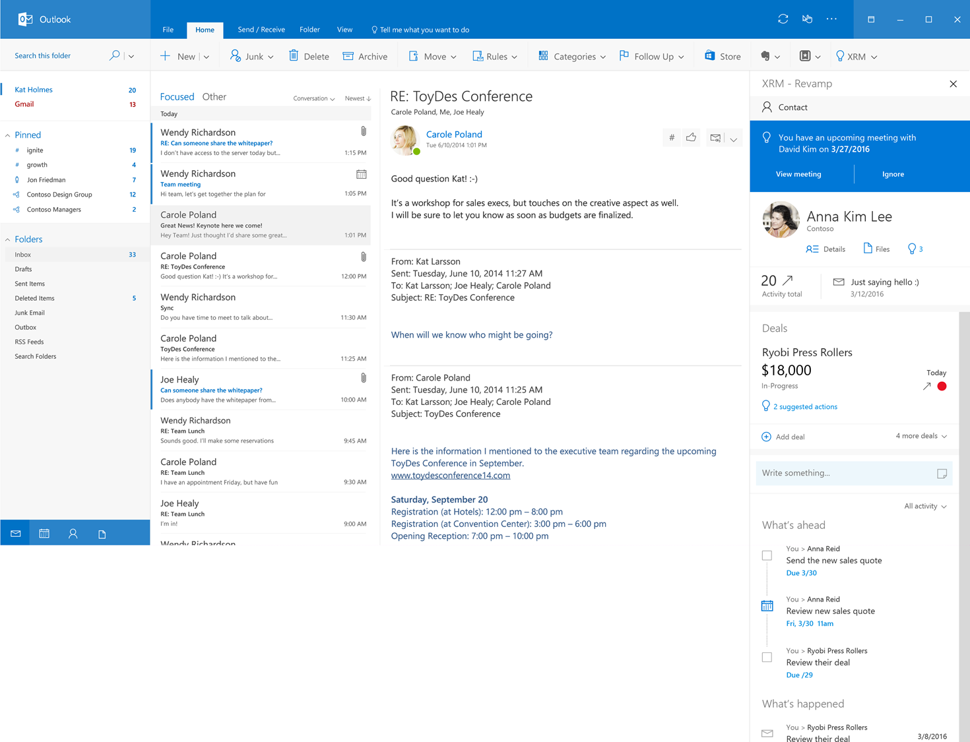
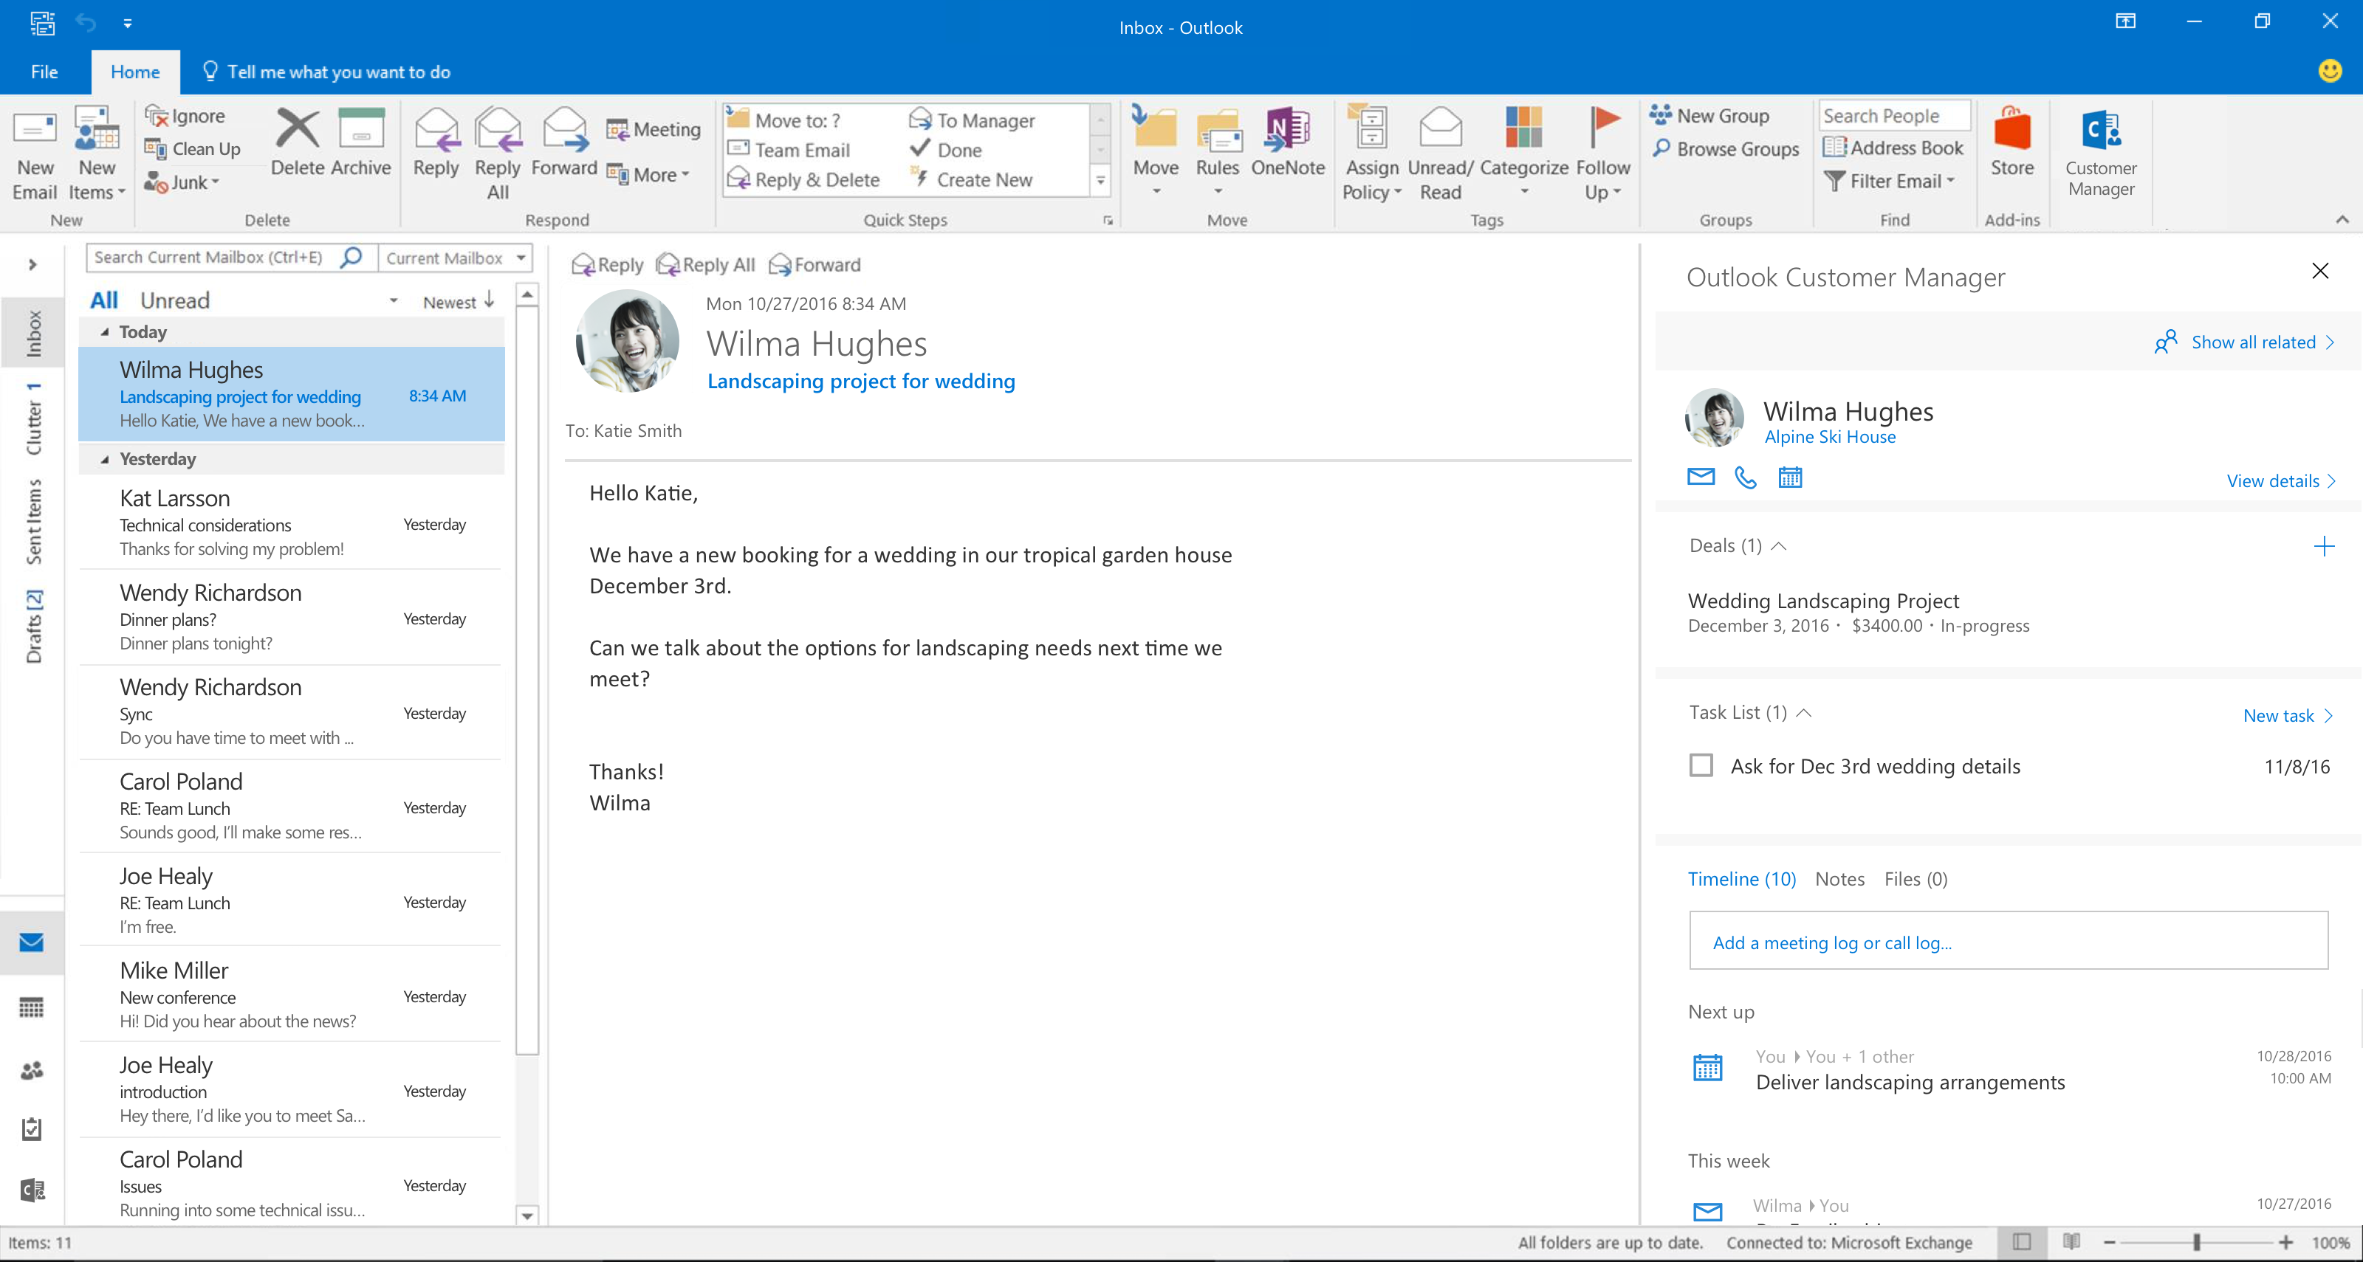

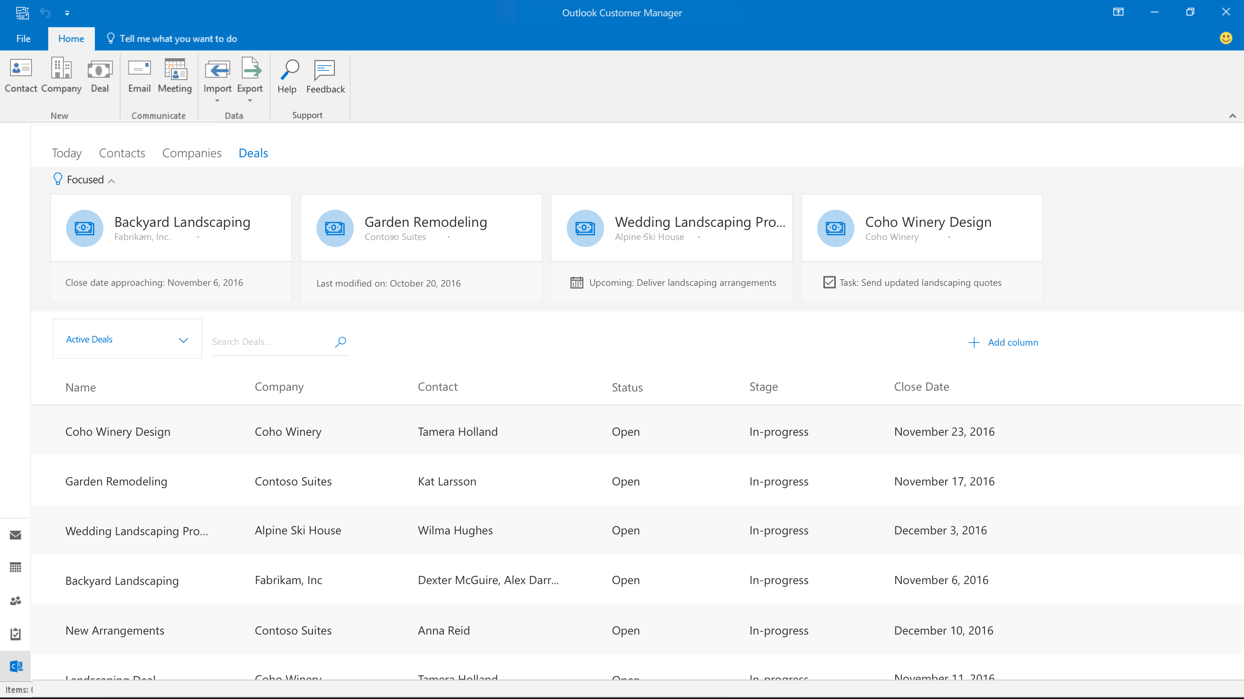
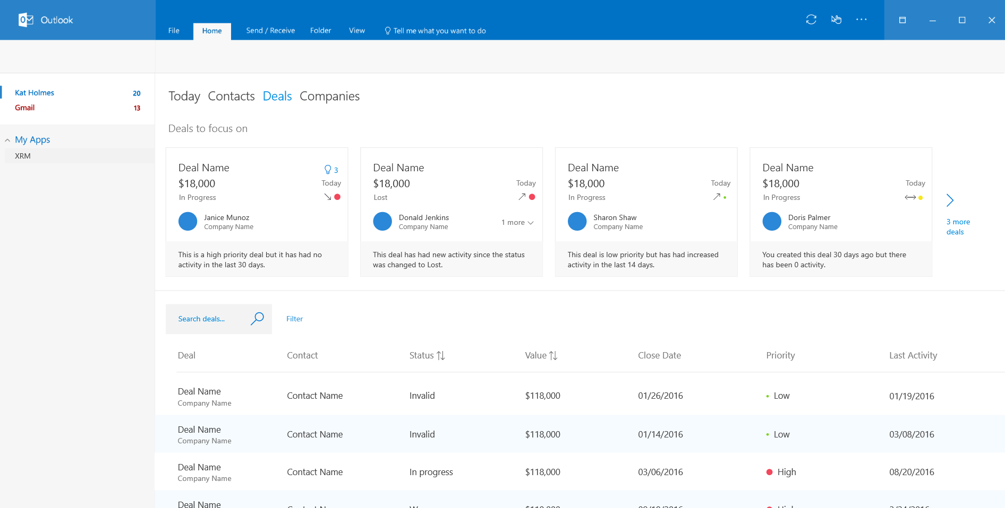
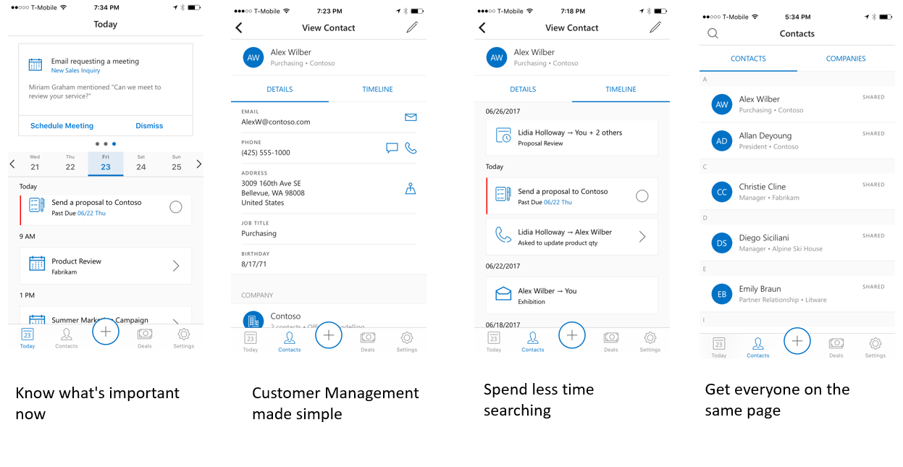
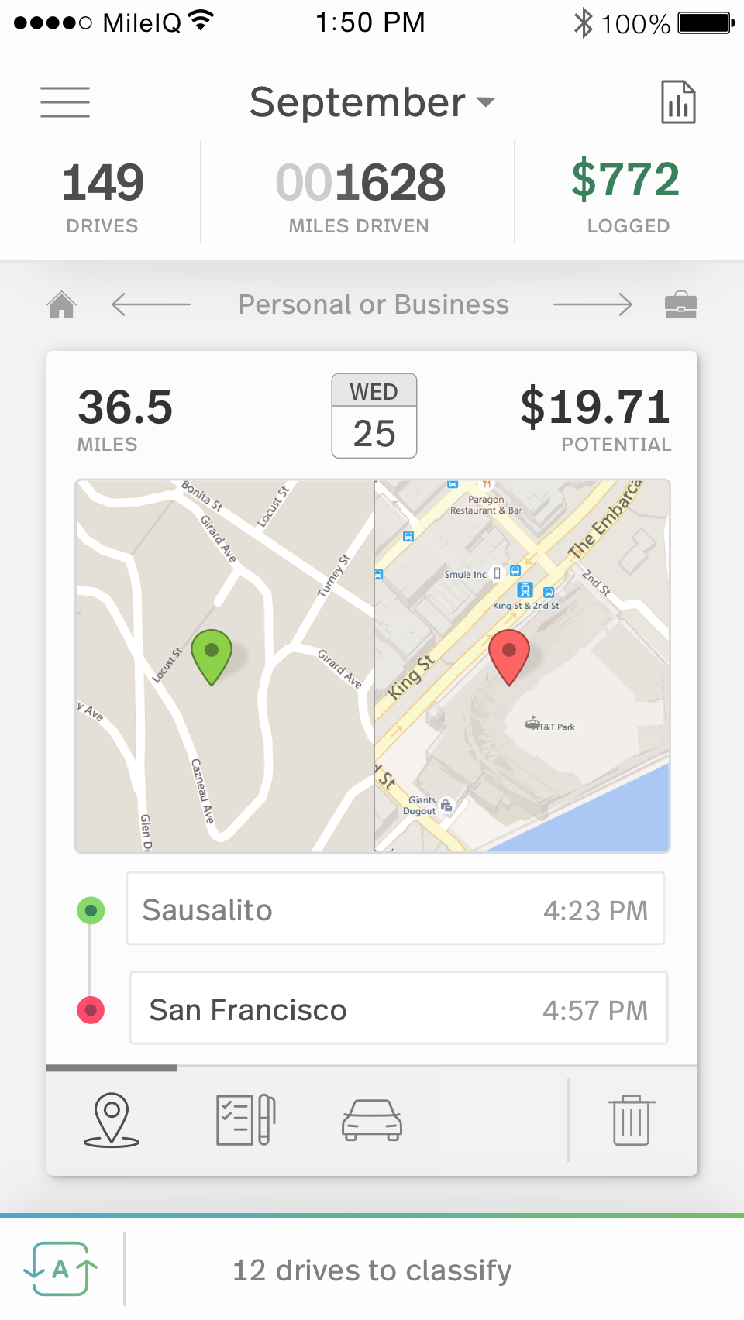
Outlook Customer Manager
Track and grow customer relationships right within Outlook
Outlook Customer Manager provides small businesses the tools they need to track & grow customer relationships
Customer management automatically organized in your inbox
Notifications to stay on top of what’s important
Easy sharing with Team members
Access it all on the go
Notes:
Customer management is automatically organized in your inbox.
Stay on top of what’s important with timely reminders.
Get team members on the same page with easy sharing.
Access it all on the go.

Slide 15
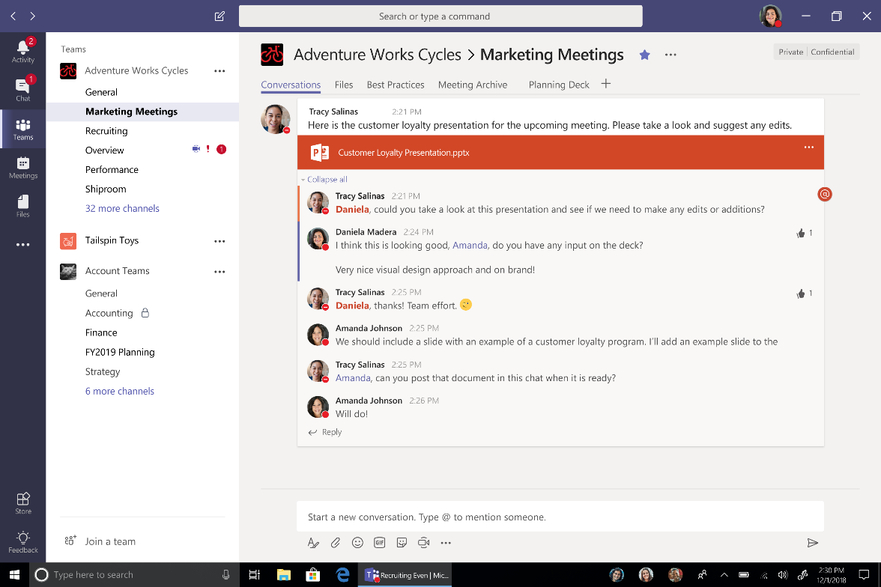
Microsoft Teams
The hub for teamwork in Office 365
Chat for today’s teams
Threaded, persistent, and contextual chat
Private chats for 1:1 or group conversations
Share information in an open and transparent way
Communicate across geographies
Conversations, files and tools in a team workspace
Share and co-author Office and other files
SharePoint, OneNote, and Planner
Integration Search across people, files, and chats
Notes:
Share information in an open and transparent way.
Communicate across geographies.
Conversations, files, and tools are kept in a team workspace.
Share and co-author Office files and other files in the app.
SharePoint, OneNote, and Planner integration.
Search across people, files, and chats.

Slide 16
Microsoft Teams
The hub for teamwork in Office 365
Chat for today’s teams
Threaded, persistent and contextual chat
Private chats for 1:1 or group conversations
Share information in an open and transparent way
Communicate across geographies
Conversations, files and tools in a team workspace
Share, and co-author Office and other files
SharePoint, OneNote, and Planner
Integration Search across people, files and chats

Slide 17
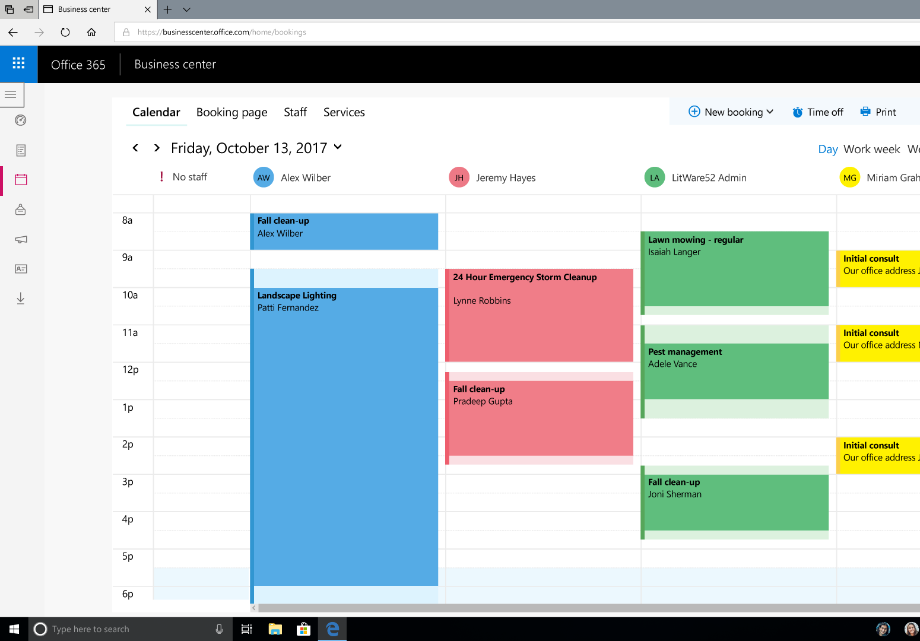
Microsoft Bookings
Simplify how customers schedule
and manage appointments
Delight customers: Your customers will love the flexibility, convenience, and control they get with Bookings. They can visit your booking page whenever they want, book the time and service they need, get a confirmation email and calendar invitation, and reschedule or cancel if they must. For customers who prefer to book by calling you, simply enter their appointment details and Bookings sends all confirmations and reminders.
Save time: Bookings gives you a fast, easy alternative to time-consuming, frustrating phone-scheduling. An easy-to-set-up, customizable webpage lets your customers find available times and book appointments 24/7. You get a private calendar for managing your schedule and automatic confirmations and reminders that save time.
Decrease no-shows: Missed appointments are bad for business. Decrease your no-shows with automatic reminders for customers and staff. Appointments appear on staff calendars as soon as they’re made and are updated automatically. Customers can add your appointments to their personal calendars and reschedule or cancel them with just a few clicks. So everyone knows where they need to be, and when.
Manage appointments anywhere: With the Bookings mobile app, you have full access to your customer, staff, and calendar info where and when you need it. Use the app to email, call, or text customers or create a new appointment with a few taps. Be where your customers are – connect Bookings to your business’ Facebook Page so your customers can book directly there

Slide 18
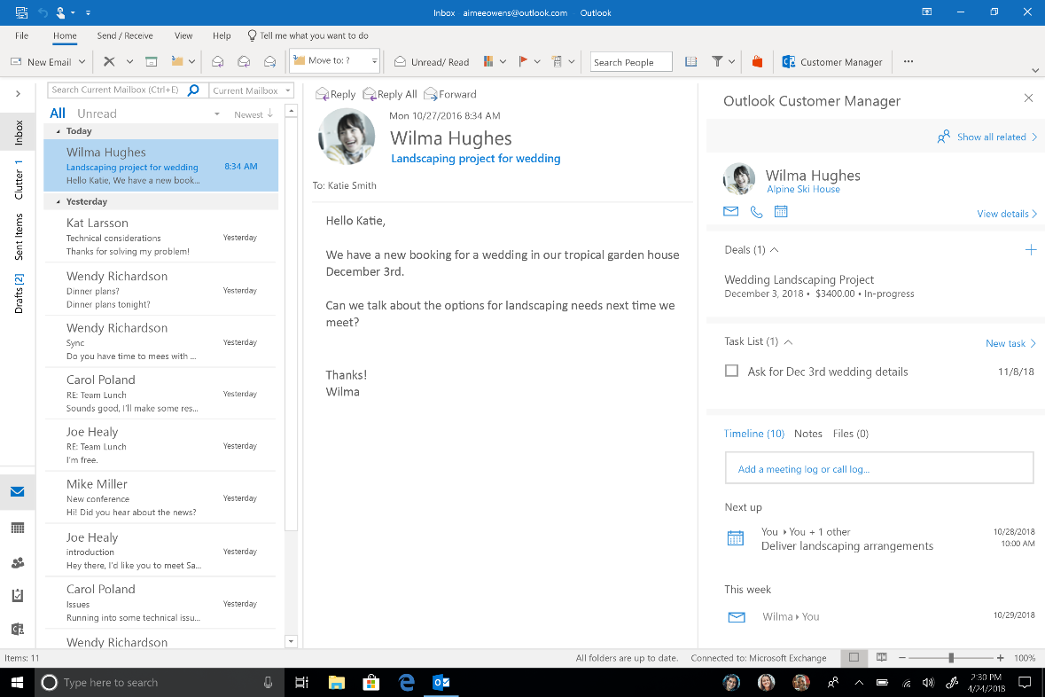
Outlook Customer Manager
Track and grow customer relationships right within Outlook
Keep customer information in one place: Spend less time managing data and more time with customers. Outlook Customer Manager automatically organizes information, including emails, meetings, calls, notes, tasks, deals, and deadlines in one place.
Never miss what’s important: No more losing customer emails and tasks in your inbox. Timely reminders and a unified list of your most important contacts and deals help to ensure that what matters is top of mind. Stay on top of what’s important with timely reminders
Get team members on the same page: Share customer information with your whole team so that customers have a consistent experience no matter who they talk to.
Get started simply: With Outlook Customer Manager, you don’t have to install new software or spend days training your team. And because your data stays in Office 365, you don’t waste valuable time setting up connectors to other software or services or managing separate products.
Access it on the go: Work doesn’t always happen in front of a desk. The mobile app for iOS gives you quick access to customer information when you're on the go or want to capture new information quickly.

Slide 19
Ransom detection and recovery in OneDrive
Protect your digital assets
Feature messaging: Office 365 protection features offer additional peace of mind for you and your family.* Tools to keep your information protected and secure.
File recovery from a ransomware attack
If attacked, get notified and help restoring your entire OneDrive to a point within the last 30 days
Ransomware detection & recovery: Office 365 will alert you if we detect a ransomware attack and help you restore your files to a point within the last 30 days.
Files restore: Files Restore allows you to restore your entire OneDrive to a previous point in time within the last 30 days. You can use this feature to recover from an accidental mass delete, file corruption, ransomware, or another catastrophic event.
*Office 365 Subscription Required

Slide 20
Product comparison :
Best Value
 | Office 365 Business Premium | Office Home & Business
Core Office apps | Premium Office apps | Classic Office apps
Additional Office apps | Access and Publisher* | Not included
Business apps | Outlook Customer Manager and Bookings | Not included
Premium business services | Skype for Business, Exchange, SharePoint, Microsoft Teams, Yammer | Not Included
Installations | Up to 5 PCs/Macs, 5 tablets, and 5 smartphones for 1 person | 1 PC/Mac
Extra storage | 1 TB of OneDrive storage per user | Not included
Domain | 1 year included** | Not included
Technical support | Included | Installation only
Payment | Annual fee | One-time cost
*Access and Publisher are for PC only
**Special offer terms: Annual commitment required. Custom domain $12/year after the first year. Only new Office 365 for business subscribers eligible. Limit one free year and one customer domain per organization. Offer not transferrable. Domains subject to availability and GoDaddy’s terms. Available worldwide. https://www.godaddy.com/legal-agreements

Slide 21
Product comparison : FPP vs CSP
 | Office 365 Business Premium | Office 365 Business Premium CSP
Core Office apps + Access and Publisher* | Premium Office apps | Premium Office apps
Business apps | Outlook Customer Manager and Bookings | Outlook Customer Manager and Bookings
Premium business services | Skype for Business, Exchange, SharePoint, Microsoft Teams, Yammer | Skype for Business, Exchange, SharePoint, Microsoft Teams, Yammer
Installations | Up to 5 PCs/Macs, 5 tablets, and 5 smartphones for 1 person | Up to 5 PCs/Macs, 5 tablets, and 5 smartphones for 1 person
Extra storage | 1 TB of OneDrive storage per person | 1 TB of OneDrive storage per person
Domain | 1 year included** | Purchased separately
Technical support | Included | Varies by partner
Payment | Annual fee | Varies by partner

Slide 22
Office 365 Business Premium benefits
Stay connected with their business
Get more value
Protect their customers and company
Make their business more productive from anywhere
Stay in control
Get help when they need it, 24/7
Notes:
Office 365 Business Premium helps your business customers….
Stay more connected with their business, thanks to great communications and collaboration tools like:
Business-class email powered by Exchange Online.
Skype for Business for online meetings, instant messaging, and voice calling.
SharePoint Online, which gives them an internal company website.
Get more value from Office with big-company business services and essential applications that work together with the core Office apps and are available in one place.
Protect their customers and company with some of the best security in the industry. Plus, they don’t have to worry about their data being used for advertising purposes. And there are lots of features that give them control over how company and customer information is accessed and used within their business.
Make their business more productive from anywhere with the ability to use Office 365 Business Premium apps and services on multiple devices, including iOS and Android phones and tablets.
Stay in control of their business. All Office 365 Business Premium apps and services are easily managed, so that business owners can see how their employees use the apps and services and create rules for how those apps and services are used.
Get help when they need it with 24/7 support. When they need help setting up rules for how apps are used, they know they’re not on their own.

Slide 23
Security, manageability, reliability
99.9% financially-backed uptime guarantee
Your data is yours
Compliance features for regulated businesses
Manage how your employees use services
Notes:
Your business customers also need their services and apps to provide security, reliability, and manageability.
We’ve already been talking about manageability. All the apps and services can be easily managed.
Business owners can control who has apps, who can manage the apps, and how they use the apps.
For example, one of the differences between OneDrive for business and the OneDrive associated with personal accounts is the additional control you have as a business.
As a Business Premium customer you can do the following:
Limit the ability for users to share files with people outside the company.
You can say they can’t share outside at all or limit sharing to only people in certain other companies.
Or, let them share files with anyone.
There are also many compliance features for regulated businesses. For example, your business customers can:
Protect company and customer information by controlling what information is shared.
Prevent users from sharing files that contain private information like bank account or social security numbers.
Or, simply be notified when those items are shared.
Obtain a letter from Microsoft confirming that Microsoft handles information in compliance with HIPAA regulations (important to healthcare providers).
Your business customers are probably concerned about their privacy, and with Microsoft services they can rest assured their data is theirs and is NOT searched by Microsoft for keywords or used to advertise to them. Additionally, Microsoft provides a 99.9% financially-backed uptime guarantee.

Slide 24


Expertzone.microsoft.com
Notes:
Brand new – we have learning site, where can sign up if you want to learn more about Office and Windows – and everything inbetween. Made for our partners – with the content for you.
Devicepartnercenter – for assets. (marketing, sales, etc.)

Slide 25
Question?

Slide 26
Thank You!

